Slide 1



Welcome to Early Years
St. Joseph’s School
Love, Learn, Grow

Slide 2

Our School Prayer
St. Joseph’s is our school.
Teach us Lord, to Love, Learn and Growtogether.
Just as you guided your beloved son, Jesus.
Open our hearts to your plans for us and
Show us your path to follow.
Each day, help us to feel your presence among us,
Protecting us on our journey.
Holy Spirit be with us.
St. Joseph pray for us.
Amen

Slide 3
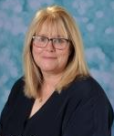
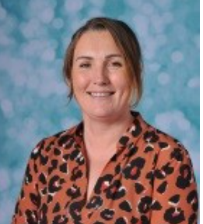
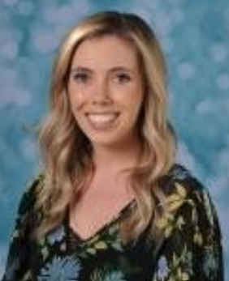
EYFS Team
Mrs Pugsley
Pre School Teacher
St Joseph
EYFS Lead
EYFS SENDCo
Mrs McGinty
Reception Teacher
St Martin
Miss Minoli
Reception teacher
St Josephine

Slide 4
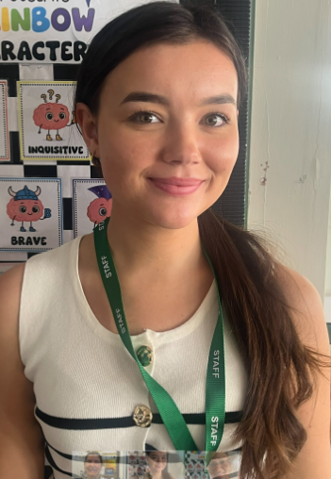

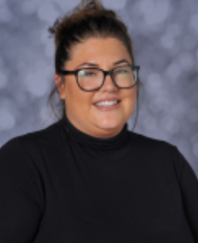
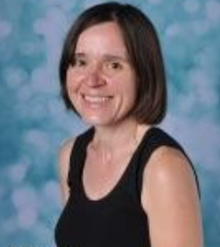
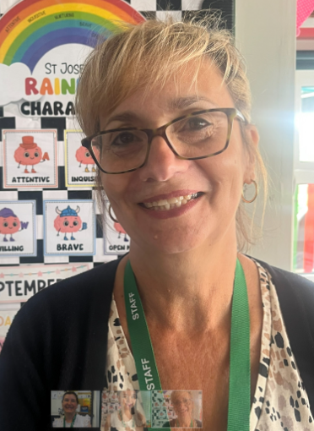
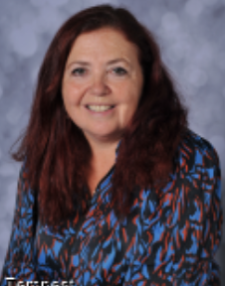
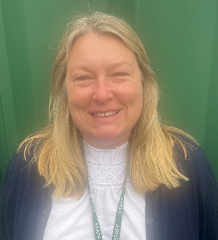
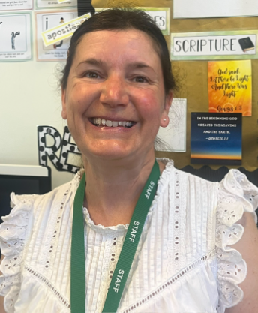
EYFS Team
Miss Duffy
Teaching Assistant
Miss Morris
Teaching Assistant
Mrs Williams
Teaching Assistant
Mrs Devine
Teaching Assistant
Mrs Christodoulides
Teaching Assistant
Mrs Breen
Teaching Assistant
Mrs Cartwright
Teaching Assistant
Mrs Lindsey
Teaching Assistant

Slide 5

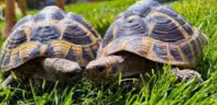
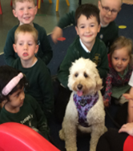


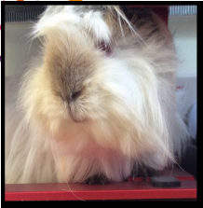
Most popular members of staff
Thelma & Louise
Minnie
Joey
Bubblepuff & Satsuma
Cazza & Tish-tish

Slide 6


Slide 7

Our Learning Characteristics

Slide 8

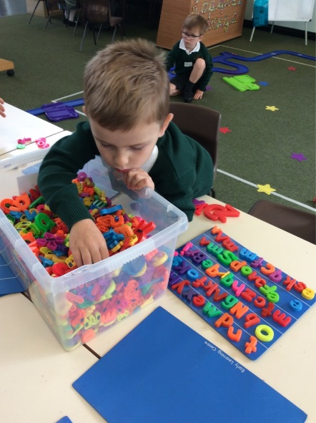
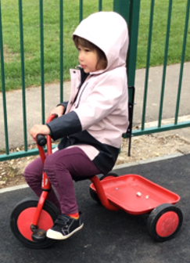
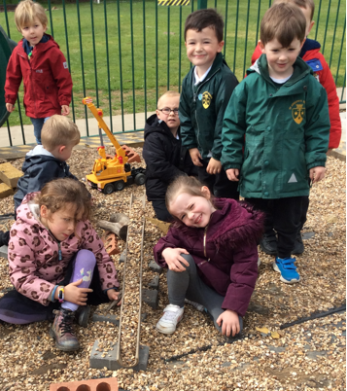
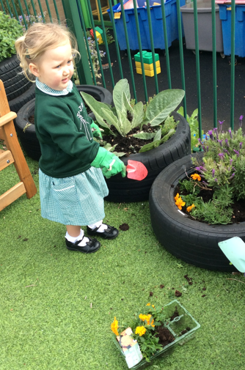
EYFS Framework
The outdoor learning environment is an essential extension of the indoor learning environment and is considered to be of equal importance.
There are 7 areas of learning. These are broken into
Three prime areas:
Personal, social and emotional development
*Self regulation
*Managing self
*Building relationships
Communication and language
*Listening, attention and understanding
*Speaking
Physical development
*Fine motor skills
*Gross motor skills

Slide 9
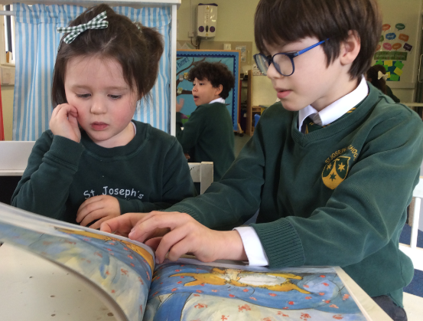
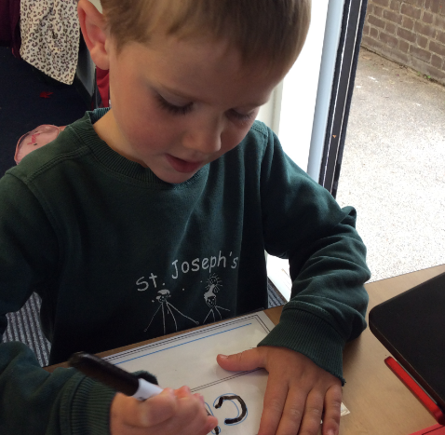
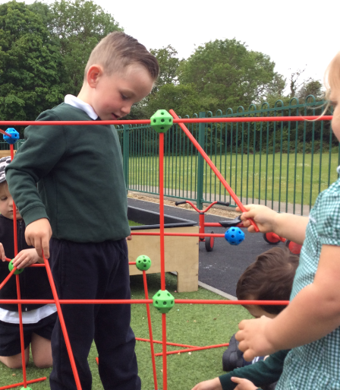
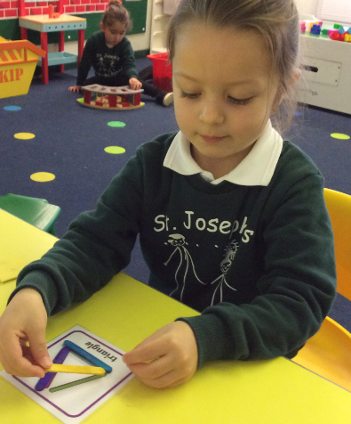

Four specific areas:
Literacy
*comprehension
*Word reading
*Writing
Mathematics
*Number
*Numerical patterns
Understanding the world
*Past and present
*People, cultures and communities
*The natural world
Expressive arts and design
*Exploring and using media and materials
*Being imaginative

Slide 10
Our Golden threads
These ‘Golden Threads’ are the key, measurable knowledge and/or skills we want to have helped the children develop by the time they leave St Joseph’s Reception. The children work on these during their time in Preschool and Reception and encompass not only academic skills and knowledge but aspects that will help them be more confident and independent in life. Here are our ‘Golden Threads’:
Preschool | Reception
To do my own coat up. To put my own socks and shoes on. To use a toilet and wash my hands mostly independently. To share an object with someone in my class. To ask for / look for help when I need it. To recognise my own name. To join in with known nursery rhymes and songs. To role play another character. To hold a pencil or writing tool comfortably. To count to 5. To catch a large ball. To begin to ask questions about the world. | To be responsible for my belongings. To use a toilet and wash my hands completely independently. To know when I am hungry and/or thirsty and what to do to help myself. To talk about how I feel with support. To confidently ask an adult for help. To know at least 6 stories or books well. To begin to understand a character’s emotion that I am role playing. To use and manage different tools safely. To count to 10. To negotiate different spaces safely. To know where I can find answers to the questions I have.

Slide 11

Curriculum

Slide 12
A typical week in Preschool
Focus text
Star number
A fine and gross motor skill focus
An Art activity
A Perfect Poem
Class reading – daily big question
Library visit
Physical activity focus
Child led play through continuous provision

Slide 13

A typical week in Reception
Phonics and Funky Fingers daily
RWInc Phonics daily session
English and Maths input and teacher led activity.
Continuous provision set up for the week will reflect the learning from lessons.
Topic input and activity three times a week
RE twice a week
Assemblies and Hymn Practice
PE once a week
Library once a week

Slide 14

Assessments – baseline currently underway.
Targeted groups to develop knowledge of phonic sounds.
Speed recognition / decoding in words and encoding for spelling.
Daily sessions
There will be a Parents’ Workshop– encourage you to make every effort to attend this session. It is vital that all children get off to the strongest start with reading.
Date to be confirmed

Slide 15
Term Dates 2024 / 2025
Advent Term | Monday 8th September –Friday 19th December Half Term Monday 20th October – Friday 31st October
Lent Term | Monday 5th January – Friday 27th March Half Term Monday 16th February – Friday 20th February
Pentecost Term | INSET Day – Monday 13th April Tuesday 14th April – Friday 17th July Half Term Monday 25th May – Friday 29th May

Slide 16

Term Dates 2024 / 2025
Advent Term | 26th September Reception Welcome Liturgy 3rd, 10th , 17th Reception Forest school 14 & 15th October Parents Evening 2nd & 3rd December EYFS Nativity 2nd,4th,9th,11th December – Preschool Forest school Me and my community topic – Visits TBC
Lent Term | 10th & 11th March Parents Evening 13th March 2pm – Chitty Chatty Tea Party Topic related visits - TBC
Pentecost Term | 7th May Reception Assembly 3rd June 9th June EYFS School Trip TBC 12th June Sports Day TBC 19th June Fathers day Challenge assembly Topic related visits – TBC

Slide 17

Expectations
For a safe and happy school, we are expected to: Arrive at school on time. Take pride in our school building. Wear our school uniform with pride. Look after our belongings. Be truthful, well-mannered and kind. Act responsibly and set a good example for others. Take responsibility for our actions in school, on trips and online. Keep our school litter free. Exercise self-control.

Slide 18


Slide 19
 | Uniform Reception – Key Stage 1 (Year 1 – Year 2) Item | Available from
Winter | Half Term Advent (Oct) – start of Pentecost Term (after Easter)
 | Dark green V-necked jumper with school crest | Earth Website
 | White polo shirt with or without school crest (worn without school tie) | Earth Website / Any stockist
 | Dark grey full-length school trousers (formal straight trousers / not jersey) / Dark grey pleated, full or A-line knee-length skirt or pinafore | Any stockist
 | Dark grey or white knee/ankle socks or tights (no branded logos) | Any stockist
Summer | Black shoes (no branded logos) Start of Pentecost Term (after Easter) - Half Term Advent (Oct) | Any stockist
 | Dark grey knee length school shorts (formal straight / not jersey) / Dark grey full-length school trousers (formal straight trousers / not jersey) / Dark grey pleated, full or A-line knee-length skirt or pinafore White polo shirt with or without school crest (worn without school tie) Dark green and white full gingham dress Dark grey or white knee / ankle socks or tights (no branded logos) Dark Green Baseball cap / Kepi cap with or without school crest Black shoes (no branded logos) No all-in ones or playsuits are permitted | Any stockist Any stockist Any stockist Any stockist Earth Website / Any stockist Any stockist
Outdoor Wear
 | Black / navy coat (plain – no branded logos) | Any stockist
 | Dark green shower-proof jacket or fleece with school crest | Earth Website
PE and Games
 | Dark green gym bag with school crest | Earth Website
 | Black (plain – no branded logos) loose fitting shorts | Any stockist
 | Green T-shirt with gold school crest | Earth Website
 | Black (plain – no branded logos) tracksuit bottoms Black (plain – no branded logos) sweatshirt | Any stockist Any stockist
 | Trainers (suitable for sporting activity) | Any stockist
School bag
 | Dark green rucksack (small) with school crest | Earth Website

Slide 20
 | Uniform Key Stage 2 (Year 3 – Year 6) Item | Available from
Winter | Half Term Advent (Oct) – start of Pentecost Term (after Easter)
 | Dark green V-necked jumper with school crest | Earth Website
 | Dark green tie with thin gold double stripe | Earth Website
 | White cotton shirt | Any stockist
 | Dark grey full-length school trousers (formal straight trousers / not jersey) / Dark grey pleated, full or A-line knee-length skirt or pinafore | Any stockist
 | Dark grey or white knee/ankle socks or tights (no branded logos) | Any stockist
Summer | Black shoes (no branded logos) Start of Pentecost Term (after Easter) - Half Term Advent (Oct) | Any stockist
 | Dark grey knee length school shorts (formal straight / not jersey) / Dark grey full-length school trousers (formal straight trousers / not jersey) / Dark grey pleated, full or A-line knee-length skirt or pinafore White cotton shirt (worn with school tie) School tie (if wearing a cotton shirt) White polo shirt with or without school crest (worn without school tie) Dark green and white full gingham dress Dark grey or white knee / ankle socks or tights (no branded logos) Dark Green Baseball cap / Kepi cap with or without school crest Black shoes (no branded logos) No all in ones or playsuits are permitted | Any stockist Any stockist Earth Website Earth Website / Any stockist Any stockist Any stockist Earth Website / Any stockist Any stockist
Outdoor Wear
 | Black / navy coat (plain – no branded logos) | Any stockist
 | Dark green shower-proof jacket or fleece with school crest | Earth Website
PE and Games
 | Dark green gym bag with school crest | Earth Website
 | Black (plain – no branded logos) loose fitting shorts | Any stockist
 | Green T-shirt with gold school crest | Earth Website
 | Black (plain – no branded logos) tracksuit bottoms Black (plain – no branded logos) sweatshirt | Any stockist Any stockist
 | Trainers (suitable for sporting activity) | Any stockist
School bag
 | Dark green book bag with school crest (Infants) | Earth Website
 | Dark green rucksack (large) with school crest | Earth Website

Slide 21
Key Information
Ensuring children are on time for school and at school every day.
All absences must be reported to the school office via telephone or email by 9am. Gates open at 8.30am each morning.
Ruck sack containing reading folder every day. (Reception)
Labelled P.E. kit. and school uniform. (Reception)
Named water bottle.(EYFS)
Coat every day (uniform policy). (EYFS)
Wellies in a named bag. (EYFS)
Sun hat and sun cream applied at home in the summer. (EYFS)
No toys from home. (EYFS)

Slide 22
End of day procedures
Passwords - to be confirmed with new class teacher – important for other people collecting your child. Assumed that other adults having this information is permission to release children.
Contact details updated via the school office if there are any changes.
Children will only be released to those over the age of 16 (Years EYFS – Year 4).

Slide 23

Stronger together

Slide 24



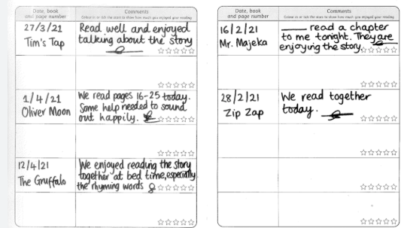



- After Christmas

Slide 25
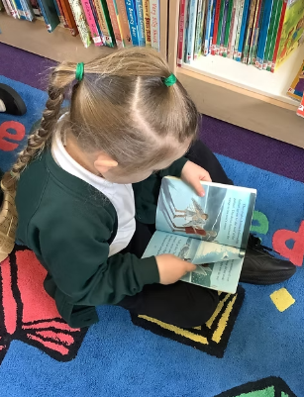
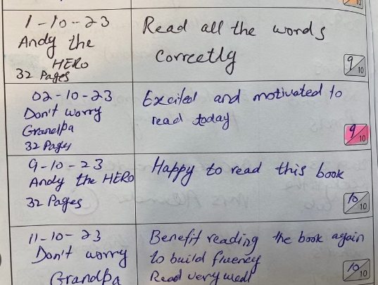
Daily Reading at home – completing the Reading Record
Information will be on the weekly notices to support parents (Reception in the first instance) to support you in helping the children become fluent and speedy with sound recognition and formation.
There is an area of the school website dedicated to RWInc - with lots of materials to support parents.
Some reading activity must take place every evening – this could be going over sounds, going over words, adults reading to children and discussing the book, once they can – children reading. This must be recorded in the Reading Record daily.

Slide 26


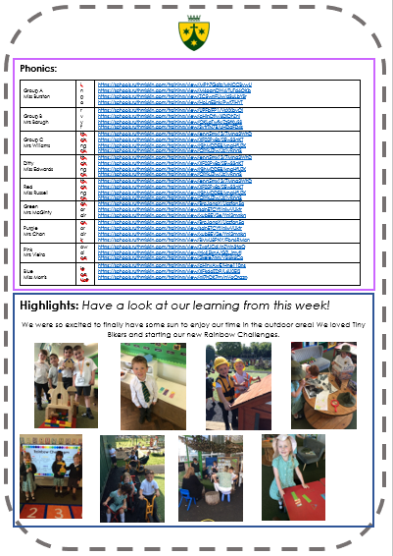
Newsletter

Slide 27
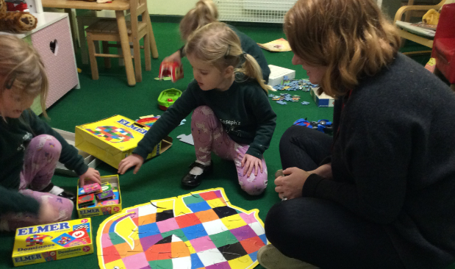
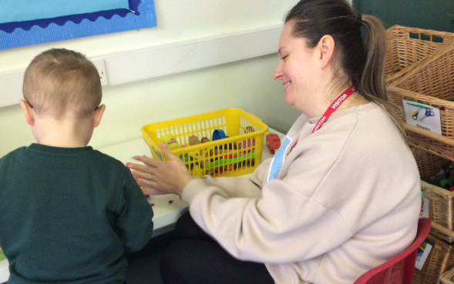
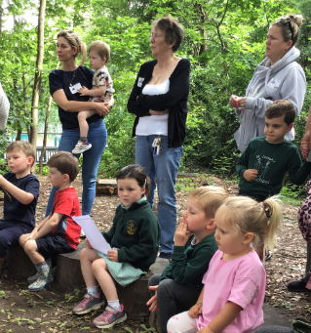
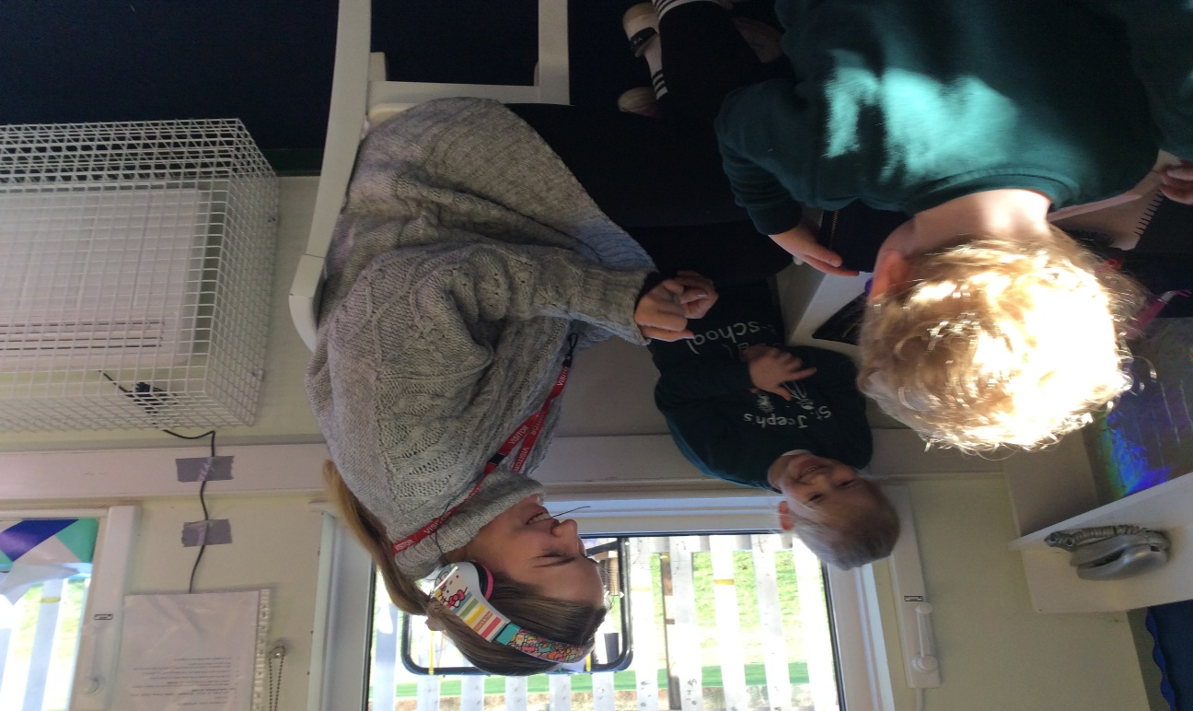
Join the fun!
Stay and play, Time to read, Forest school, trips.

Slide 28
Communication with school
Class teacher
EYFS Leader
Mrs Pugsley
Phonics Leader
Mrs O’Kane
Years 1-2 Leader
Mrs Davies
Year 3-4
Leader
Mrs Thomson
Years 5-6
Leader
Mrs O’Leary
Assistant Headteacher
Mrs Ford (SENCo/Inclusion/ Safeguarding)
Deputy Headteacher
Mrs O’Kane (Curriculum and Assessment / Behaviour)
Mrs Lovegrove
Headteacher

Slide 29
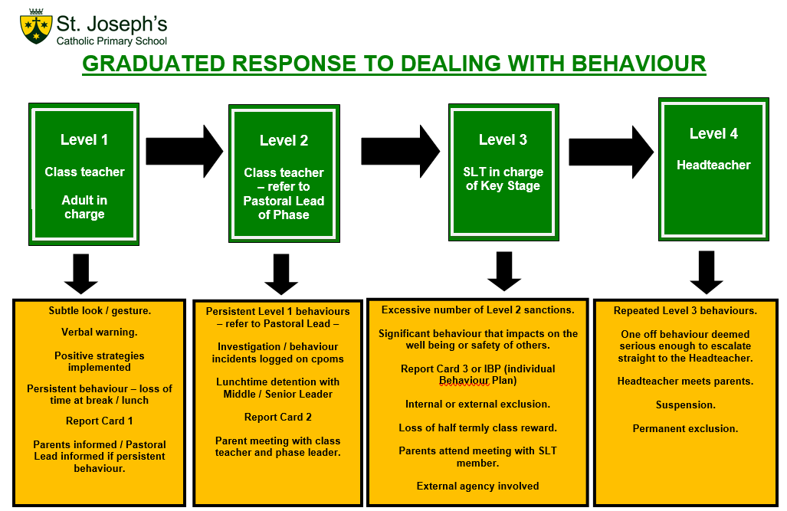
Please see our full Positive Behaviour Policy – on the school website
Notes:
SLT

Slide 30

Raise Your Child’s Attendance, - Raise their Chances! High attendance encourages the widest possible opportunities for YOUR child.
Notes:
KS

Slide 31
The Impact of Non-Attendance
95% - 9 days, 50 lessons lost
90% - 19 days, 100 lessons lost
85% - 29 days, 150 lessons lost
80% - 38 days, 200 lessons lost
All children should be in school at ALL times
We do understand that 100% is not always possible due to a child being unwell
Nevertheless, FULL ATTENDANCE should always be the AIM

Slide 32
School Hours
8:30am –
School gates open, all pupils welcomed.
Pupils that arrive at this time have the opportunity to settle in the classroom.
8:45am –
The school gates are closed. The school day has officially started.
8:55am -
Registers are officially closed and sent to Attendance Officer. Any pupils arriving after this time are recorded as late on the register. Pupils with 10 late codes will be invited to a meeting to discuss poor punctuality.
9.00am -
Pupils arriving after 9am will be coded as U, this will be recorded as absent and will affect attendance figure.
3.30pm -
School day finishes and all pupils are expected to be collected on time or prior arrangements made by parents to use the wrap around provisions provided by Busy Living.

Slide 33

Appointments during school time
Taking your child out of school for medical/dental appointments disrupts their learning, along with the learning of rest of the class
Appointments must be booked outside of the school day or during the holiday period
Documentation must be produced, in advance, for any appointments that you wish your child to attend during the school day

Slide 34

Holidays and exceptional circumstance leave
No holidays during term time are allowed, any term time holidays will be recorded as unauthorised and escalated to Buckinghamshire County Council attendance team, where parents will enter an attendance contract and penalty fines will be given, direct from the council
(contracts and fines are not limited to term time holidays, also to persistent absence and persistent lateness).
All holidays need to be taken during the school holidays.
If any leave is required during term time,
due to special circumstance, speak with
the Attendance Officer and we can
discuss further, supporting documents
will be required

Slide 35


Rewards
Weekly Draw
We reward those pupils who do achieve 100% attendance on a weekly basis, with the winner of the draw receiving a goodie bag each Friday.
Grand Prize
Our grand prize draw raffle of a £50 Amazon voucher will also reward those pupils who have full attendance each week during the term.
Both these draws are celebrated during assemblies, with the whole school present.

Slide 36
Information
Attendance Policy is available to view on our website, along with an attendance chart, which outlines the procedures, so that everyone is clear of the process with regards to attendance
01753 887743 / absence@stjosephschalfont.school
Contact before 8:30am if your child cannot attend school, giving the reason. You must contact the school each day your child is absent.
All attendance related queries can be directed straight to the Attendance Officer, preferably after 10am, Monday-Friday.

Slide 37
Dietary & Medical Needs
Inform us immediately of any changes to dietary or medical needs
If we are required to keep medication onsite permanently you will need to complete:
Healthcare plan and an agreement for administering medication
If we are required to keep medication onsite, short term, for example antibiotics, you will need to complete:
Agreement for administering medication
All medication must be brought to the school office by an adult, are not permitted to carry any type of medication in their bag.
All medication must be prescribed, in the original packaging and age related.

Slide 38

Takes precedence over everything else in school.
Mrs Ford (Assistant Headteacher) Safeguarding Lead for the school.
Mrs O’Kane (Deputy Headteacher) Deputy Safeguarding Lead for the school.
Mrs Lovegrove (Headteacher) has overall responsibility for Safeguarding.
If you have any safeguarding concerns, please bring them to the attention of one of the members of staff listed above.
Notes:
SLT

Slide 39
Check your emails / texts regularly – this is the main means of communication from school.
Check weekly school newsletter
Check school website https://www.stjosephschalfont.school
Facebook:
Instagram:
Whatsapp groups are not the schools means of communicating information – often parents putting information on these groups causes confusion and complicates things.
Please use the official means of communication as outlined above.
Drop In Session this half term
Wednesday 24th September 3.30-3.30
Tuesday 30th September 3.30-4.00
Parents’ Evenings
Tuesday 14th October 3.45-6.45pm / Wednesday 15th October 4.15-7.15pm
Please make every effort to attend coffee mornings / assemblies and key parent workshops on curriculum areas to remain informed and support us and your child.
Parking around School
Please be considerate to the local Residents. Please use the Church carpark and walk up Priory Road.

Slide 40
Supporting Your Child
Read to your child, as well as them reading to you
Follow the RWInc guidance that will come home as the children progress.
Practice number facts
Use the knowledge organisers for regular quizzing
The school website has links to additional educational sites and materials that you may wish to access
Teach them to be independent!

Slide 41

St Joseph’s is a school that goes above and beyond for its pupils.
The school ensures that pupils feel valued and that their individual talents are harnessed.
Early reading is expertly taught. Children get off to a flying start with reading as soon as they join the school.
Pupils are happy, and they keenly attend school.
They welcome people from different backgrounds with open arms and treat each other with respect.
The school provides extensive opportunities for pupils. Consequently, they make great strides in their personal development.
They learn to respect everyone regardless of background or beliefs.
Pupils lead the way.
Pupils trust the dedicated and caring staff to look after them.
The school has gone from strength to strength in recent years. Every member of the school community makes sure that pupils receive the highest quality of education.
Pupils become articulate, respectful, well-rounded young people.
The school has high expectations for what pupils can achieve. Pupils work hard to meet these expectations.
They behave exceptionally well and demonstrate highly positive attitudes to learning.
The school embraces equality and diversity. Well-trained, skilled staff waste no time quickly identifying pupils who have special educational needs and/or disabilities.
The school’s curriculum is ambitious, exciting and engaging. It is meticulously designed and delivered.
Pupils have a thirst for learning, immersing themselves in tasks and discussions. They produce high-quality work.
Leaders have a highly accurate picture of the school’s strengths and priorities for further development.
The arrangements for safeguarding are effective.
May 2025

Slide 42

Thank you for coming and for your continuing support.
QUESTIONS

