Slide 1
PSHE
2024

Slide 2
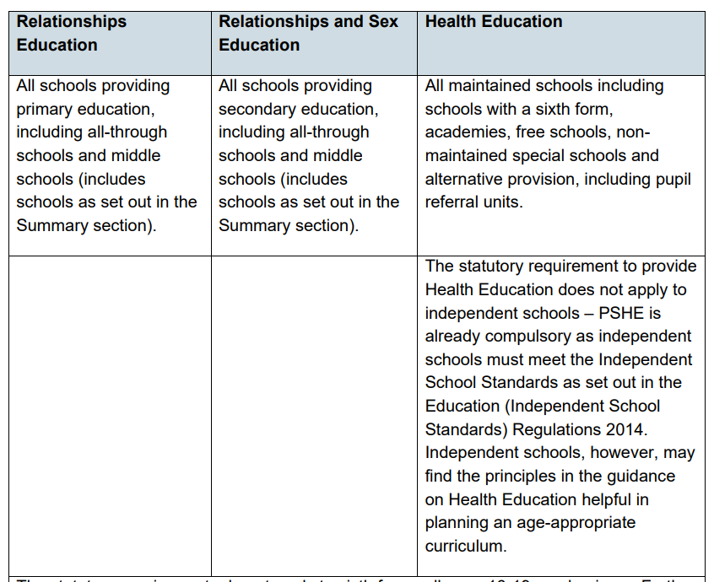
The Relationships Education, Relationships and Sex Education and Health Education (England) Regulations 2019, made under sections 34 and 35 of the Children and Social Work Act 2017, make Relationships Education compulsory for all pupils receiving primary education and Relationships and Sex Education (RSE) compulsory for all pupils receiving secondary education. They also make Health Education compulsory in all schools except independent schools. Personal, Social, Health and Economic Education (PSHE) continues to be compulsory in independent schools.

Slide 3
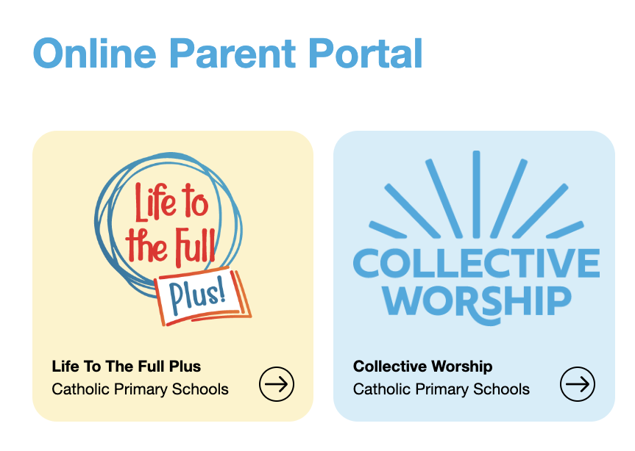
Ten:Ten Resources
Our new PSHE Resource website / section

Slide 4
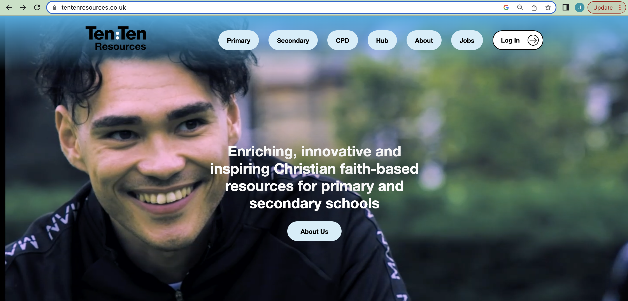
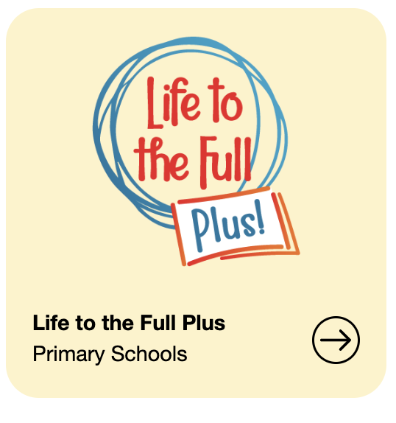
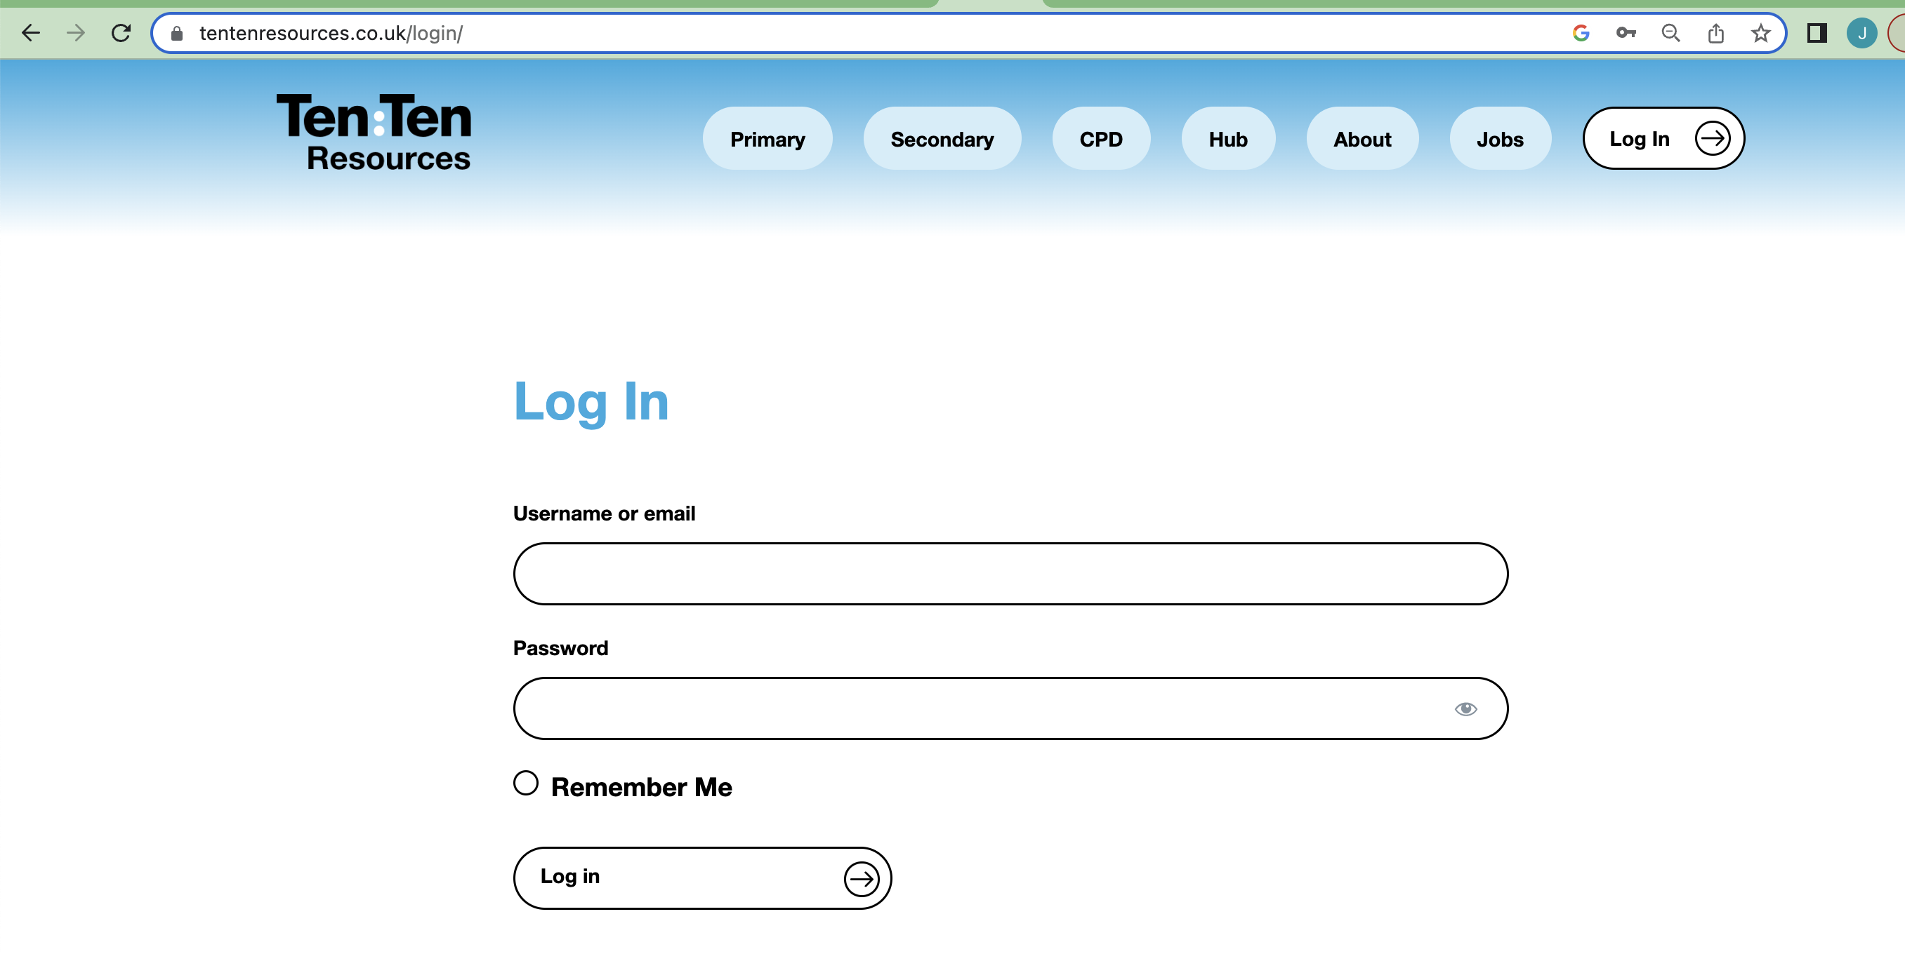
Ten:Ten Resources
Click on the login button here.
Login!
Username: stjosephssl9
Password: new-year24
Click here!

Slide 5
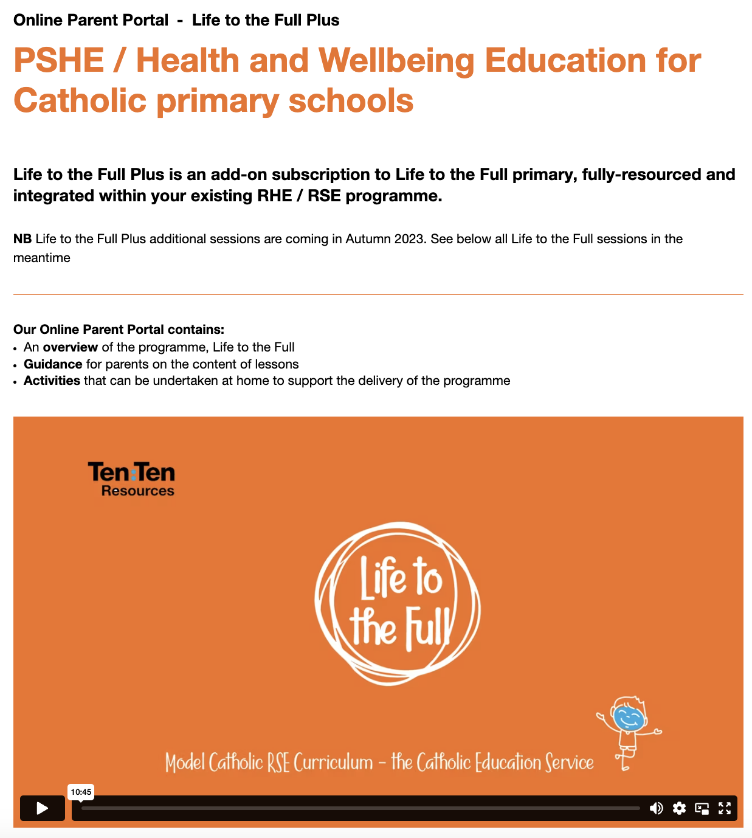
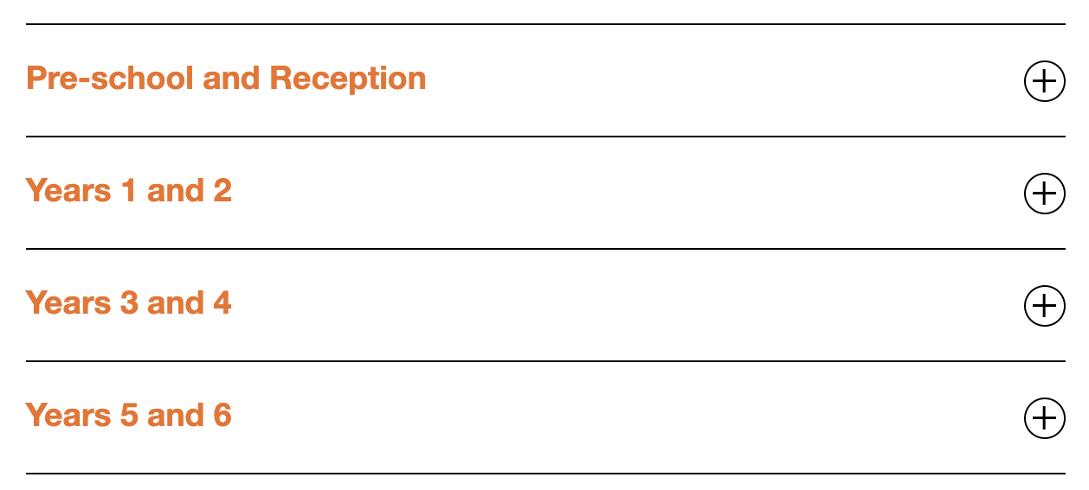
Ten:Ten Resources
There is some information here regarding the curriculum and an introduction video about the curriculum.
This is where you can find the modules/lessons for each key stage.

Slide 6
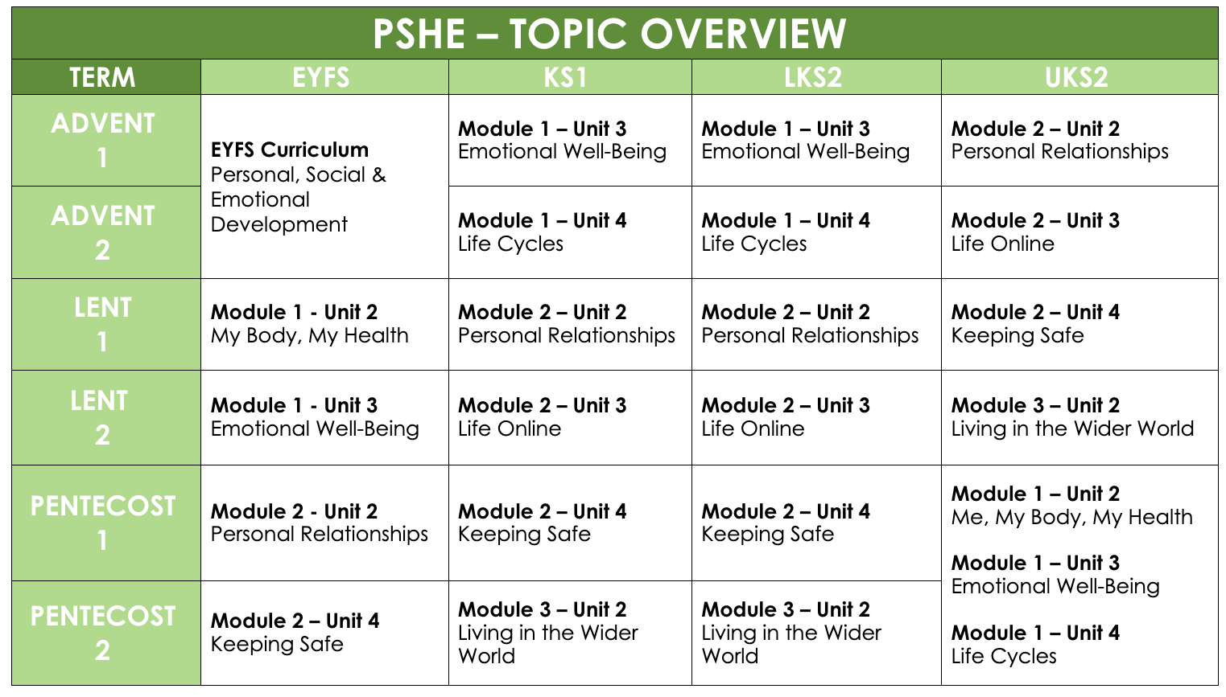
Whole School Overview
The Ten:Ten Resources work best in key stages.
We have altered the scheduling of the module to better suit our school's needs.
All Topics:
My Body, My Health
Emotional Wellbeing
Life Cycles
Personal Relationships
Life Online
Keeping safe
Living in the Wider World

Slide 7
EYFS – CURRICULUM DETAILS
Year | Knowledge and Skills – Children will be able to/learn that:
MODULE 1: Created and Loved by God | Unit 2: Me, My Body, My Health Acknowledge we are each unique, with individual gifts, talents and skills. Understand whilst we all have similarities because we are made in God’s image, difference is part of God’s plan. Engage with physical activities exploring movement of the body. Learn the parts of the body (not genitalia). Understand that our bodies are good, and we need to look after them. Learn what constitutes a healthy lifestyle, including exercise, diet, sleep and personal hygiene. Unit 3: Emotional Well-Being We all have different tastes (likes and dislikes) but also similar needs (to be loved and respected, to be safe, etc). Acknowledge it is natural for us to relate to and trust one another. There are different ways to describe their feelings. Understand that everyone experiences feelings. Understand that feelings are neither good nor bad, they give us information regarding our experiences. Use simple strategies for managing feelings, emotions and behaviour. Learn how feelings can affect actions, and that actions have consequences. That people have choices and they can impact how we feel and respond.
Example of what each modules learning objectives are.

Slide 8
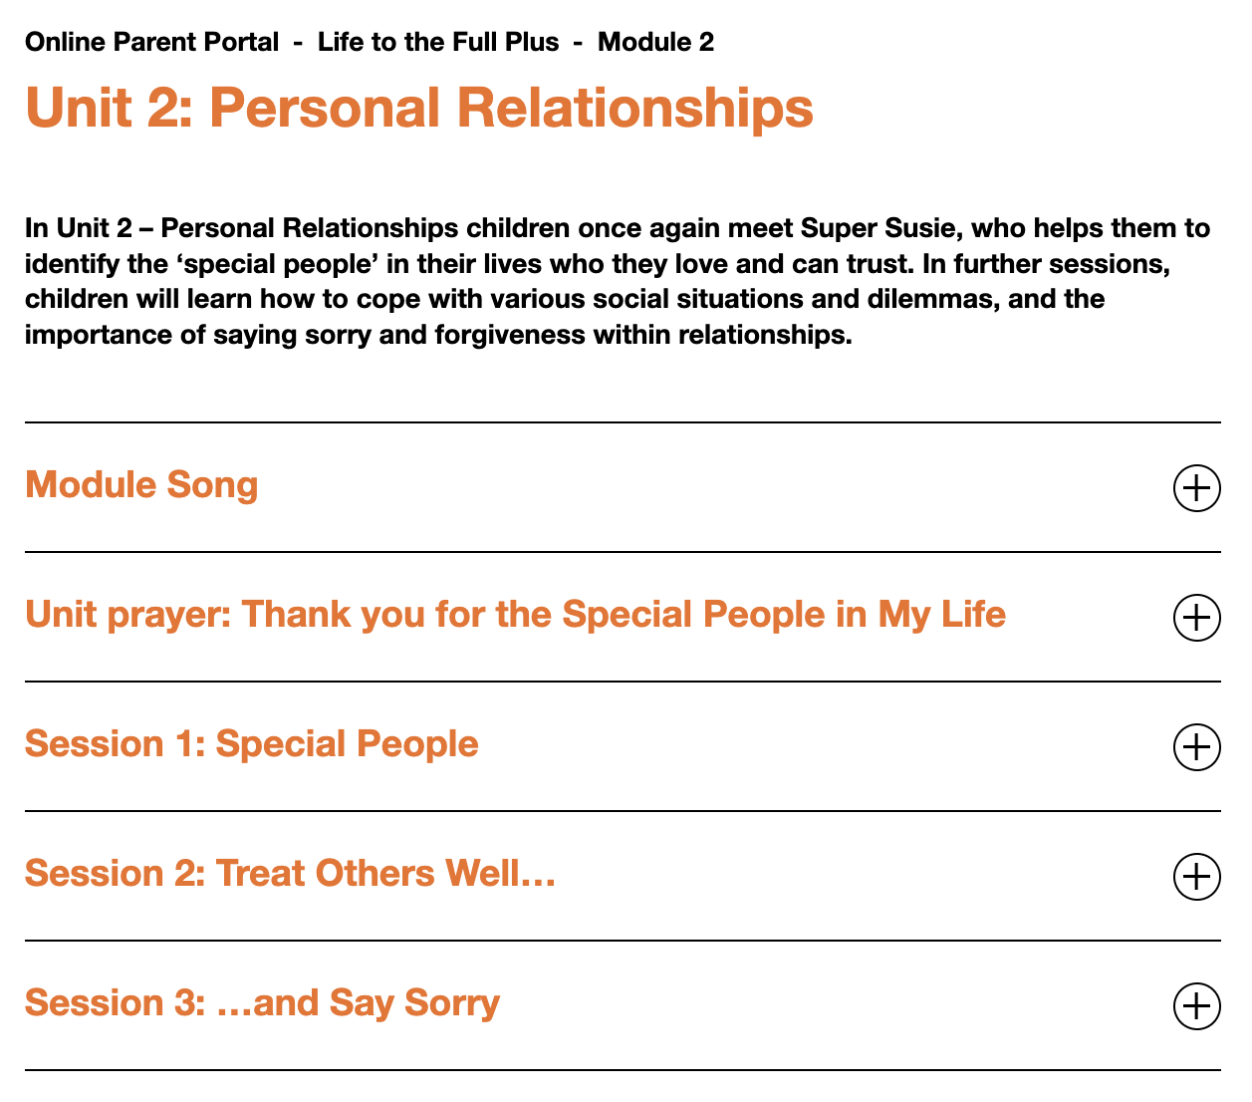
Ten:Ten Resources
Here is an example of what each module will include.

Slide 9
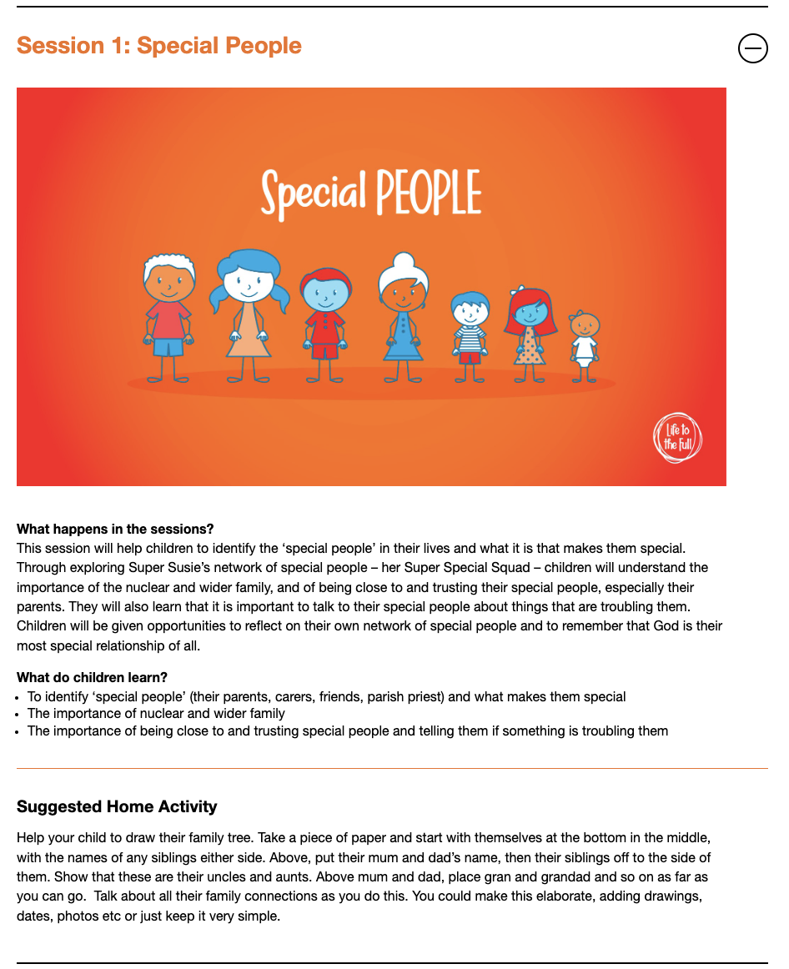
Ten:Ten Resources
Here is an example of what each session will include.

Slide 10
Teaching
Building a safe learning environment to help pupils when sharing feelings, exploring values and attitudes, expressing opinions and considering those of others, without attracting negative feedback.
Using distancing techniques like stories and scenarios with fictional characters and storylines helps to stimulate discussion whilst ‘de-personalising’ discussions.
Asking open ended questions to which children can relate to supports a meaningful discussion and often allows pupils to engage more objectively with the lesson content.
Encouraging pupils to ask questions. Teachers are asked to postpone their answers if they are unsure, to allow them time to research and give a factual, age-appropriate answer.
Being sensitive to the needs of all children. This is done in many ways like providing different discussion opportunities, establishing ground rules about respect, having an area for anonymous questions or concerns, etc.

Slide 11
Planning
PSHE has recently been changed to and will now continue to be ran as ONE DAY each HALF TERM.
This will be a scheduled day in Week 1 or 2 which allows teachers and students the opportunity to refer to learning throughout the term in different situations.

Slide 12
Relationships Education
Relationships Education is highly involved within the PSHE curriculum, and it is a statutory requirement to teach the scientific aspects of development. It is handled and taught in an age-appropriate manner according to the curriculum and needs of our learners.
Relationships and Sex Education curriculum begins in Years 5 & 6.
Gradually, we are working through the modules and sessions to organise our lessons that will begin in the Summer Term.
We will host a consultation with parents of years 5 & 6 before we begin teaching any of these modules in May.

Slide 13
Questions?
Thank you all for coming!

