Slide 1


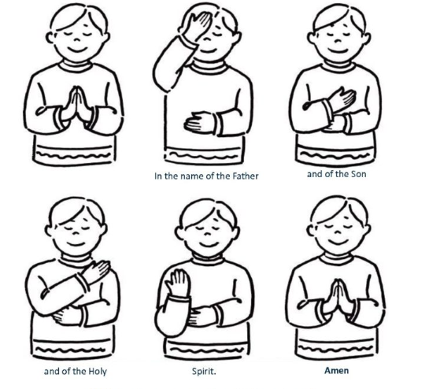
Lent term
2026
Notes:
https://www.youtube.com/watch?v=RGB2E0NzO2A
https://www.youtube.com/watch?v=pD7z76sMGaw – Clinging to the cross
https://www.youtube.com/watch?v=OCKq_CdoYE0 – wait for the lord
https://www.youtube.com/watch?v=uzTo-8pusSQ – Jesus remember me
https://www.youtube.com/watch?v=RGB2E0NzO2A
https://www.youtube.com/watch?v=9oCNwIA6xLc - Remembrance

Slide 2



LOVE, LEARN, GROW AWARDS LENT 2026

Slide 3
Love Awards

Slide 4

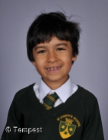
Kairav…
… for being nurturing and kind to all children in the class. You are always thinking about others and treat others as you would like to be treated.

Slide 5
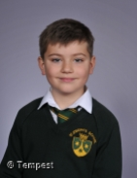
Teddy…
… for consistently demonstrating kindness, care and warmth towards your peers, teachers and adults in school. Your smile is infectious and brightens up everyone's day.

Slide 6
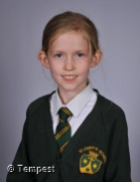
Livvy…
… for being a kind, thoughtful and positive presence in the class. You show care for others and help create a warm and welcoming environment. Your gentle nature and uplifting attitude make the classroom a better place for everyone.

Slide 7

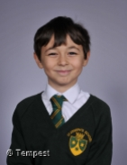
William…
…for always maintaining a positive outlook and encouraging others, giving advice that is consistently thoughtful, kind and uplifting.

Slide 8
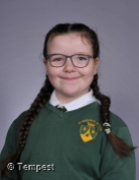
Sienna…
… for demonstrating a real love for learning and school life. You are always cheery and positive, showing kindness and care to those around you.

Slide 9

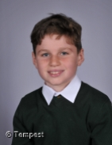
Martin…
… for showing love to everyone around you. Your kind and caring nature shows in everything that you do. You look for ways to help in the classroom and are a great role model for others to follow.

Slide 10

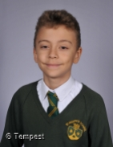
Thomas…
… for being a wonderfully loving and caring member of the class. You consistently show kindness towards your peers. Your thoughtful nature helps create a positive and welcoming atmosphere.

Slide 11

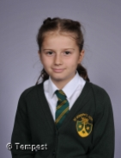
Millie…
… for showing kindness, empathy and respect in everything you do. You make the classroom a happier and more welcoming place through your thoughtful words and caring actions. You remind others what it truly means to love and care for those around us.

Slide 12
Learn Awards

Slide 13

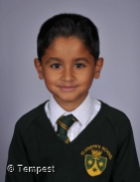
Rajvir…
… for working to the best of your ability in all subject areas. You work well both independently and with a group. It has been lovely to watch you contribute to class discussions and produce good quality written work.

Slide 14

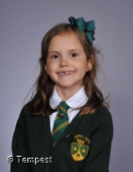
Anna…
… for always demonstrating a genuine love of learning and consistently striving to achieve your best. Your writing is exceptional, and your imaginative use of language is something we always look forward to reading.

Slide 15

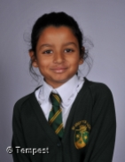
Maahi…
… for always putting exceptional care and effort into every piece of work. You stay focused, listen carefully, and consistently show remarkable dedication.

Slide 16

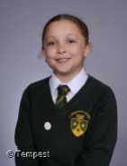
Mia…
… for always demonstrating a love of learning, completing work to a high standard, and consistently challenging yourself by moving on to the extension tasks. Well done!

Slide 17

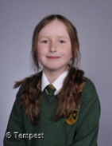
Lily…
…for impressing us every day with your attitude to learning. You try your hardest to complete all tasks to the best of your ability and learn from your mistakes.

Slide 18

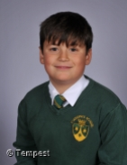
Pablo…
… for consistently trying your best in all areas of the curriculum and always acting on feedback to improve your work. Your positive attitude to learning makes you an excellent role model for others.

Slide 19

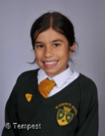
Sienna…
… for always being conscientious about your learning and striving to improve. You ask lots of questions to further your learning and listen carefully to feedback to make effective changes to your work.

Slide 20

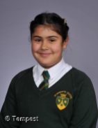
Safiya…
… for approaching every learning opportunity with enthusiasm, determination and curiosity. You always try your best, ask thoughtful questions and never shy away from a challenge. Your positive attitude towards learning sets a great example for everyone.

Slide 21

Grow Awards

Slide 22

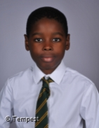
Chimdi…
… for developing self belief and confidence - it is great to see your mature approach to school life. You focus on your work and are becoming more vocal in class discussions.

Slide 23

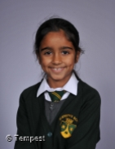
Ariya…
… for demonstrating maturity and exceptional growth this term. You have taken true ownership of your learning and consistently show a positive attitude when approaching new challenges.

Slide 24

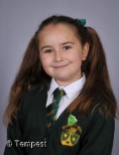
Emilia…
… for the wonderful progress made this term. You consistently put effort into your independent work. Your determination and focus are shining through, and it’s wonderful to see how much you have achieved.

Slide 25

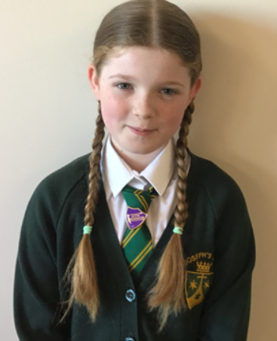
Bailey…
… for demonstrating greater independence, routinely reviewing and enhancing your work. You are now facing challenges with persistence and a clear focus on exceeding expectations.

Slide 26
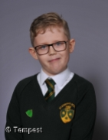
Henry…
… your growth this term has been super. You have really grown in confidence and now contribute so well to class discussions. You have shown the same growth in your independent work.

Slide 27
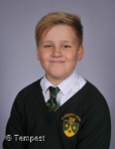
Anton…
You have shown great resilience and continue to work hard even when you find something challenging. Your mature attitude to learning has enabled you to make good progress.

Slide 28

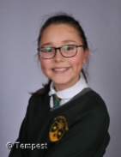
Olivia…
… for your remarkable growth throughout Year 6, both academically and personally. You have become increasingly confident, responsible, and independent, approaching new challenges with maturity and enthusiasm.

Slide 29

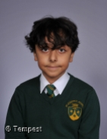
Yazdan…
… for becoming much more self driven in your learning, managing tasks with maturity and taking pride in completing work to the best of your ability. Your growing sense of ownership is wonderful to see.

Slide 31

Attendance Winner

Slide 32

Our School Prayer
St. Joseph’s is our school.
Teach us Lord, to Love, Learn and Grow together.
Just as you guided your beloved son, Jesus.
Open our hearts to your plans for us and
Show us your path to follow.
Each day, help us to feel your presence among us,
Protecting us on our journey.
Holy Spirit be with us.
St. Joseph pray for us. Amen

Slide 33
To end our assembly, let us make the sign of the cross together.
Notes:
https://www.youtube.com/watch?v=pD7z76sMGaw – Clinging to the cross
https://www.youtube.com/watch?v=OCKq_CdoYE0 – wait for the lord
https://www.youtube.com/watch?v=uzTo-8pusSQ – Jesus remember me
https://www.youtube.com/watch?v=RGB2E0NzO2A
https://www.youtube.com/watch?v=9oCNwIA6xLc - Remembrance

Slide 34

Notes:
https://www.youtube.com/watch?v=dszpVNJIklM
https://www.youtube.com/watch?v=gfJkJavuz-s

