Slide 1


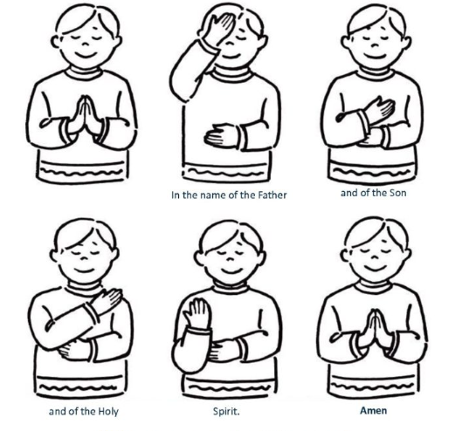
Lent term
2026
Notes:
https://www.youtube.com/watch?v=RGB2E0NzO2A
https://www.youtube.com/watch?v=pD7z76sMGaw – Clinging to the cross
https://www.youtube.com/watch?v=OCKq_CdoYE0 – wait for the lord
https://www.youtube.com/watch?v=uzTo-8pusSQ – Jesus remember me
https://www.youtube.com/watch?v=RGB2E0NzO2A
https://www.youtube.com/watch?v=9oCNwIA6xLc - Remembrance

Slide 2



LOVE, LEARN, GROW AWARDS LENT 2026

Slide 3
Love Awards

Slide 4

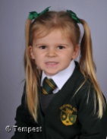
Willow…
… for showing love in school. You treat everyone with care and kindness. You are always happy to help!

Slide 5
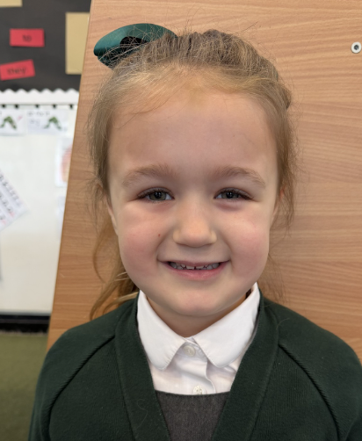
Mia…
… for being thoughtful and caring. You brighten the classroom with kindness. You show love by helping a friend, sharing a smile and making sure everyone is included.

Slide 6
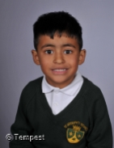
Ishar…
…for displaying determination which inspires everyone around you. You go the extra mile to put others before yourself.

Slide 7

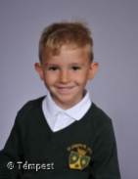
Tadhg…
… for the sense of calm and gentleness that you bring to the classroom. You are generous, considerate and thoughtful. You know how to treat others and make sure that your friends feel valued.

Slide 8

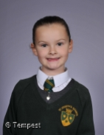
Grace…
… for the kindness you show to others which is admirable and makes the classroom a happy place. You greet everyone with a big smile and are a wonderful example to those around you.

Slide 9

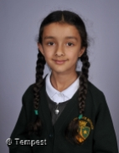
Taaray…
… for showing love in all that you do. You are kind and caring person who goes above and beyond to spread love. It has been wonderful to watch your caring nature and see you develop new friendships.

Slide 10
Learn Awards

Slide 11

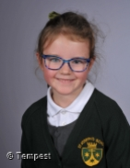
Eloise…
… for working so hard, especially with phonics. You listen carefully, contribute in lessons and have made exceptional progress with your reading and writing!

Slide 12

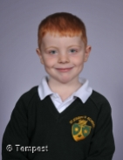
Connor…
… for being a wonderfully enthusiastic member of Reception class, always eager to answer questions and share your ideas. You have natural curiosity and it is great to watch you explore the environment with excitement and a real love for learning.

Slide 13

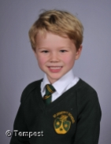
Archer…
… for possessing such an infectious curiosity and love of learning by asking thoughtful questions, eagerly exploring new ideas and sharing knowledge with the class.

Slide 14

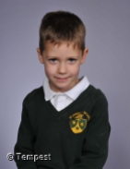
Oscar…
… for engaging brilliantly in lessons and asking questions which allow you to be an independent learner. You stay focused, work hard and never give up, even when something feels challenging.

Slide 15

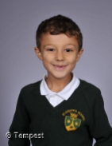
Oscar…
… for working incredibly hard and making incredible progress since you joined St Joseph’s. You are determined to improve in every part of your learning. You are eager to learn more, confidently joining discussions in lessons.

Slide 16

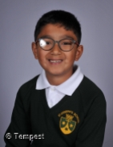
Aarav…
… for the effort and pride you take in responding to feedback, which is brilliant! You always strive to achieve more in your learning. You are engaged, consistently focused and a role model to others - showing them how to get the most out of learning.

Slide 17

Grow Awards

Slide 18

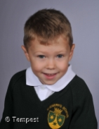
Oliver…
… for your attitude towards learning which is fantastic! You are a role model for your peers, showing how to behave in lessons and this has enabled you to make great progress. It is lovely to see you encouraging your peers with their learning.

Slide 19

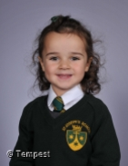
Siena…
… for your growth in confidence and self-belief this term, which has had a positive impact on your learning. You have made great progress this term and shown determination and hard work, particularly in Phonics. It has been a pleasure to see how much you have achieved.

Slide 20

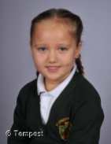
Luna…
… for showing great progress this term in your confidence and the ability to believe in yourself. You always give 100% in everything you do - especially your writing. You are a great role model to others.

Slide 21

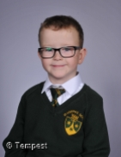
Nathan…
… for showing wonderful growth this term, coming into school with courage and a happy attitude. It’s been lovely to see you start each day calmly, ready to learn. We are so proud of the independence you are developing.

Slide 22

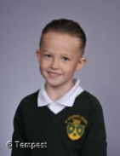
Kingslee…
… for the fabulous journey you have been on since the start of the year! You have grown in so many ways: in your mindset, your maturity, your dedication to making the right choices and putting effort into your work. Watching you grow has been a pleasure!

Slide 23
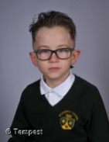
Levi…
… for your growth in confidence and for developing a really positive attitude to learning. Your effort has been amazing. You are always trying to improve and we can’t wait to see this continue!

Slide 25

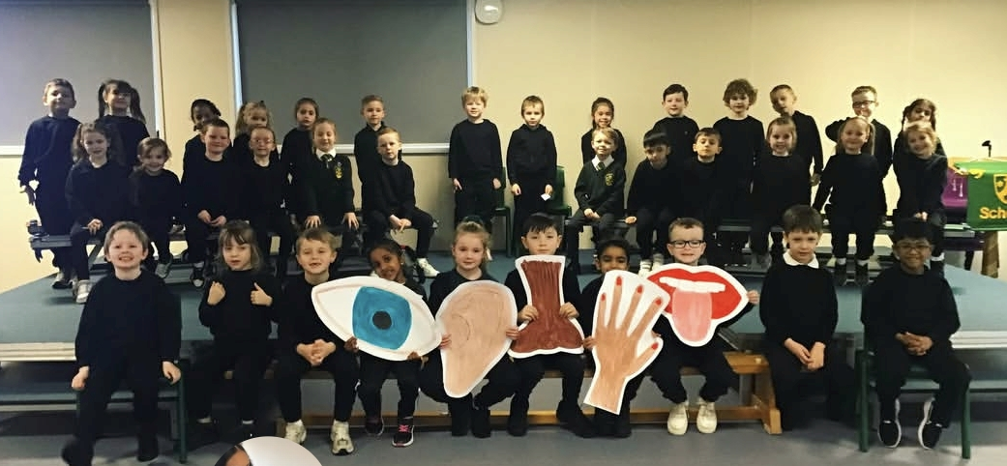



Love, Learn, Grow
5 Senses
Year 1 shared their knowledge of the 5 senses with their parents. They had learnt so many facts. They want to share their song with you!

Slide 26

Our School Prayer
St. Joseph’s is our school.
Teach us Lord, to Love, Learn and Grow together.
Just as you guided your beloved son, Jesus.
Open our hearts to your plans for us and
Show us your path to follow.
Each day, help us to feel your presence among us,
Protecting us on our journey.
Holy Spirit be with us.
St. Joseph pray for us. Amen

Slide 27
To end our assembly, let us make the sign of the cross together.
Notes:
https://www.youtube.com/watch?v=pD7z76sMGaw – Clinging to the cross
https://www.youtube.com/watch?v=OCKq_CdoYE0 – wait for the lord
https://www.youtube.com/watch?v=uzTo-8pusSQ – Jesus remember me
https://www.youtube.com/watch?v=RGB2E0NzO2A
https://www.youtube.com/watch?v=9oCNwIA6xLc - Remembrance

Slide 28

Notes:
https://www.youtube.com/watch?v=dszpVNJIklM
https://www.youtube.com/watch?v=gfJkJavuz-s

