Slide 1

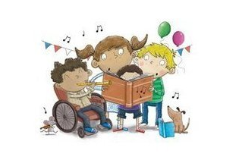

Slide 2
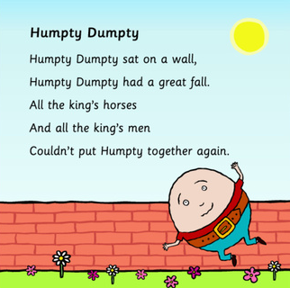

Slide 3
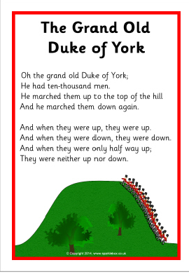
Verse 2:
Oh the Grand old Duke of York
He had ten thousand men
They banged their drums to the top of the hill….
Verse 3:
Oh the Grand old Duke of York
He had ten thousand men
They played their flutes to the top of the hill….
Verse 4:
Oh the Grand old Duke of York
He had ten thousand men
They banged their gun to the top of the hill….

Slide 4
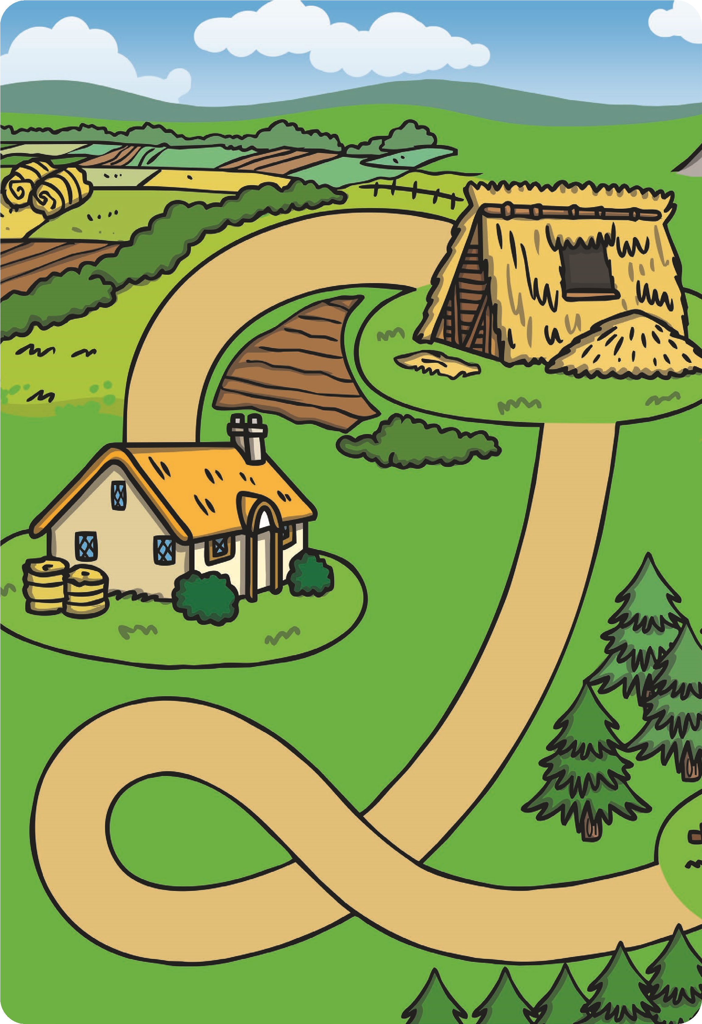
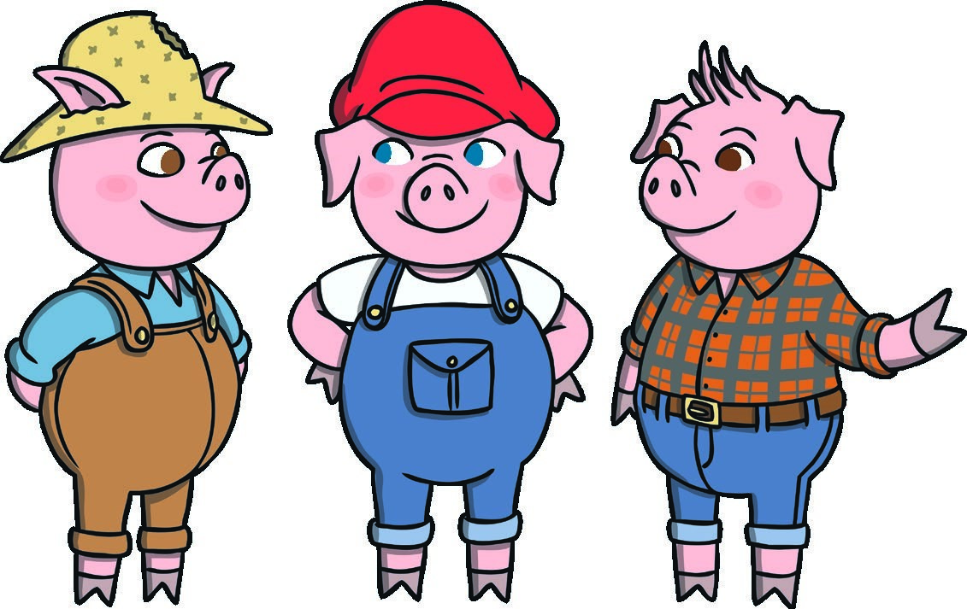
This Little Piggy
Went to Market
This little piggy went to market.
This little piggy stayed at home.
This little piggy had roast beef.
This little piggy had none.
This little piggy went wee, wee, wee,
All the way home.

Slide 5
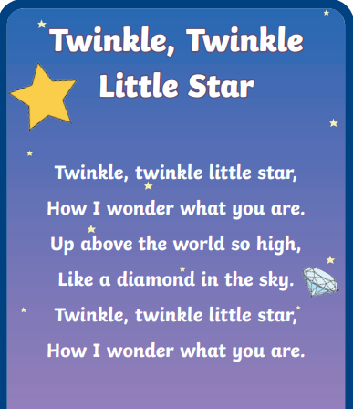

Slide 6
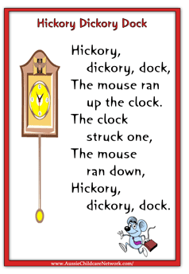
Verse 2:
Hickory, dickory, dock
The mouse ran up the clock
The clock struck two,
The mouse went boo!!
Hickory, dickory ,dock
Tick tock, tick tock, tick tock
Verse 3:
Hickory, dickory, dock
The mouse ran up the clock
The clock struck three,
The mouse went weee!!
Hickory, dickory ,dock
Tick tock, tick tock, tick tock
Verse 4:
Hickory, dickory, dock
The mouse ran up the clock
The clock struck four
The mouse said ‘No more!’
Hickory, dickory ,dock
Tick tock, tick tock, tick tock

Slide 8
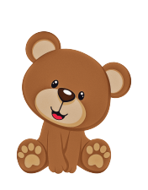
Teddy Bear Teddy Bear
Teddy Bear, Teddy Bear, turn around
Teddy Bear, Teddy Bear, touch the ground
Teddy Bear, Teddy Bear, jump up high
Teddy Bear, Teddy Bear, touch the sky
Teddy Bear, Teddy Bear, bend down low
Teddy Bear, Teddy Bear, touch your toes
Teddy Bear, Teddy Bear, turn off the light
Shhh!
Teddy Bear, Teddy Bear, say goodnight!

Slide 9
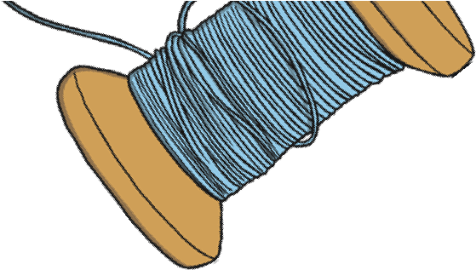

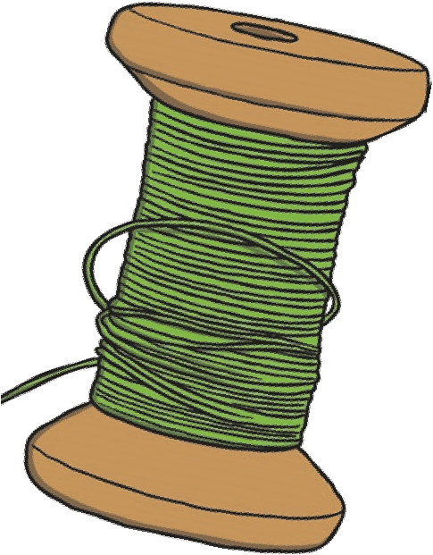
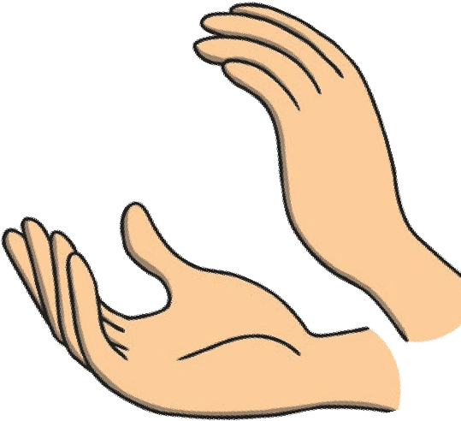

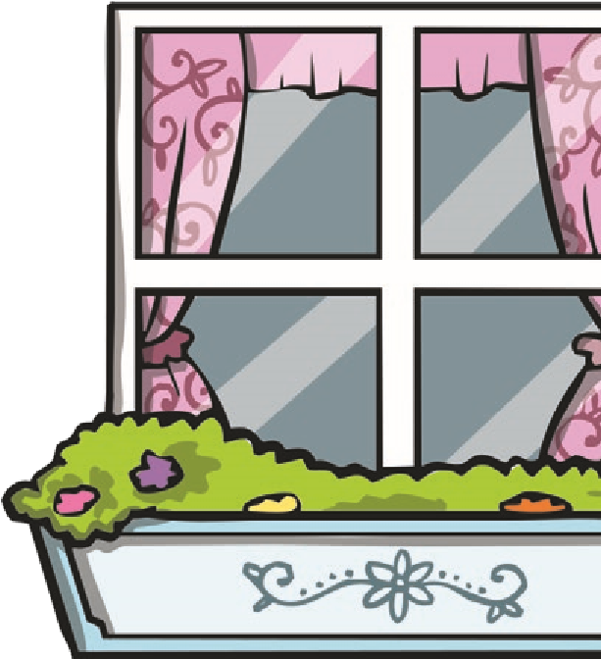
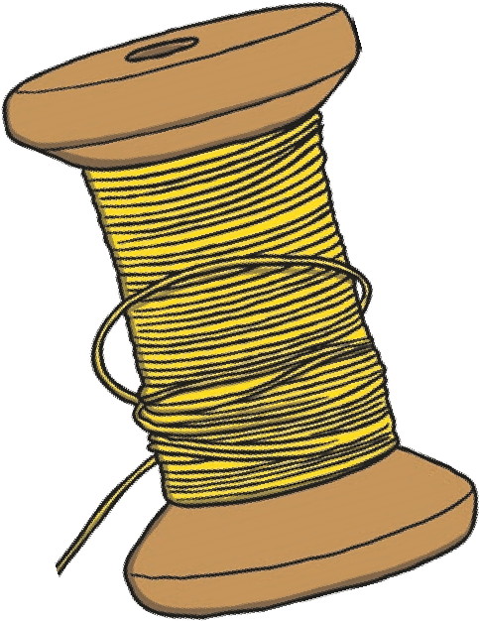
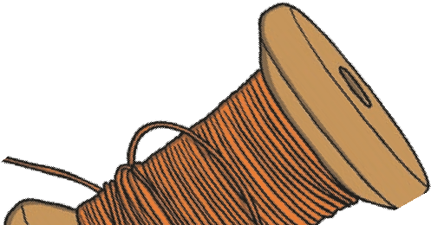
Wind the Bobbin Up
Wind the bobbin up,
Wind the bobbin up,
Pull, pull, clap, clap, clap.
Wind it back again,
Wind it back again,
Pull, pull, clap, clap, clap.
Point to the ceiling,
Point to the floor,
Point to the window,
Point to the door.
Clap your hands together, 1, 2, 3,
Put your hands upon your knee.

Slide 10
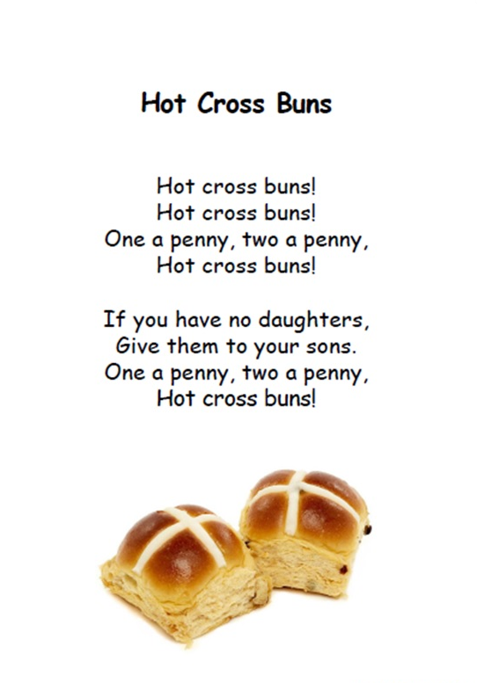

Slide 11
