Slide 1

Communication and language
EYFS Team
St Josephs Catholic Primary School

Slide 2

What do you think communication means?

Slide 3
Being able to communicate is not just about talking.
● Getting your own message across
● Expressing your feelings appropriately ● Being able to listen
● Paying attention
● Interacting and playing with others
● Understanding what is being said
These are all fundamental skills a good communicator needs. This presentation explorers these important skills and contains lots of ideas and activities to help you support your child with their development.

Slide 4
“Research shows that vocabulary size has a huge impact on how well children will perform in education and their life chances. Children with a limited vocabulary at the end of EYFS are twice as likely to be unemployed at 34.”
“You don’t run a marathon – to run a marathon”
Build up slowly to get ready and prepare for the marathon.
Same with education – it is a gradual build up – marathon is run in primary school at the end of Year 6.
Start of this is developing children’s language and communication in EYFS.
“Don’t restrict or limit the language you use – give them difficult stuff e.g. tea bag in a cup of water ‘infuses’.”

Slide 5
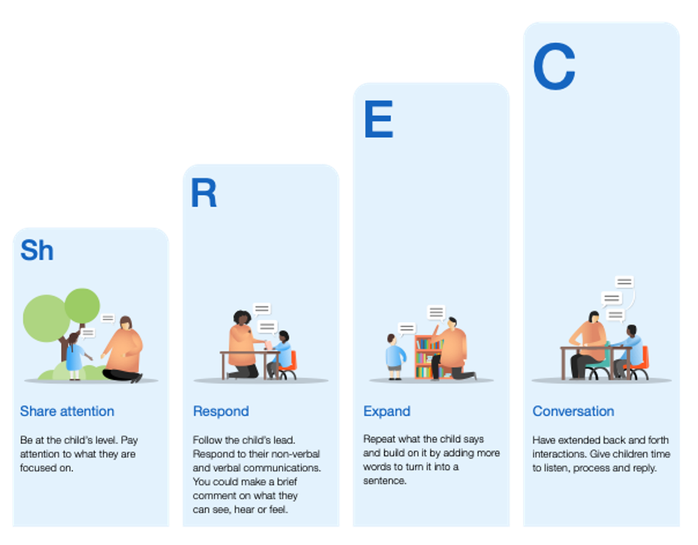
Our approach
https://youtu.be/HJSfZRtUMXk
Share attention
Respond
Expand
Conversation

Slide 6


Four Areas of Effective Communication
Listening
Interaction
Play
Understanding

Slide 7

Listening
Listening is an essential skill for talking and learning. Everywhere we go there are different noises around us.
Sometimes children need a bit of quiet time to help them tune into talking rather than the other noises going on around them.
Listening is different to hearing.
Adults need to show children the way – when we listen to children, they learn what to do in order to be good listeners.
Be a Listening Role Model – what does this look like?

Slide 8
Developing Listening
Play listening games
Matching sound games are fun there are lots of commercial ones you can buy but you can make up your own.
Collect a number of pots and pans. Allow your child to test them out and then ask them to shut their eyes while you strike one. Can they identify which one?
You can also play the same game with pictures of animals. Make a noise and ask them which animal made the noise.
Following instructions
This can be great when you have lots of housework to do! Can you go and get me the laundry basket? Build up the number of instructions until you get to at least 3. Can you put your shoes away, hang up your coat and put the water bottle in the sink please?

Slide 9
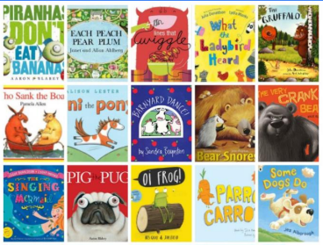
Developing Listening
Rhyme and Repetition
Read lots of stories with rhyme and repetition
The Great Big List of 55 Rhyming Picture Books for Kids (childhood101.com)
Give clues about different things that rhyme… there might be more than one right answer.
• It’s a part of your body, it rhymes with bed.
• It’s something you ride in, it rhymes with throat.
• It’s an animal, it rhymes with peep.
• It’s an insect, it rhymes with wider.
Show Me / Tell me
Tell a story about something that involves steps to complete a task e.g. dressing up – you have to listen and remember exactly what is worn. I am going to wear my big red shoes, purple spotty trousers, a yellow shirt and a red bow tie and on my head a green hat with a feather on top. Show Me / Tell Me… What am I wearing?

Slide 10

Interaction
We communicate and interact with each other in different ways; learning the skills of interaction is really important for having good conversations and interactions with others.
We need to learn:
● When to talk and when to listen.
● How to take turns.
● How to notice if someone is not listening or bored with what we’re saying.
We need words to do this, but also skills in looking, listening and noticing people around us.
Children learn from adults by watching how they interact with other adults and with children.
Be an Interaction Role Model – what does this look like?

Slide 11
Developing Interaction
What is different?
Get your child to look at you carefully and then ask them to close their eyes.
While they are not looking, change something about your appearance, like rolling up your sleeves, messing up your hair or putting on some glasses.
Can they spot what is different?
Favourite Things Game
Play a game sharing ideas of favourite things.
Ask your child what their favourites are and tell them yours.
My favourite food is bananas-modelling intonation and how to say a question ‘sense of a sentence’. Model then ask the child to copy
• My favourite day is...
• My favourite book is...
• My favourite sport is...

Slide 12
Developing Interaction
Three Good Things
Share some time with your child to talk about what they have enjoyed in their day.
A good way to do this is to start by sharing with them good things that have happened in your day.
Then ask, “Can you think of three good things you did today?” “What made you happy today?”
Charades
Get your child to play charades.
Write down the words and phrases below on separate pieces of paper. Your child chooses one and acts it out for you to guess.
• Film - The Lion King
• Book - Frog on a Log
I went to Market
Each player has to say what they brought and what everyone else did too!
“I went to market and I brought an apple. I went to market and I bought an apple and an book etc.”

Slide 13

Understanding
Understanding is key to talking and learning.
Children need to understand what single words mean and when words are joined together into sentences, conversations and stories.
Children go through phases where they ask lots of questions. They are trying to find out how things work and understand the world around them.
Adults play an important role in answering the many questions children have and in checking out whether children understand and modelling how to pose questions and what we do if we don’t know the answer.
Understanding help us to:
Keep us safe
Be informed
Work out what is happening in a situation
Continue learning/moving forwards
Appreciate others’ feelings and express our own needs appropriately

Slide 14
Developing understanding
Riddles
Tell riddles and see if your child can guess the answer: It’s an animal, it has stripes, it’s black and white... It’s a food, it’s round, it’s crunchy, it grows on trees, it begins with “a”
Sentence Starters
You begin a sentence and someone else finishes it. Decide whether it’s silly or sensible:
• Chicken is my favourite...
• One day I ate an enormous...
• In my garden I saw a...
• I won an amazing...
• The clown I saw was juggling...
Odd one out
Which is the odd one out of the following:
• Sheep, cow, chicken, lion
• Apple, orange, grapes, carrot
• Chair, table, sofa, hat
• Cabbage, yoghurt, potato, broccoli
• Football, rugby, judo, cricket

Slide 15

Play
Play is a really important part of children’s learning and development.
Children learn all kinds of skills through play; they learn how things work, how to interact and share with other children, how to play with different toys and to enter a world of imagination.
Playing enables children to test things out in a safe way, to learn about emotions and to talk with others.
Children often love adults to play with them. It’s great if you can follow their lead and join in the fun.
Be a Play Role Model – what does this look like?

Slide 16
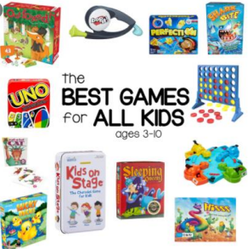
Developing play
Board games
Dobble
Kim’s Game
Spot the difference
Construction and Small World
Construction and small world also offers the opportunity for children to build on their language skills, expanding their vocabulary and their understanding.
Physical Gross Motor Play
Active play in children is required for brain growth, physical development, communication and social growth.
The Best Role Models Play with or alongside Children

Slide 17
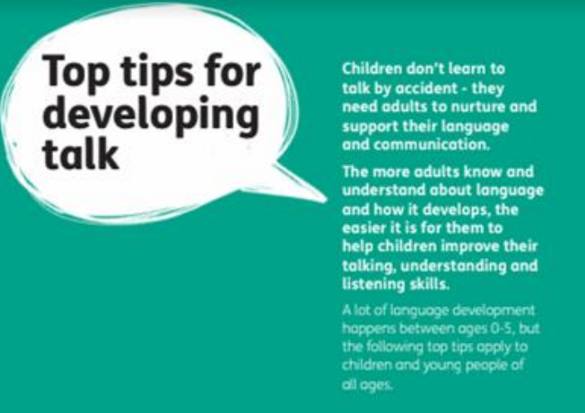
Developing talk
Would anybody like to share their ideas or tips for developing talk?

Slide 18
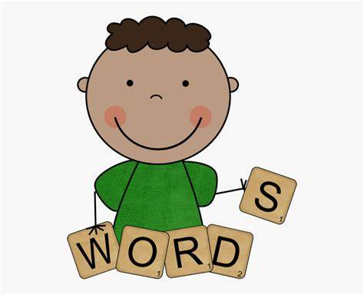
Finally…
Education is the process of preparing us for the big world, and the big world has big words. The more big words I know, the better I will survive in it. Because there are hundreds of thousands of big words in English, I cannot learn them all. But this doesn’t mean that I shouldn’t try to learn some.
(Word, words, words, by David Crystal)

