Slide 1
Library
A Reading Culture
Phonics and Fluency
Reading at Home
Class Reader
Reading at
St Joseph’s
Accelerated Reader
Whole Class Reading
Notes:
Tried to make something to sit alongside writing cycle
Various aspects of reading
Really important that we all feel confident talking to anyone about what we do to support reading
Realise it’s not just about comprehension and lessons – whole ethos and environment
Deep dive guaranteed
We’re doing well – need to perfect and be consistent across the school

Slide 2
Reading Records
-Children need to read every day (5x weekly).
-currently grey/ blue RWI book being read repeatedly and the take home RWI book (to remain in their school bag).
-children will also have a book to read for pleasure.
-books may be sent home for 3 or 4 days during RWI cycles.

Slide 3
Whole Class Reading Lessons
Lessons based around real texts
Texts chosen to be challenging
Teacher modelling book talk and written responses
Range of genres covered etc.
Regular exposure to test style questions
Can be used to support/extend other curriculum areas
Format:
1. Vocab check (visuals)
2. Read aloud
3. Quickfire recall
4. Teacher modelling
5. Paired/group discussion
6. Independent thinking
Notes:
2 lessons a week on top of phonics
Half hour
Year 1 – 2 discussion
Must have teacher modelling responses either verbally or written using sentence stems
Use of whiteboards in pairs where necessary
Year 2 – 2 will focus on written responses through paired/group work then independent work
Insight up on iPad to assess children as you hear/read responses
Year 1 Summer term move to 1 discussion lesson, 1 written but will have discussion with class teachers when appropriate
Noun project

Slide 4
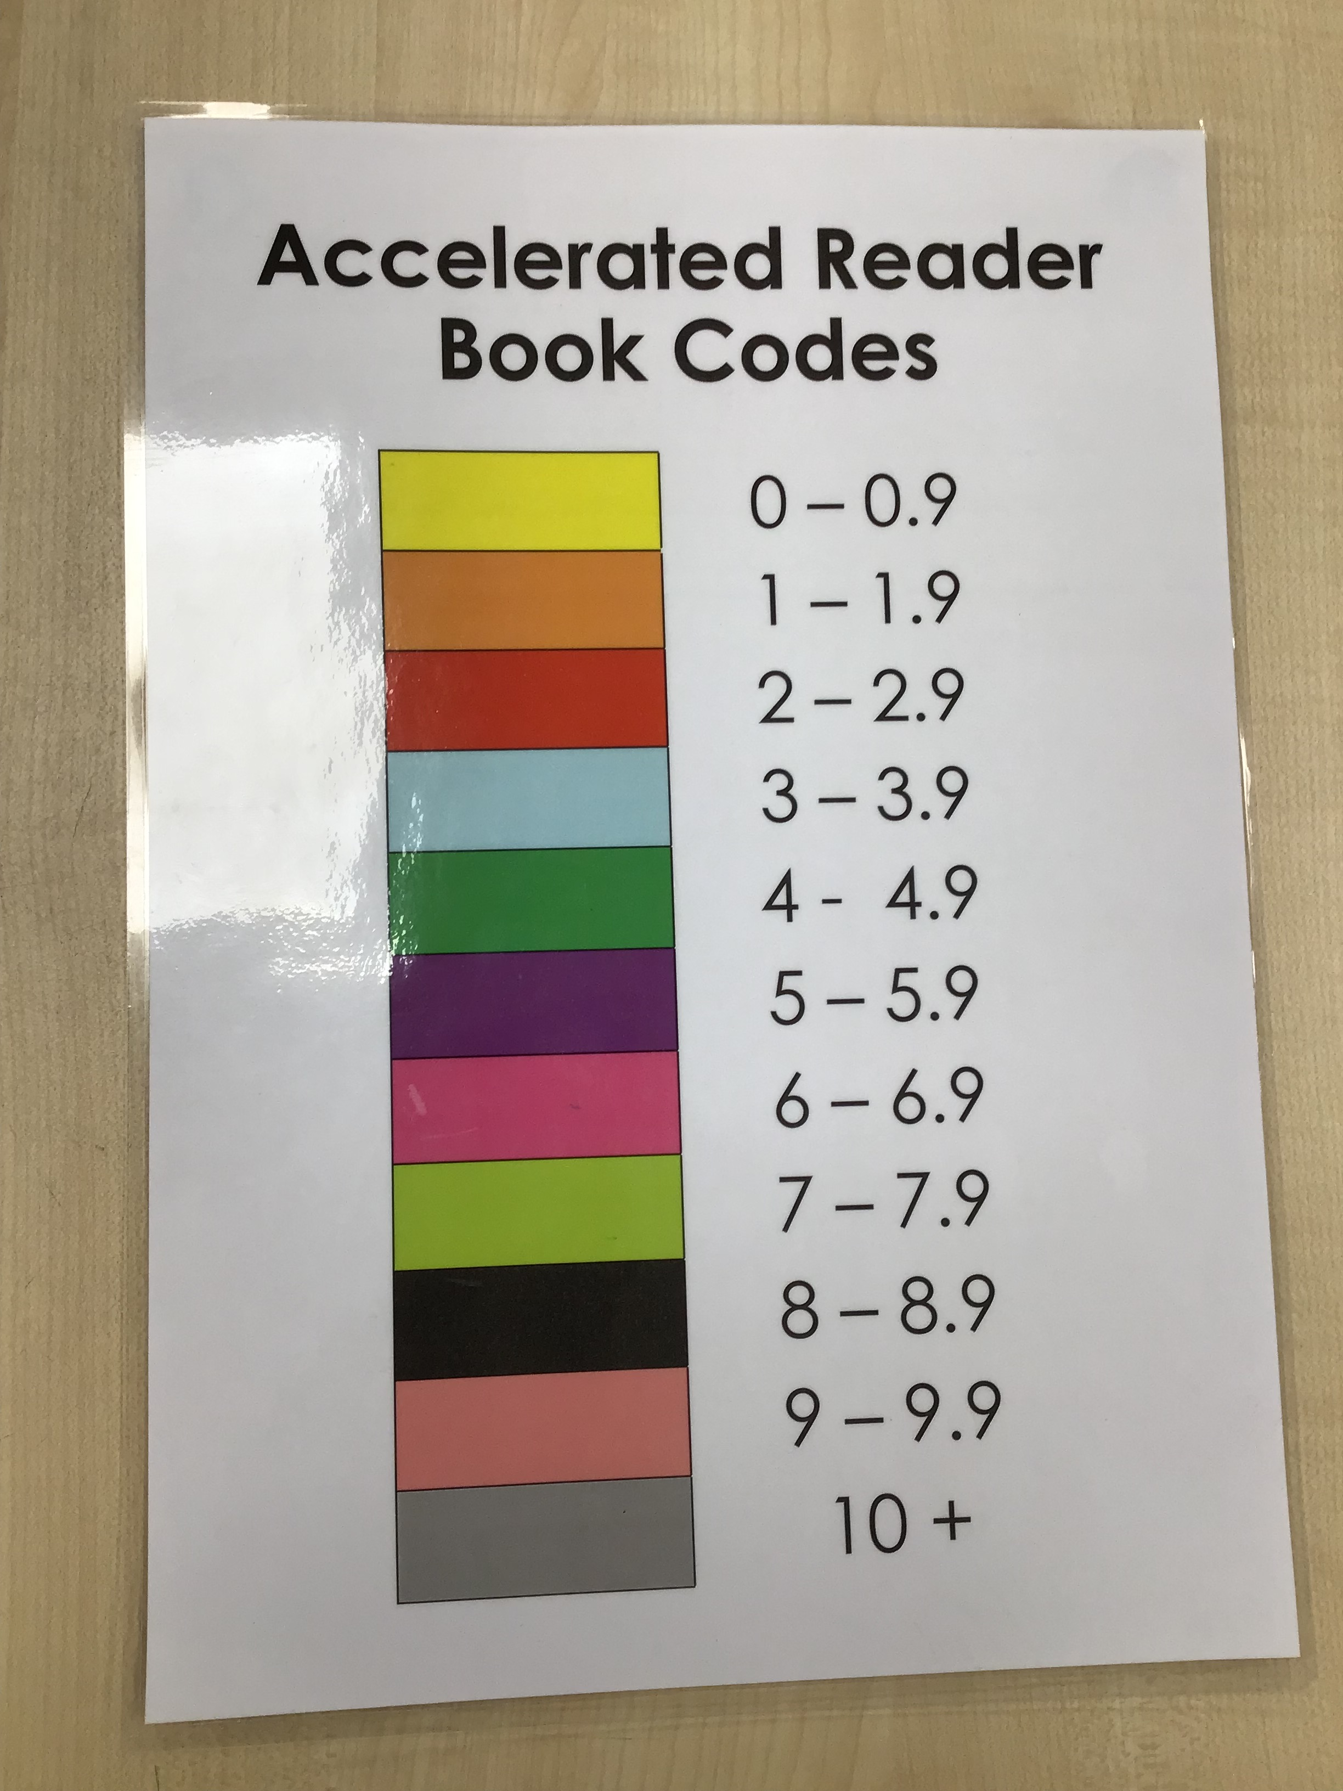
Accelerated Reader
Years 2-6
Half-termly assessments to generate reading level (STAR tests)*
Reports generated
Library books linked to reading level
Levels colour coded
Individual log ins
Quizzes upon completion of a book (48hrs)
Teacher monitors quizzes completed online and performance
Notes:
Used to support the selection of appropriate books and monitoring reading at home

Slide 5
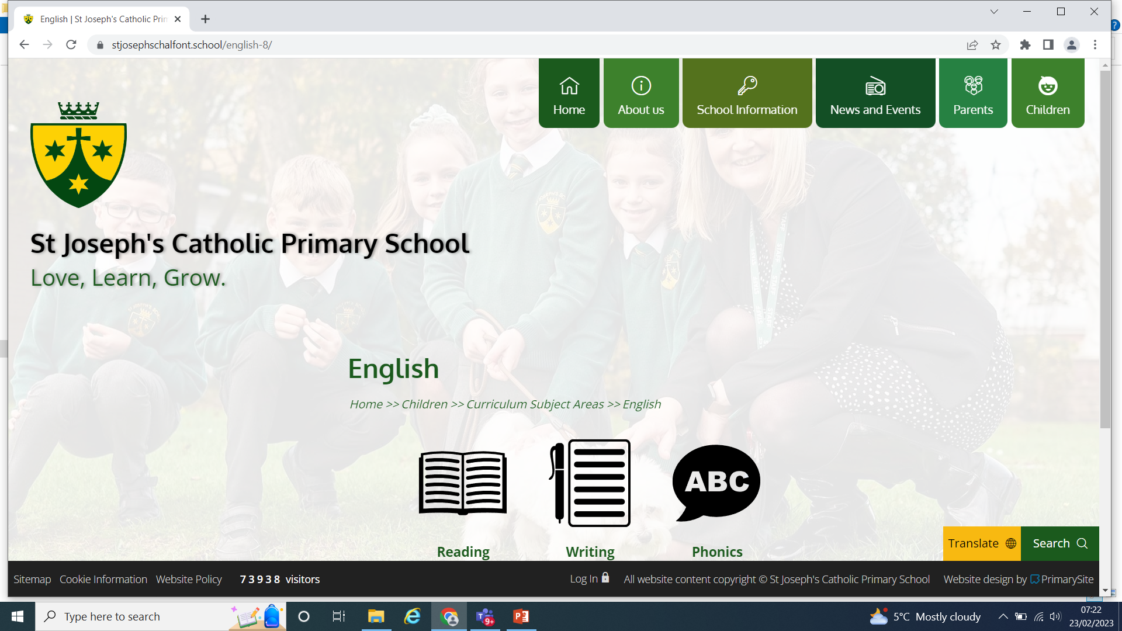
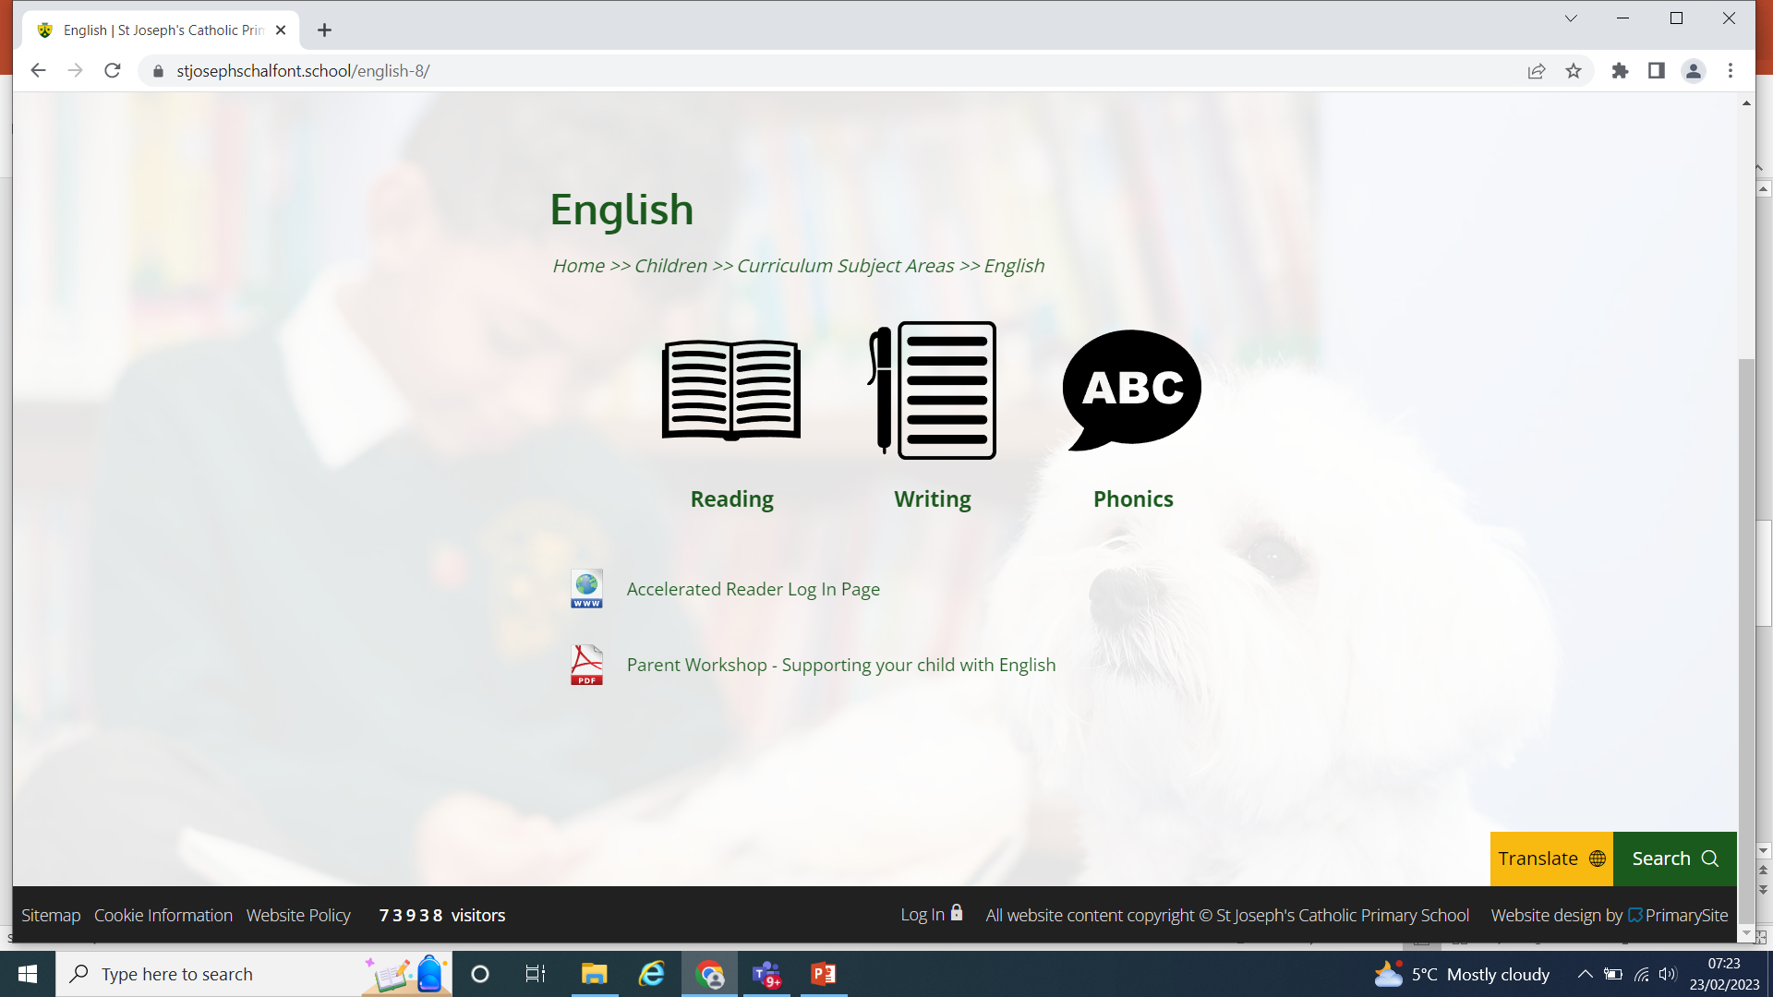
Click on the children link→ curriculum page→ English
Click on accelerated reader tab

Slide 6
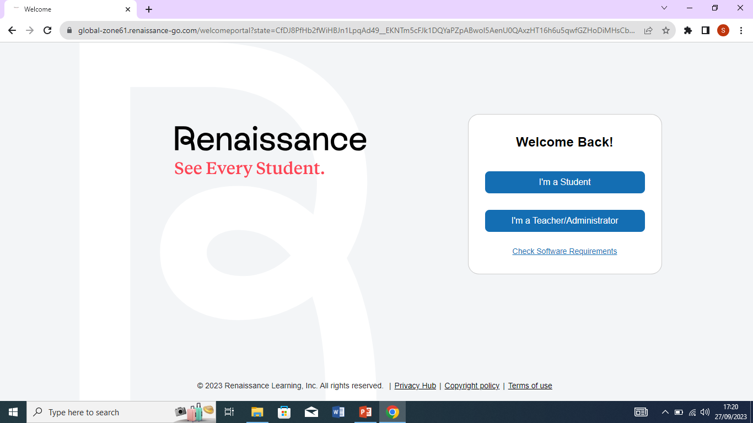
Log in as a student

Slide 7
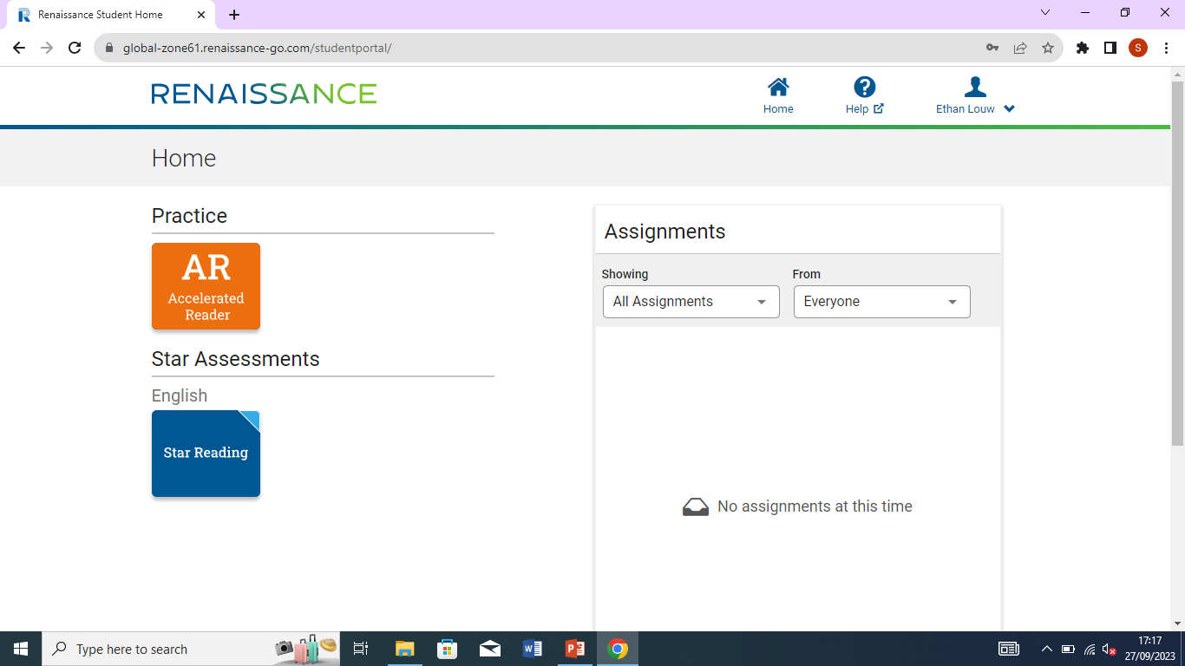
Click on the ORANGE AR button

Slide 8
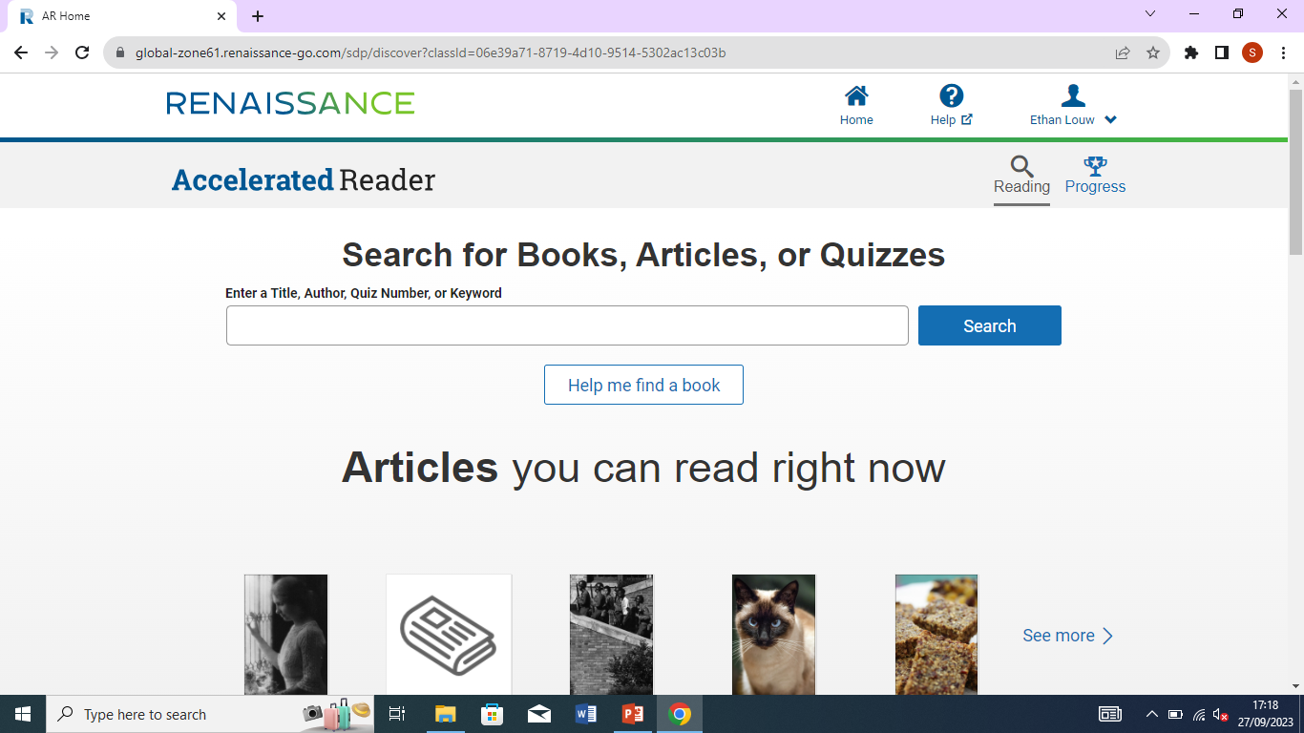
Fill in the details

Slide 9
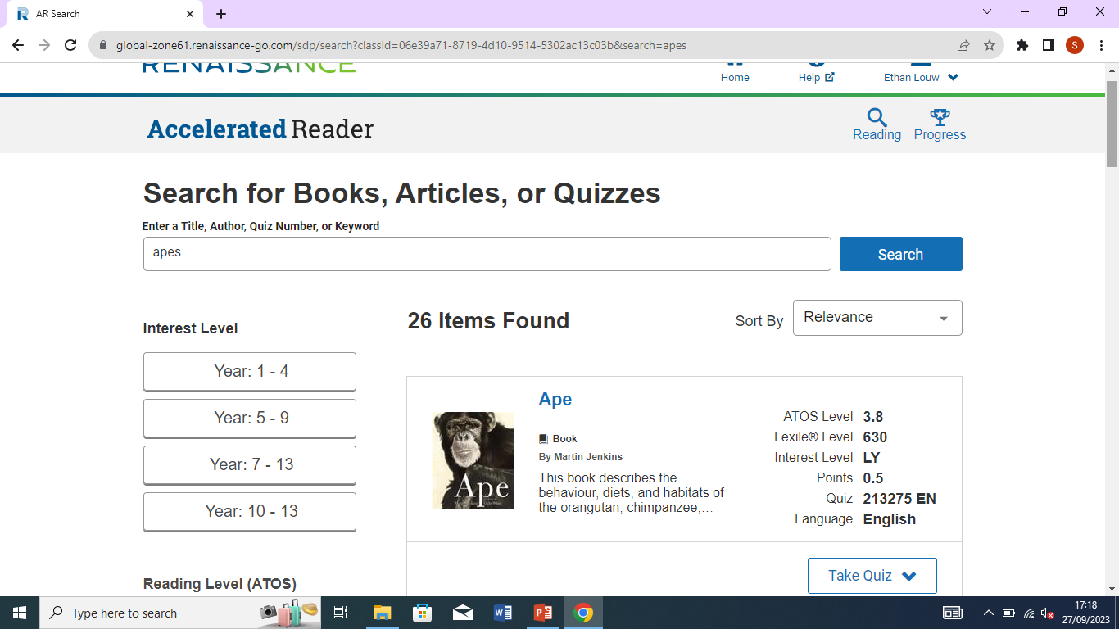
Book Apes

Slide 10
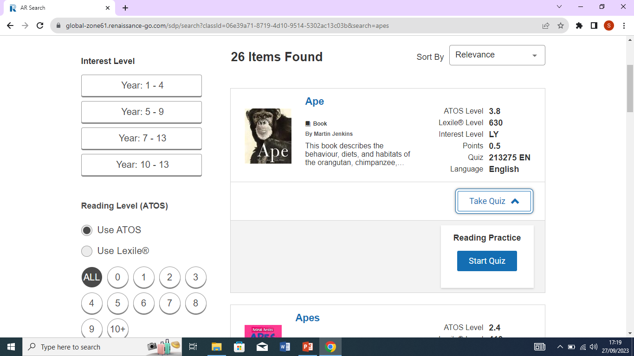
Launches the quiz

Slide 11
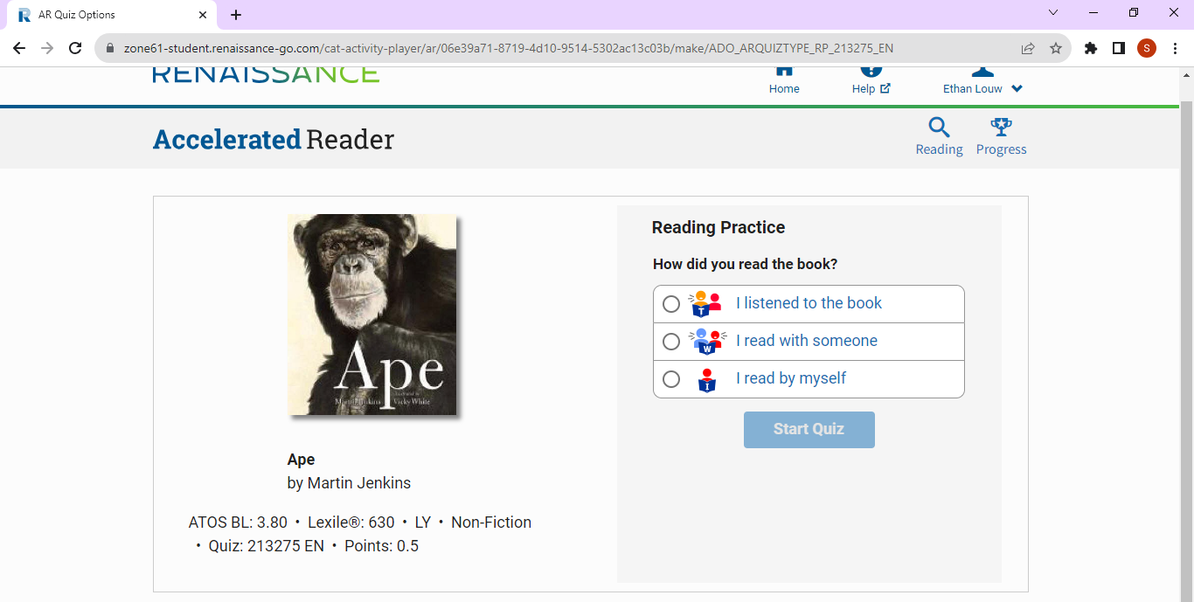
Choose from the options

Slide 12
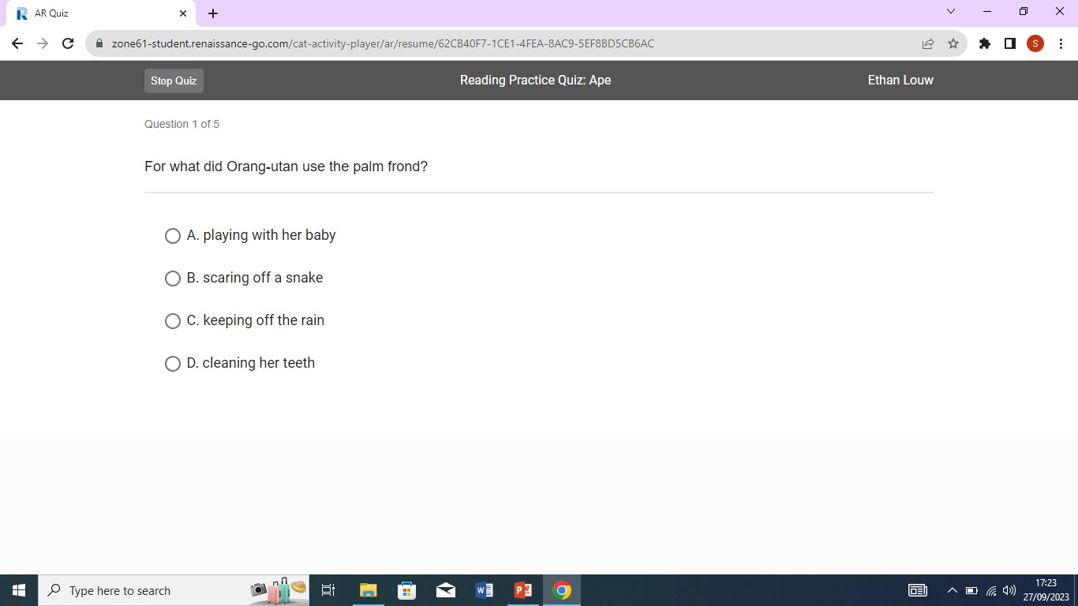

Slide 13
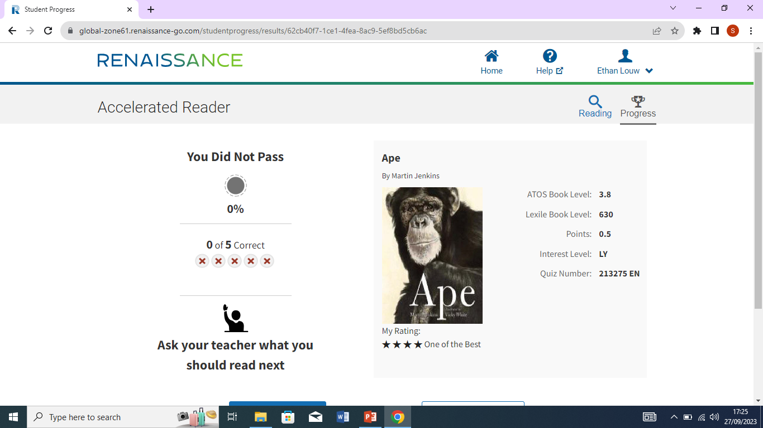

Slide 14
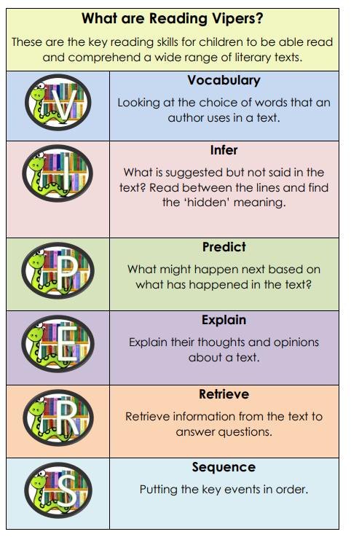

Slide 15
Looking at the word choices the author makes in the text.

Slide 16
What is suggested but not actually said in the text.
Reading between the lines or finding some hidden meaning.

Slide 17
What might happen next – based on what you have already read.

Slide 18
Explain your thoughts and opinions about a text.

Slide 19
Retrieve (find and copy) information from the text.

Slide 20
Put key events in order.

Slide 21
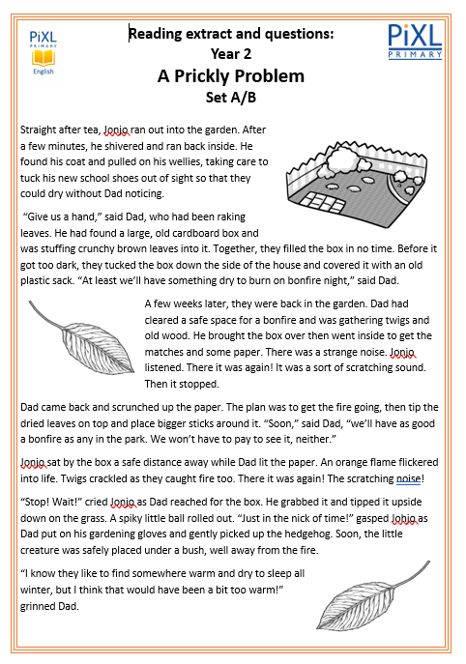
3 day cycle for each text
Day 1
First Read and exploring the text
Read the text with a partner.
Identify key vocabulary / phrases.
Read the text as a class.
Discussion.
Highlighting key words and phrases.

Slide 22
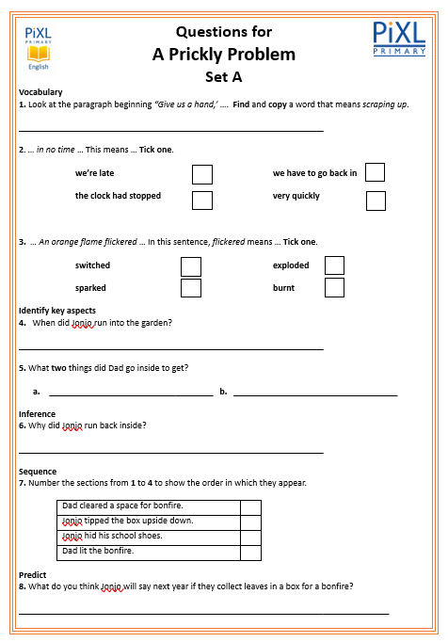
Day 2:
Set A questions based around the text
Quick re-read of the text as a class.
Partner work – complete the question sheet together.
Whole class discussion / feedback of the answers.

Slide 23
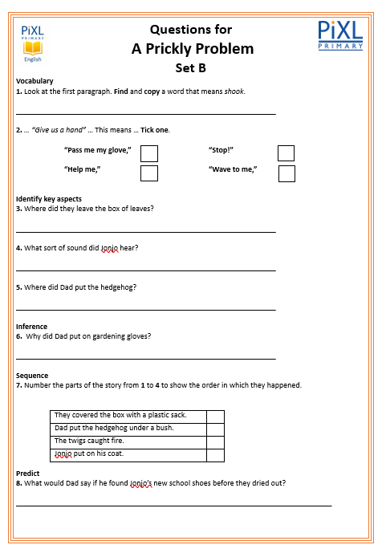
Day 3:
Set B individual Work
Quick re-read of the text as a class.
Individually – complete the question sheet.
Whole class discussion / feedback of the answers.
Teacher check.

Slide 24
Reading fluency refers to the reader’s ability to read effortlessly with accuracy in word reading and automaticity in word recognition, at an appropriate speed and with meaningful expression which enables them to construct the meaning of the text.
To take meaning from a text. When pupils read too slowly or haltingly the text is broken up into meaningless groups of words; pupils’ efforts become focused just on what they are reading rather than putting that effort into extracting its meaning.
Although accuracy in word reading and automaticity in word recognition are important skills needed for reading fluency, they should go hand in hand with developing prosody – appropriate phrasing, pace and expression. This enables the reader to construct the meaning as they read the text.

Slide 25
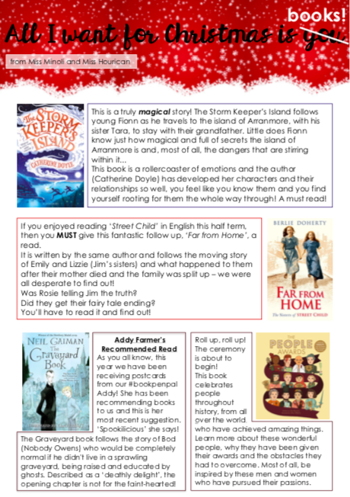
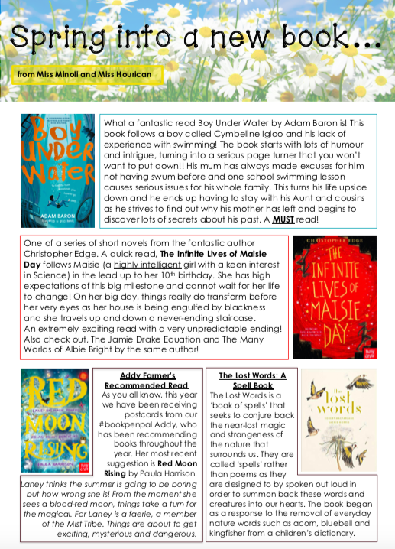
Notes:
Termly reading newsletters
Recommendations
Librarian suggestions and reading challenges
Made for whole school for next academic year

Slide 26
Questions?

Slide 27
Thank you for your time today.
We hope you have found it useful.

