Slide 1

Year 4
Woodrow Residential
Monday 27th – Tuesday 28th April

Slide 2
Dietary/Medical Needs
Any medication that is required must be handed to the office prior to the event, Wednesday 22nd April, at the very latest.
Do not let your children take their own medication to Woodrow, and do not allow them to administer any medication themselves. All medication administered whilst at Woodrow, must be recorded by an adult.
All medication must be in the original packaging, named and have the original instructions included. Hand written notes will not be accepted.
Medication that is already kept on site, such as inhalers, will go along to Woodrow, it will not be necessary to provide the school with extra medication.
Standard medication such as Calpol and Piriton is supplied by the school, to be used on an ad hoc basis. You do not need to provide your own, unless there is a specific reason, which you are welcome to discuss with the teachers.
Some medication or needs can be sensitive, class teachers are available to support you, should you feel your child has any worries or concerns. All conversations are confidential, as are the administering of medication and supporting sensitive needs, by the teachers whilst at Woodrow.

Slide 3
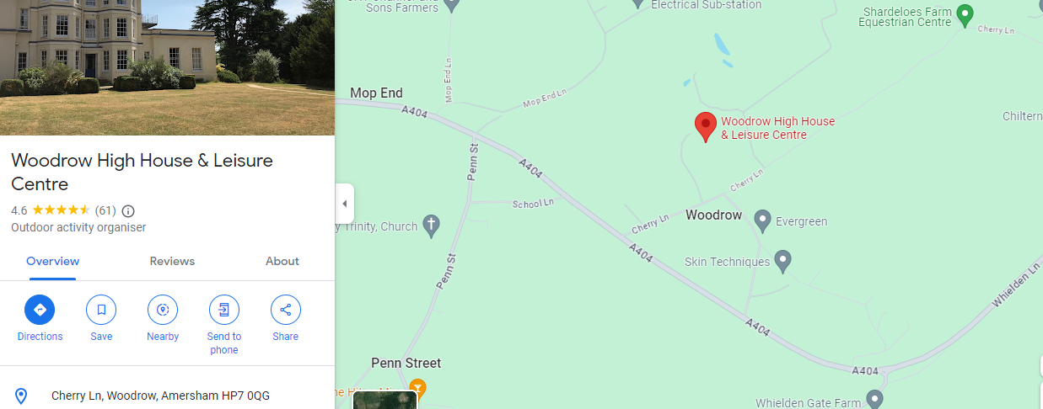
Itinerary
Monday 27th Tuesday 28th
Arrival – 10am Departure – 2pm
Car sharing where possible!
Please drop/collect children to Woodrow House

Slide 4
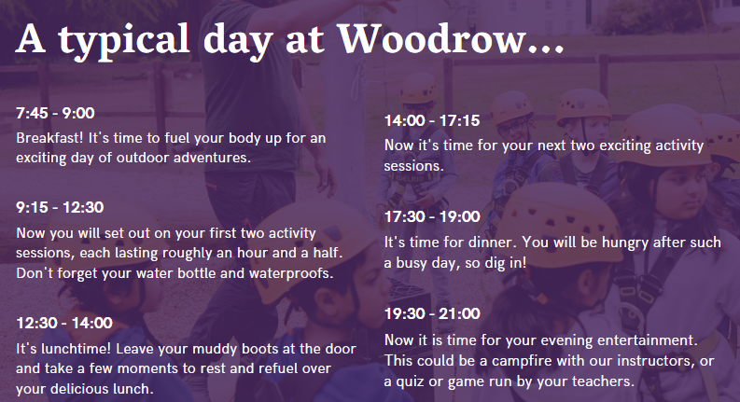

Slide 5


Activities
Pioneering
Archery
High Ropes – Crate Stack
Challenge Course
Orienteering
Indoor Curling

Slide 6

Meals
Please bring your child with a packed lunch.
We will also bring packed lunches from school – sandwiches pre ordered.
Woodrow can provide alternatives for allergy and intolerance sufferers, cultural diets, food phobias etc.
Please do not pack snacks and treats.

Slide 7
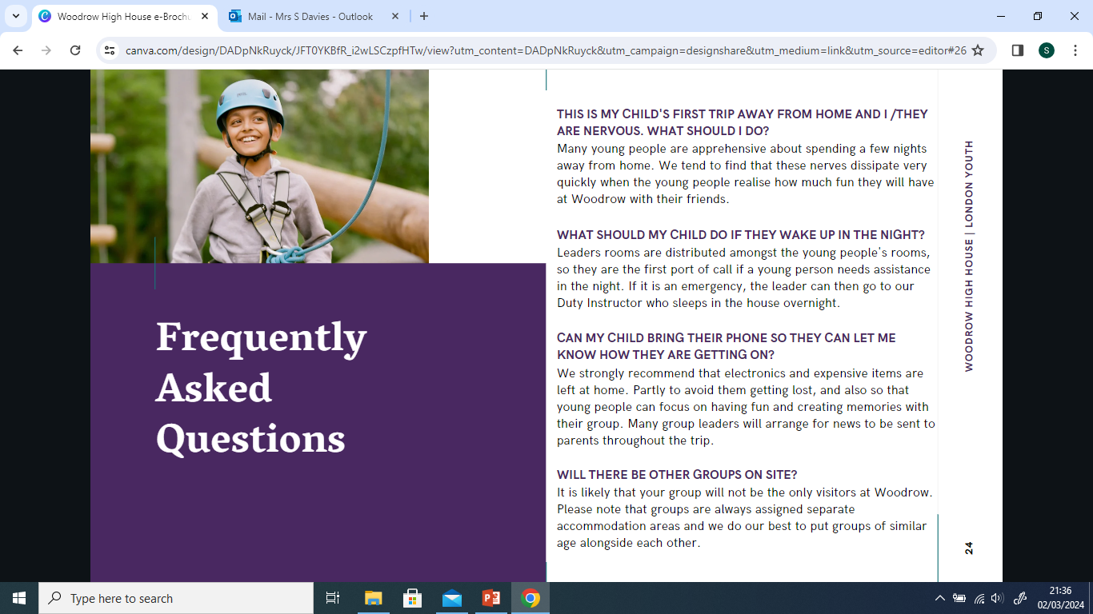
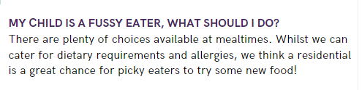

FAQs

