Slide 1
Year 6 SATs 2023 Presentation for Parents

Slide 2
What are the SATs?
SATs are the Standardised Assessment Tests
that are given to children at the end of Key Stage 2.
The SATs take place over four days,
Tuesday 9th May - Friday 12th May.

Slide 3
When are the SATs?
The SATs papers consist of:
Spelling, punctuation and grammar Spelling (2 papers) – Tuesday 9th May
Reading – Wednesday 10th May
Maths (paper 1: Arithmetic) –Thursday 11th May
Maths (paper 2: Reasoning) –Thursday 11th May
Maths (paper 3: Reasoning) –Friday 12th May
Writing is assessed using evidence collected throughout Year 6.
There is no Year 6 SATs writing test.

Slide 4
How are the SATs are completed?
Normal school hours
Examination conditions
Papers are sent away to be marked externally.
The results are sent to the school in July.
No longer than 60 minutes:
Spelling, punctuation and grammar (paper 1: Grammar/ Punctuation) – 45 minutes
Spelling, punctuation and grammar (paper 2: Spelling) – 15 minutes
Reading – 60 minutes
Maths (paper 1: Arithmetic) – 30 minutes
Maths (paper 2: Reasoning) – 40 minutes
Maths (paper 3: Reasoning) – 40 minutes

Slide 5
The results
Tests are marked externally. Once marked, the tests will be given the following scores:
A raw score (total number of marks achieved for each paper);
A scaled score (see below);
A judgement on if the National Standard has been met.
Scaled scores range from 80 to 120.
A scaled score of 100 or more shows the pupil is meeting the National Standard.

Slide 6
Spelling, Punctuation and Grammar: Tuesday 9th May
Spelling, Punctuation and Grammar consists of two papers:
Paper 1 focuses on all three elements (spelling, punctuation and grammar).
The paper lasts for 45 minutes.
Paper 2 consists of a spelling test only.
Approximately 15 minutes, although this is not a set amount of time
(pupils should be given as much time as they need to complete the test).

Slide 7
Spelling, Punctuation and Grammar: Paper 1
This test requires a range of answer types - but does not require longer formal answers.
Circling
Drawing lines to connect
Multiple choice questions
(including ticking tables)
One-word answers
Short answer questions
This test focuses on:
Grammatical terms/ word classes;
Functions of sentences;
Combining words, phrases and clauses;
Verb forms, tenses and consistency;
Punctuation;
Vocabulary;
Standard English and formality.

Slide 8
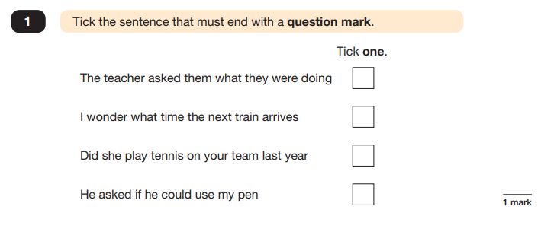
Spelling, Punctuation and Grammar: Paper 1
e.g. that, which
✓

Slide 9
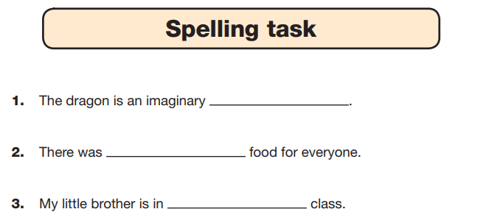
Spelling, Punctuation and Grammar: Paper 2
Shorter paper that focuses solely on spellings.
creature

Slide 10
Reading - Wednesday 10th May
There is one reading test that lasts for 60 minutes.
Measure if the children’s comprehension of age-appropriate reading material meets the national standard.
These could be any combination of non-fiction, fiction and/ or poetry.
The test covers the following areas (Content Domains):
Give/ explain the meaning of words in context;
Retrieve and record information/ identify key details from fiction and non-fiction;
Summarise main ideas from more than one paragraph;
Make inferences from the text/ explain and justify inferences with evidence from the text;
Predict what might happen from details stated and implied;
Identify/ explain how meaning is enhanced through choice of words and phrases;
Make comparisons within the text.

Slide 11
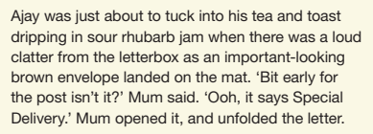
Reading

Slide 12
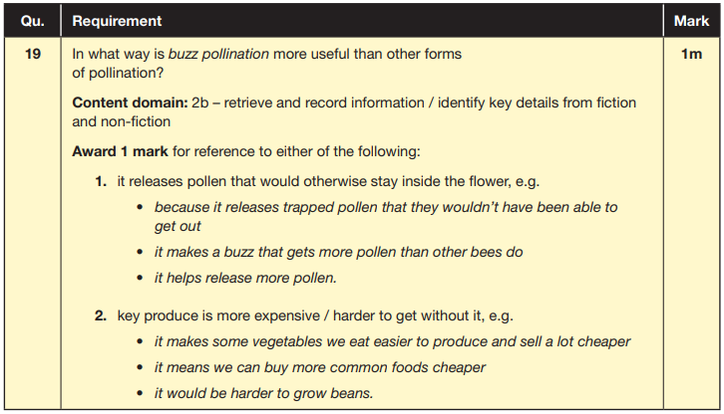
Reading

Slide 13
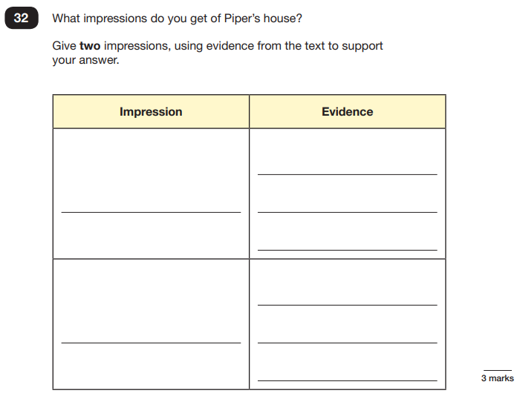
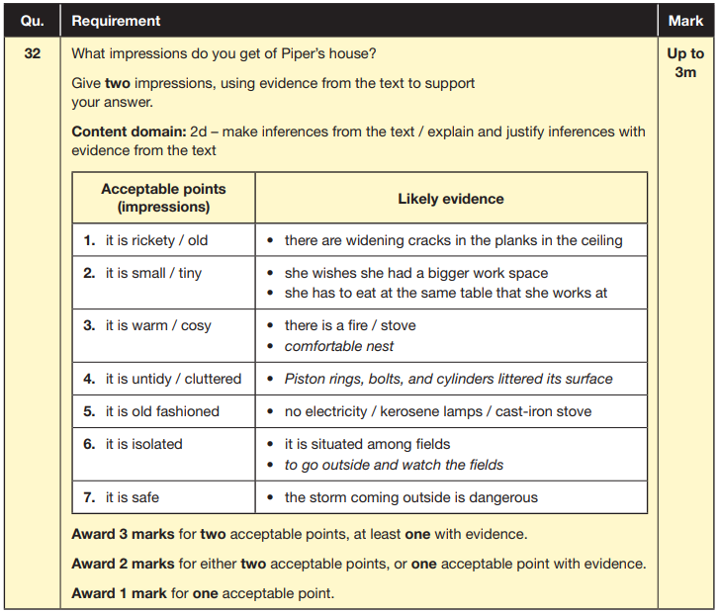
Reading

Slide 14
Reading
There has been a tendency for three types of questions to be the most popular.
Words in context
Retrieving and recording
Inferences

Slide 15
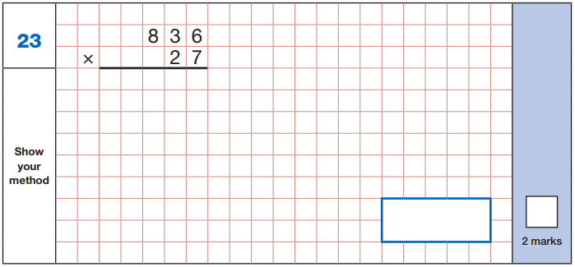
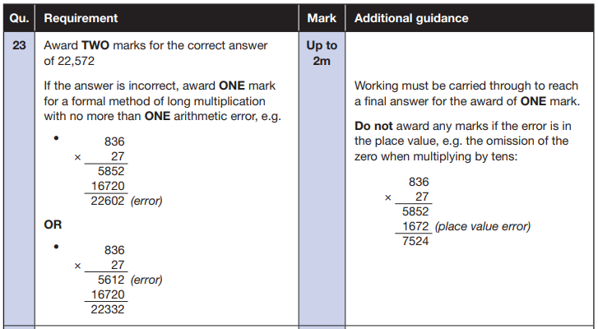
Maths Paper 1 (Arithmetic) Thursday 11th May
The maths arithmetic paper has a total of 40 marks.
The test covers the four operations (addition, subtraction, multiplication, division), percentages of amounts and calculating with decimals and fractions.
Example question:

Slide 16
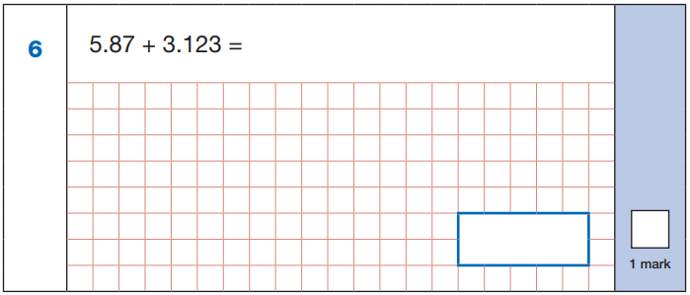
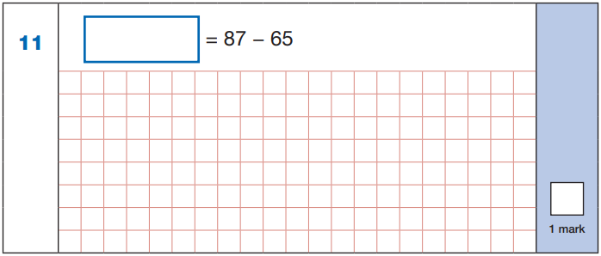
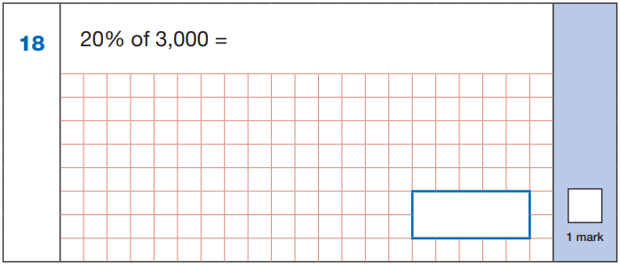
Maths Paper 1 (Arithmetic)
22
5.87
+ 3.123
8.993
87
- 65
22
8.993
60 ÷ (30 - 24)
60 ÷ 6 = 10
10% of 3,000 = 300
20% of 3,000 = 600
10
600

Slide 17
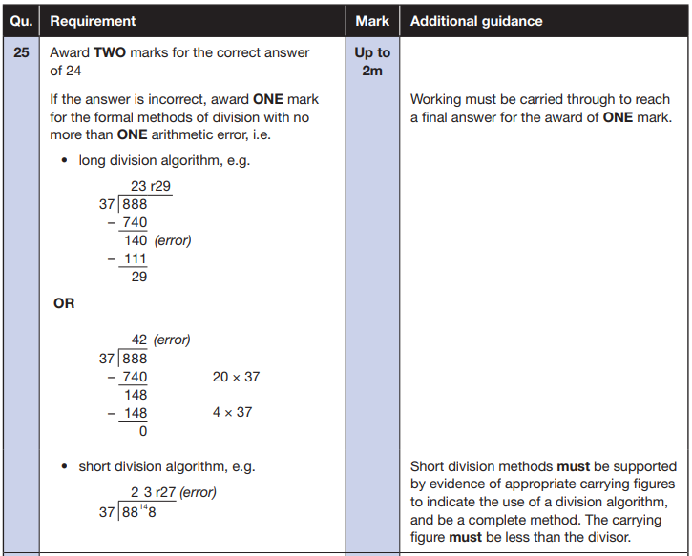
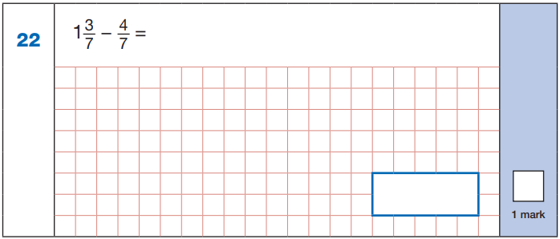
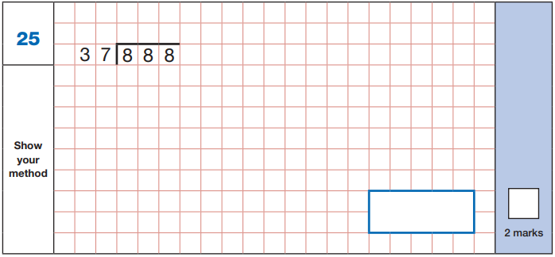
Maths Paper 1 (Arithmetic)
Example questions:
$\frac{\text{10}}{\text{7}}$ - $\frac{\text{4}}{\text{7}}$ = $\frac{\text{6}}{\text{7}}$
$\frac{\text{6}}{\text{7}}$
24

Slide 18
Maths Papers 2 and 3 (Reasoning)
Paper 2 - Thursday 11th May
Paper 3 - Friday 12th May
35 marks each
Demonstrate their mathematical knowledge and skills
Solve problems using their mathematical reasoning.
They cover a wide range of mathematical topics from key stage 2 including,
Number and place value (including Roman numerals);
The four operations;
Geometry (properties of shape, position and direction);
Statistics;
Measurement (length, perimeter, mass, volume, time, money);
Algebra;
Ratio and proportion;
Fractions, decimals and percentages.

Slide 19
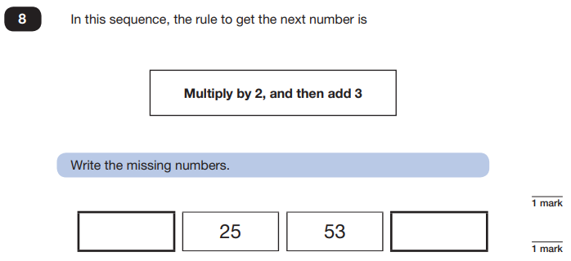
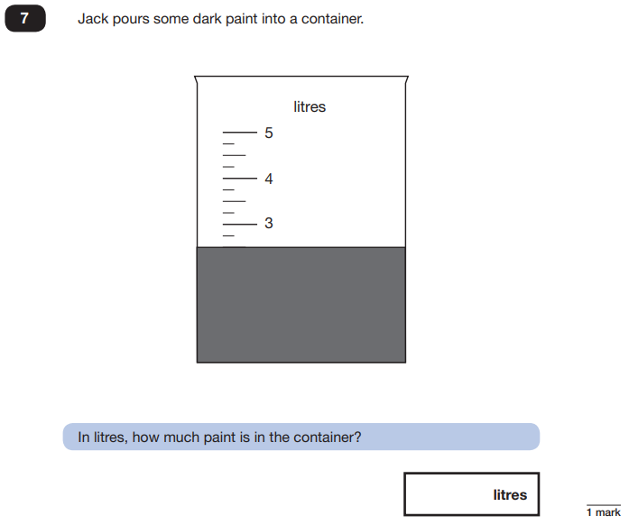
Maths Papers 2 (Reasoning)
Example questions:
11
109
2.5 or 2 ½

Slide 20
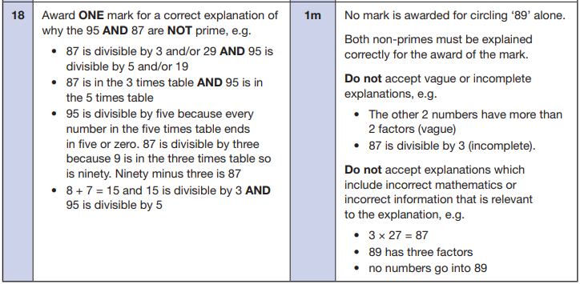
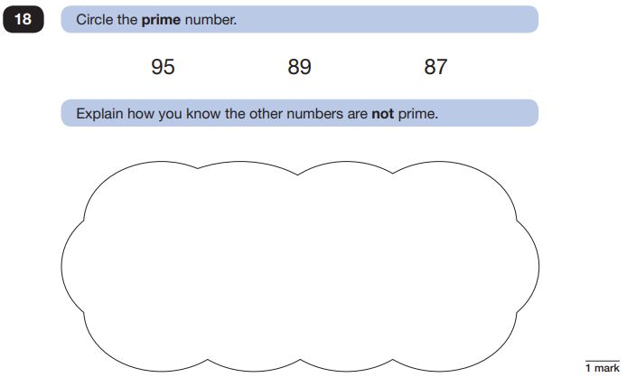
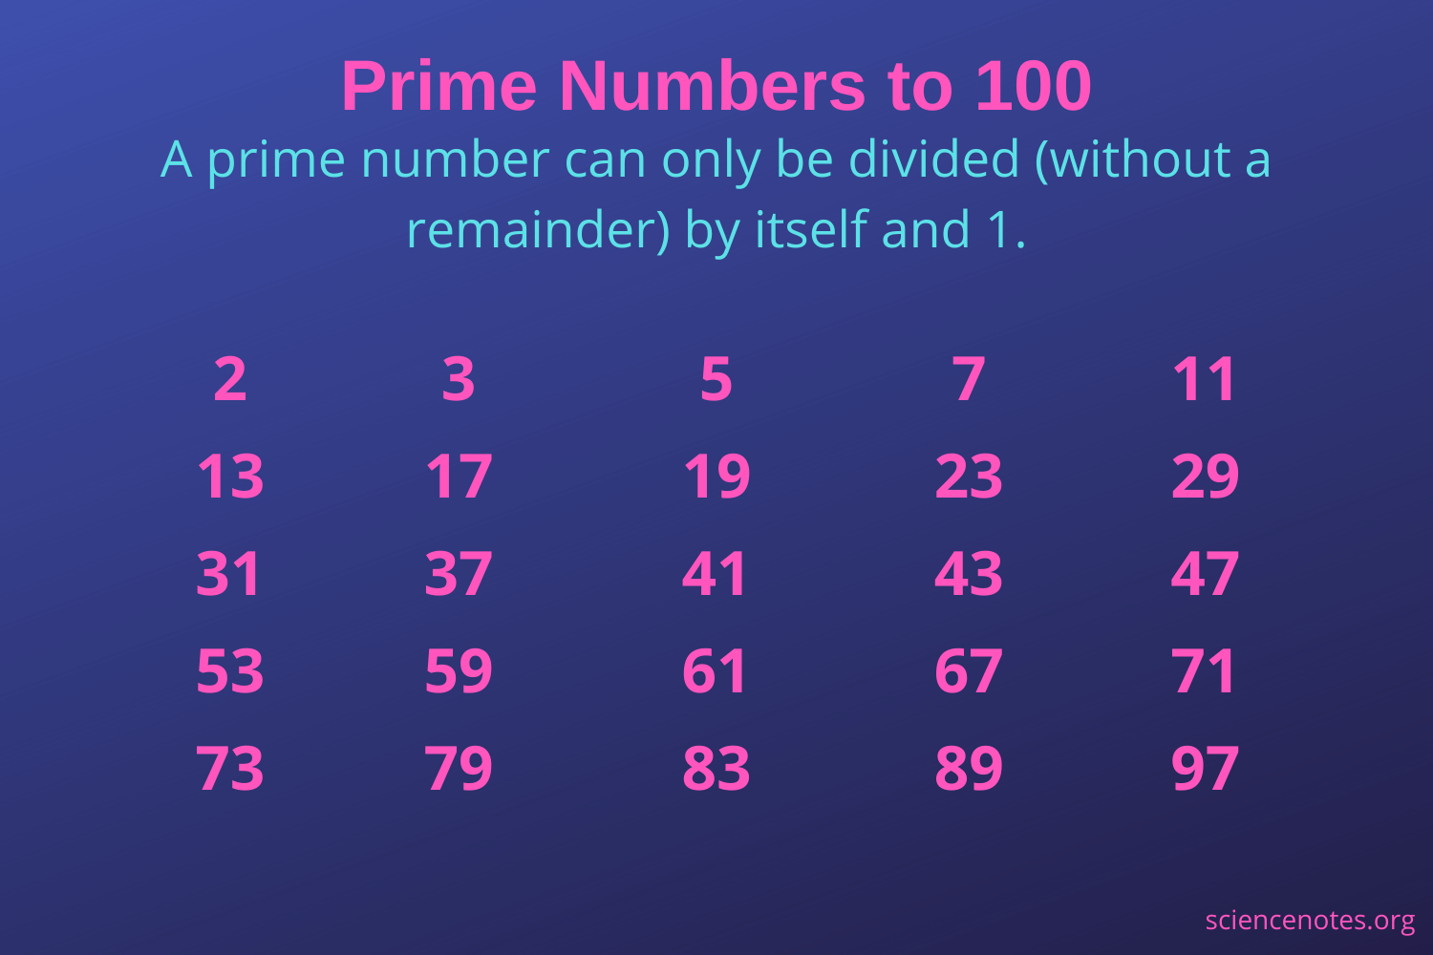
Maths Papers 2 (Reasoning)
Example question:

Slide 21
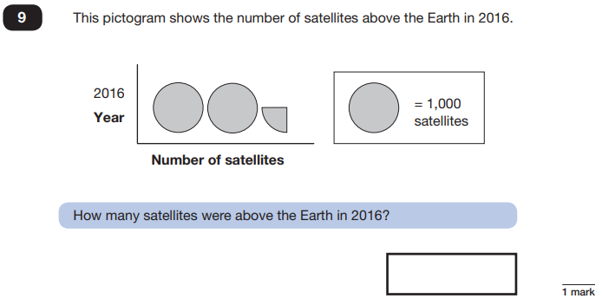
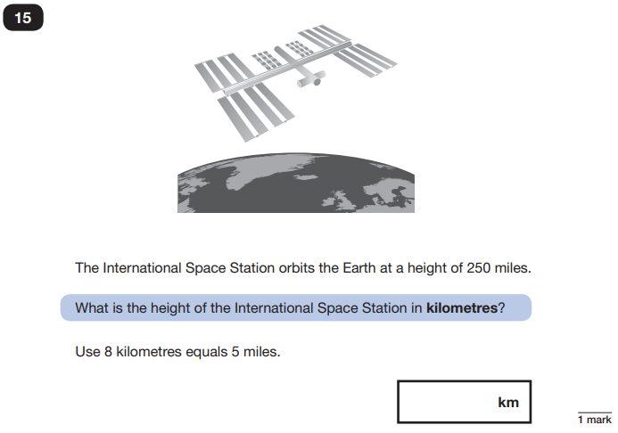
Maths Papers 3 (Reasoning)
Example questions:
2,250
400

Slide 22
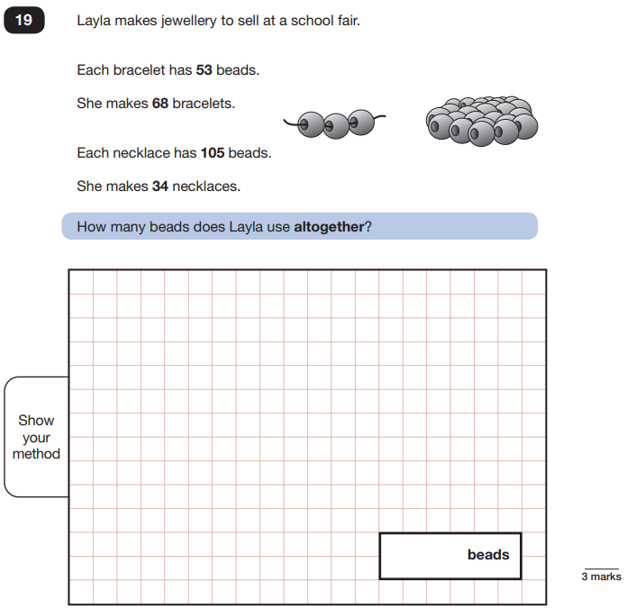
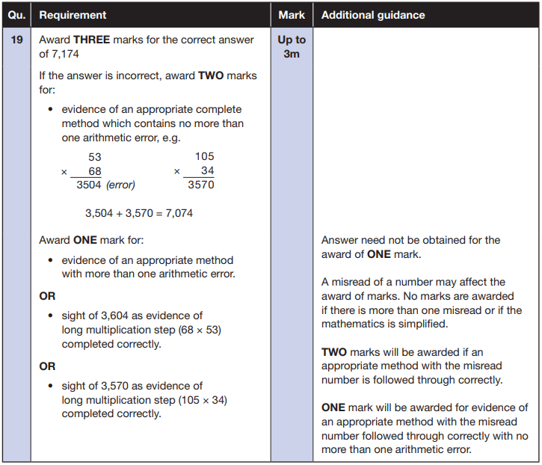
Maths Papers 3 (Reasoning)
Example question:

Slide 23
Supporting your child in preparing for the SATs
Talk to your child’s class teacher if you have any concerns rather than worry your child.
Ensure your child is eating and drinking well and getting a good amount of sleep.
Ensure your child has the best possible attendance at school.
Support your child with any homework tasks. Make good use of the revision guides!
Practise times tables.
Talk to your child about what they have learnt at school and what book(s) they are reading (the character, the plot, their opinion).
Make sure your child has a good sleep and healthy breakfast every morning of the SATs.

Slide 24
Things to remember about SATs
SATs focus on what children know about Maths and English.
They will not reflect how talented they are at science, geography, art, PE…, and they certainly won’t highlight all of their amazing personal characteristics.
SATs don’t tell the whole story.
Their results will say if they did or did not meet a certain standard but not necessarily by what margin. These thresholds change each year according to the overall national performance, so what was classed as ‘meeting the expected standard’ this year might not be the same as last year.
They are a reflection of your child on one day / one test!

Slide 25
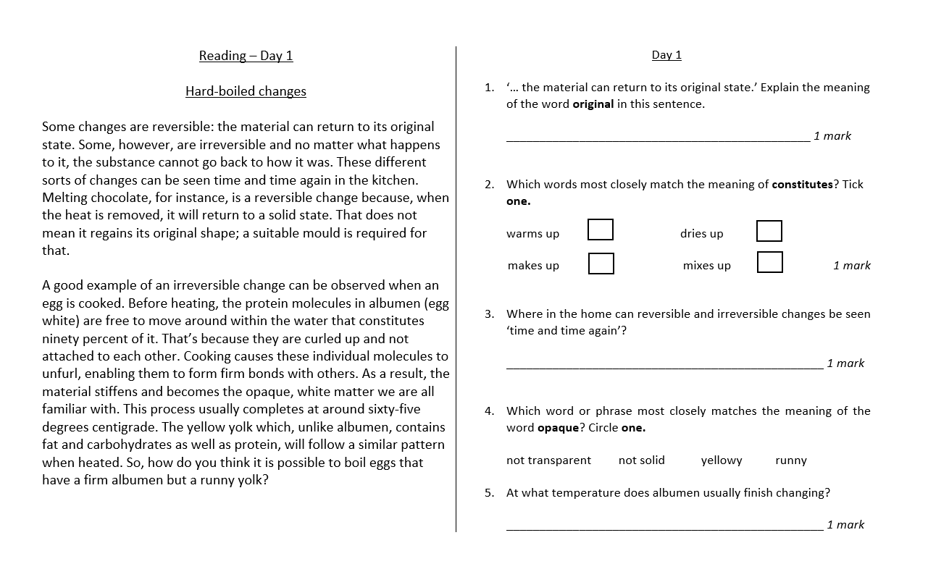
PIXL – 10 FOR 10 READING / MATHS

