Slide 1
Relationships &
Sex
Education​​
Parent Workshop - Years 5 & 6
8th May 2024

Slide 2
HOW IT WILL WORK AT ST JOSEPHS
Parents are the first educators of their children. It is their right and responsibility to inform and educate their children in matters relating to human growth and development, particularly sexual development.
We as a school are aiming to work in partnership with parents and carers. The teaching offered by schools will complement and not replace their primary role.

Slide 3
HOW IT WILL WORK AT ST JOSEPHS
In Pentecost 2, our Year 5 & 6 students will participate in two days of PSHE learning about Relationships & Sex Education.
MONDAY 3rd JUNE
Both year levels (5 & 6) will do the same topic on Emotional Wellbeing.
Module 1 - Unit 3
TUESDAY 4th JUNE
Year 5: Puberty & Menstruation
​
Me, My Body, My Health​
Module 1 – Unit 2
Menstruation (from Life Cycles)
Module 1 – Unit 4
Year 6: Sex​
Life Cycles
Module 1 – Unit 4

Slide 4
IMPLEMENTATION
The sessions begin with a Paradise Street Video.
It is the 4 children (who have different personal and social experiences related to growing up and puberty) discussing different things with their parents​, asking questions and getting casual, life-based answers.
It is followed with a Delving Deeper Episode.
This is where the students listen to more detailed descriptions, adult discussions and images/diagrams of body parts.​
​
Class discussion​ for students to ask questions, have peer communication, and allow an open conversation about what they have learnt/watched.
​
Another video that is a combination of Paradise Street and Delving Deeper where they recap the children's questions and important details.
​​
The students will then complete a task that is based off what they have learnt to facilitate learning and provide opportunity for further discussion and understanding. ​
​
Finalised with a prayer.

Slide 5
DAY 1: EMOTIONAL WELLBEING
Unit 3 – Emotional Well-Being helps children learn about pressures that they may experience from themselves, others and the media. Children will develop ideas on how to build resilience through thankfulness, use simplified CBT techniques to manage their thoughts, feelings and actions and cope with new or difficult feelings such as romance and rage. The final session in this Unit covers how children may be affected by what they see online, including pornography.

Slide 6
DAY 1: EMOTIONAL WELLBEING
Session 1: Body Image​
Episode 5 of ‘Paradise Street’ investigates some of the pressures pubescent young people can face from others, their own expectations and the media. Leyla feels pressure to look grown up after her Mum shares a photo of her on social media with a caption ‘my baby’, and Finn feels weak and inadequate and so tries to build muscle too quickly. Through exploring these and other pressures that they may experience, children will develop ideas of how to build resilience through thankfulness.
Session 2: Peculiar Feelings​
In Episode 6 of ‘Paradise Street’, Marcus imitates inappropriate behaviour that he sees at home from his Mum’s boyfriend. He learns that some behaviors are always wrong, no matter what feelings accompany them, and learns that he has to take responsibility for his actions. Meanwhile, Siobhan and Leyla fall victim to a miscommunication which ruptures their friendship. In this session, through films and activities pupils will consider how people behave and react to their feelings and emotions, and how these feelings can change quickly.
Session 3: Emotional Changes​
In Episode 7 of ‘Paradise Street’, Leyla has a crush on an older boy and gets a bit carried away. Meanwhile, following recent events in Marcus’ personal life, Miss Nichols gives him a creative outlet for the powerful emotions he has been experiencing. This session provides plenty of opportunity for discussion and reflection, including how to manage feelings that can seem uncontrollable.
Session 4: Seeing Stuff Online​
This session explores the emotional and mental impact that videos and images of an adult nature can have on children and young people, particularly pornography*. In Episode 8 of ‘Paradise Street’ we explore the relationship that the characters have with online devices. Leyla and Siobhan rave about a vlogger they have discovered, whilst Finn secretly discovers a pornographic website. Initially shocked and scared by what he has seen, he becomes more and more drawn to it. When his Dad discovers what Finn has been looking at, he sits down with him for a chat to explain the effect that these videos and images will have on his young brain.

Slide 7
DAY 2: ME, MY BODY, MY HEALTH (Year 5)
In Unit 2 – Me, My Body, My Health, children will learn that celebrating differences between people is enriching to a community and know that their self-confidence should arise from being loved by God. They will learn about the physical changes that boys and girls go through during puberty and how they should respect and take care of their bodies as gifts from God. Genitals are also mentioned here, but not named and identified.

Slide 8
DAY 2: ME, MY BODY, MY HEALTH (Year 5)
Session 2: Girls’ Bodies​
This second episode of ‘Paradise Street’ starts with a lesson talking about the physical changes that boys and girls experience during puberty; to which the children respond with degrees of embarrassment and confusion. The film then focuses on the girls’ perspective through the character of Leyla. Through the film, follow-up discussion, teaching and personal activity, pupils will learn about the physical changes that take place for girls through puberty.
Session 3: Boys’ Bodies​
This third episode of ‘Paradise Street’ starts with a lesson talking about the physical changes that boys and girls experience during puberty; to which the children respond with degrees of embarrassment and confusion. The film then focuses on the boys’ perspective through the characters of Marcus and Finn. Through the film, follow-up discussion, teaching and personal activity, pupils will learn about the physical changes that take place for girls through puberty.​
Session 4: Spots and Sleep​
This session discusses how children can respect their bodies as gifts from God by looking after them appropriately. They will learn that good choices regarding rest, sleep, exercise, personal hygiene and diet will have a positive impact on their health.
LIFE CYCLES (YEAR 5)
Session 3: Menstruation​
In the final episode of ‘Paradise Street’, we see Siobhan get her first period and feeling uncertain about what to do. She is sad that her Mum, who died a number of years ago, isn’t there to show her the ropes, but she is helped by her teacher and her Dad to become confident going forwards. Through this session, pupils will learn about how girls manage their periods (menstruation), and understand some of their possible side effects (including PMS). They will learn why periods happen, that fertility is necessary to bring a child into the world, and how the menstrual cycle is part of God’s plan for creation.​

Slide 9
DAY 2: LIFE CYCLES
(Year 6)
In Unit 4 – Life Cycles, children will learn about God’s design for creating new life through a more nuanced understanding of menstruation, fertility, conception, foetal development in the womb and childbirth. An optional session talks about sexual intercourse within the context of marriage being God’s plan for the place of sex within a relationship. Framed within the Christian understanding of eternal life, a further session on death and grief helps pupils to consider and communicate about death in a direct yet gentle way, and consider ways to support themselves and others. The module concludes with a celebration of the journey of change pupils have been on, and look forward to upcoming changes including the transition to secondary school. Children will reflect on God’s presence with us throughout our lives, and how this helps us to cope with change of all kinds.

Slide 10
DAY 2: LIFE CYCLES
(Year 6)
Session 1: Making Babies (Part 1)​
This session explores how a baby grows in the womb, building on and developing the teaching at Lower Key Stage Two. In this episode of ‘Paradise Street’, Finn learns that his Mum is going to have a baby. He discusses it with his friends, who don’t know much about where babies come from. Finn learns from his Mum about the miraculous process of human life and how it is conceived and developed in the womb. Finn also has his worries alleviated about being ‘replaced’ or not loved so much when the new baby comes along.​
Session 2: Making Babies (Part 2)​
Previously in ‘Paradise Street’, Finn and Leyla asked questions about how babies are made and they learned about the different stages of life in the womb. At the end of the episode, Finn disarms his Dad with the question, “How did your sperm actually get inside Mum’s body?” In this session, pupils will learn some key information and facts about sexual intercourse, underpinned with the religious understanding that sexual intercourse is intended for married couples and has been designed by God.
Session 5: Coping with Change​
This session reflects and celebrates the journey of change that pupils have been on throughout primary school, and looks forward to upcoming changes. Children will explore their feelings about moving to secondary school and strategies that will help them with this transition, with a particular focus on resilience and gratitude. Pupils will have an opportunity to reflect on God’s presence with us throughout our lives, and how this helps us to cope with change.

Slide 11
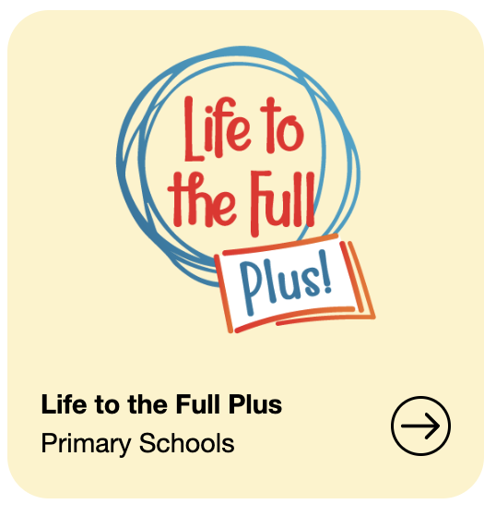
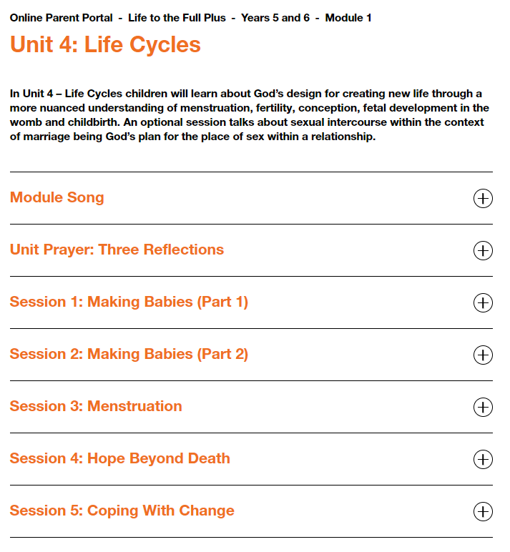
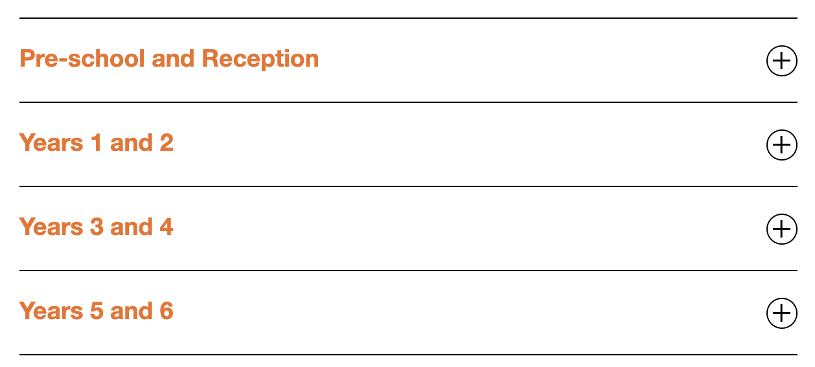
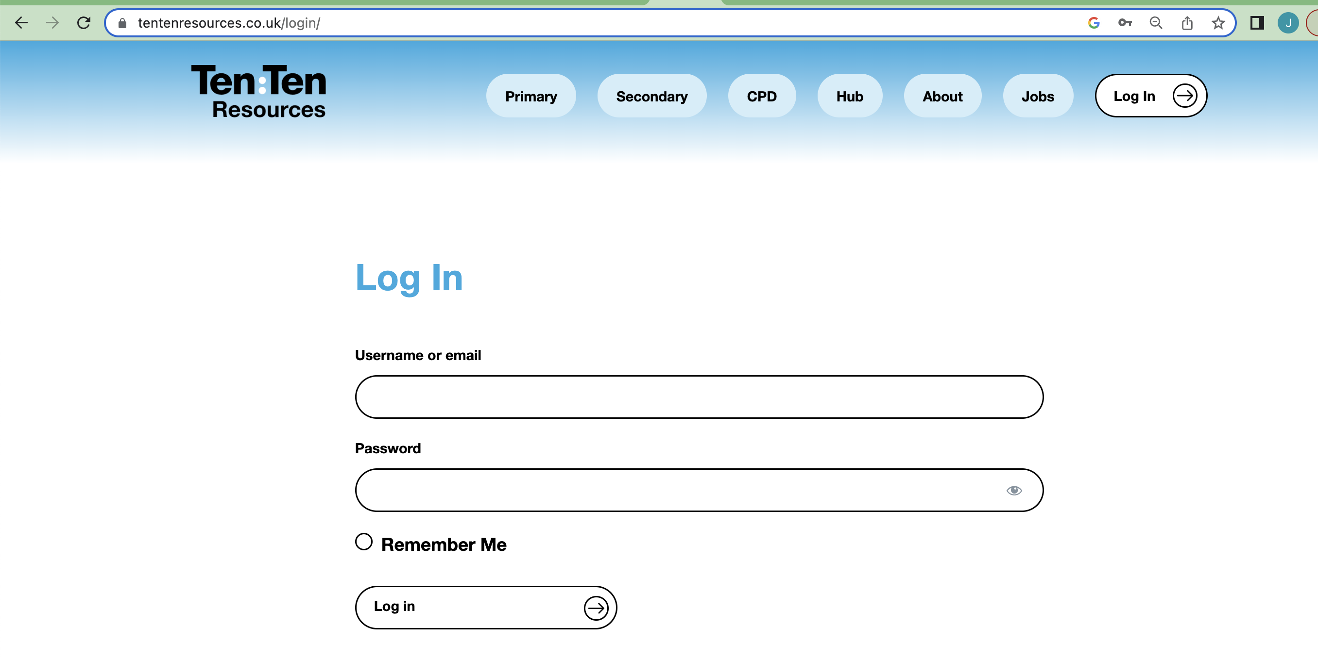
ACCESSING THE TEN TEN CURRICULUM
Ten:Ten Resources
Click here!
Login!
Username: stjosephssl9
Password: new-year24
Find your module & click to read about the learning.

Slide 12
CATHOLIC LIFE IN THE CURRICULUM
We ensure a good understanding of pupils’ faith backgrounds and positive relationships between the school and local faith communities help to create a constructive context for the teaching of these subjects.​
​
In all schools, when teaching these subjects, the religious background of all pupils will be considered when planning our teaching, so that the topics that are included in the core content in this guidance are appropriately handled.​
​
At St Josephs, our curriculum follows the catholic way of learning and therefore discusses/has examples of relationships as husband and wife. We understand that the world is ever-changing, and this is only one example of a relationship. Other relationship types will be discussed throughout class discussions, answering questions and when completing tasks.

Slide 13
STRATEGIES FOR DISCUSSION AT HOME
Encourage your children to ask questions and share their thoughts about sex and relationships.
​
Create a safe and non-judgmental environment for open discussion.​​
Keep your answers short and simple and explain new words they might not have heard before.​
Keep the conversation open. For example: “What other questions about stuff like this do you have?” or “What’s going on in your life/at school that made you think more about this stuff?”​
Check their understanding. After answering a question, you can ask, “Does that answer your question?” or “What do you think about that?”​
If you don’t know the answer to something, you can look it up on your own or together. You can say, “I’m glad you asked that question. I’m not sure how to explain it/what the answer is. Let’s look it up!”​
Remember, it’s OK if you feel a little awkward, or if you or your kid get embarrassed. Try to work through your embarrassment. It’ll be worth it for both of you. Plus, the more practice you get answering tough questions, the easier it becomes.​

Slide 14
PERMISSIONS
In primary schools, the subject is entitled ‘Relationships and Health Education’. There is no compulsory mention of the word ‘sex’ in the subject for primary schools. This means that ‘sex education’ is an optional subject.​
​
Parents in England have the right to withdraw their children from lessons that teach ‘Sex Education’.​
​
At St Josephs, all children will be expected to participate in 'Day 1: Emotional Learning' as this is the general PSHE curriculum for UKS2. On 'Day 2: Puberty & Menstruation/Sex' students will be expected to complete the scientific aspects of the learning (i.e. body part names, developmental factors, etc), but parents can choose to withdraw permissions for the sexual education sessions (for example; Making Babies – Part 2 for Year 6).

Slide 15
ANY QUESTIONS?
Thank you for coming!

