Slide 1
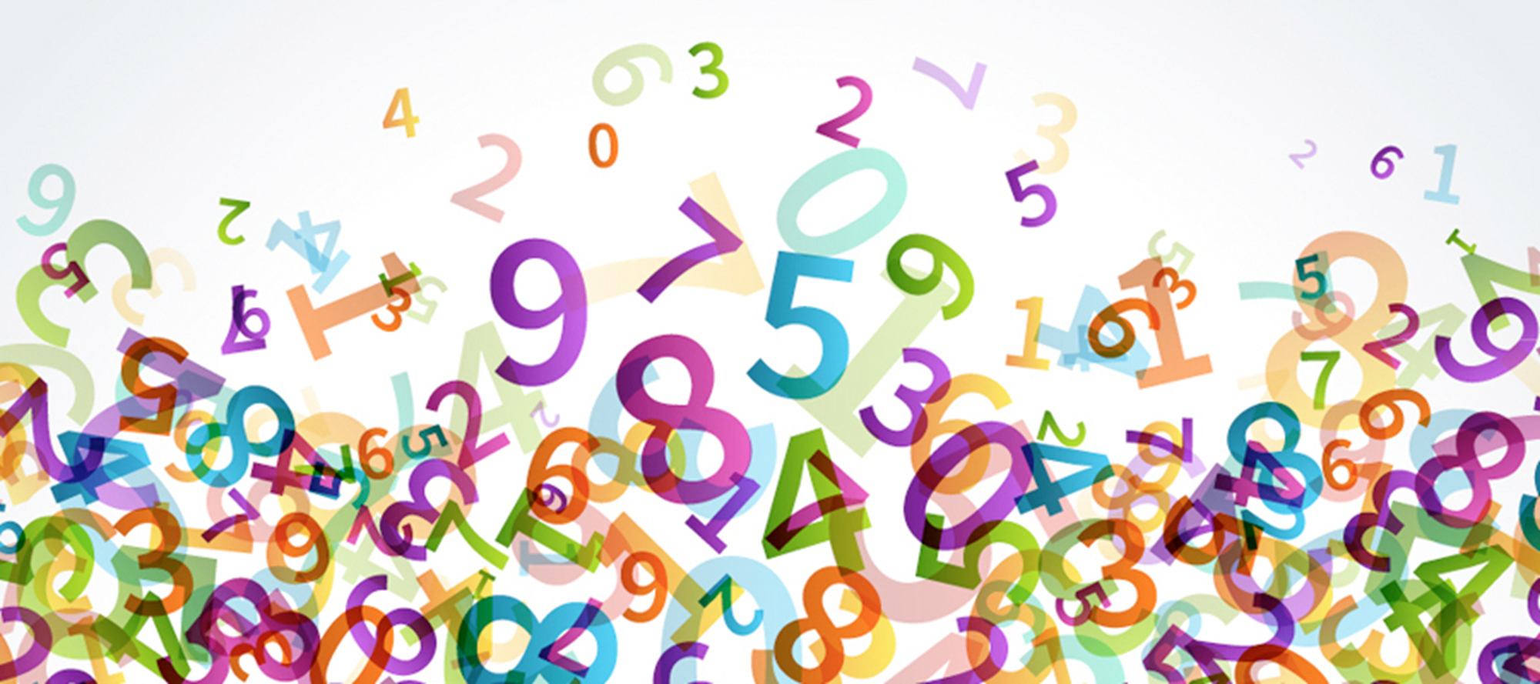
Multiplication Check 2026

Slide 2
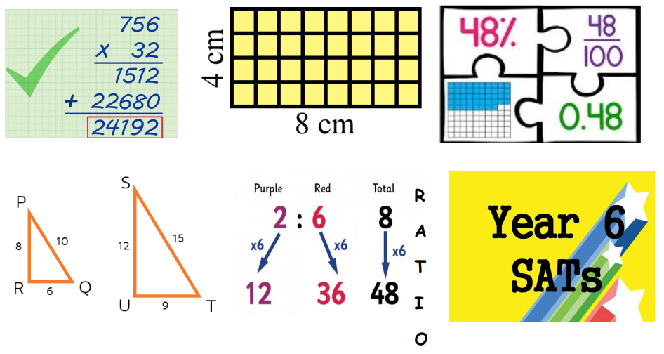
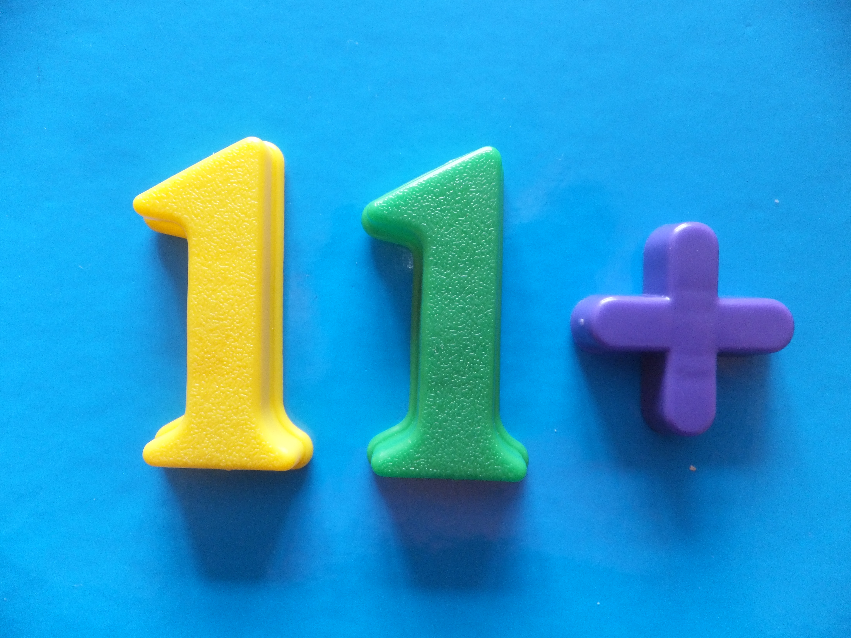
Why are multiplication tables important?

Slide 3

What is the purpose of the multiplication check?
The purpose of the check is to determine whether your child can fluently recall their times tables up to 12 X 12, which is essential for future success in mathematics.
It will also help us identify if your child may need further support.

Slide 4

What is the multiplication check?
The check is taken in June – Year 4
(1st – fortnight)
It is an on-screen check consisting of 25 times table questions.
There is an initial practice session where the children run through a whole test – this will be a few days before the actual assessment.
Your child will then be able to answer 3 practice questions before taking the actual check.
They will then have 6 seconds to answer each question.
On average, the check should take no longer than 5 minutes to complete.

Slide 5
Are there any access arrangements?
There are several access arrangements available for the check, which can be used to support pupils with specific needs. Your child’s teacher will ensure that the access arrangements are appropriate for your child before they take the check in June.
The check was designed to be inclusive and accessible to as many children as possible, including those with special educational needs or disability (SEND) or English as an additional language (EAL).
However, there may be some circumstances in which it will not be appropriate for a pupil to take the check, even when using suitable access arrangements. If you have any concerns about your child accessing the check, you should discuss this with your child’s teacher.

Slide 6

How will the results be used? Will I know my child’s result?
There is no pass mark.
Schools will have access to all their pupils’ results, to allow them to identify pupils who need additional support.
You will be told your child’s result in their end of year report.

Slide 7
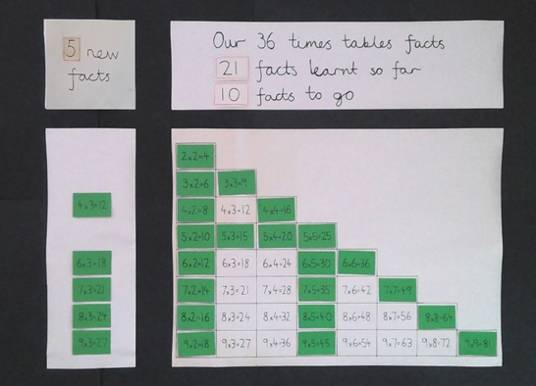
Are times tables taught in school?
Usual maths lessons have multiplication and division units.
Maths fluency sessions delivered three times a week using a structured times‑tables programme.
Children learn key facts e.g. 9 x 3 = 27
From that they will know:
3 x 9
27÷3
27÷9
Children tested on tables and work to improve/ maintain their score each time.

Slide 8

How can I help?
Support your child to know their times tables.
Stress to your child the importance of the check and why they need to know it.
Little and often! Last minute puts your child under pressure.
Plenty of regular daily practise is key.
A wide range of times‑tables practice, including verbal recall, written activities and online games.

Slide 9
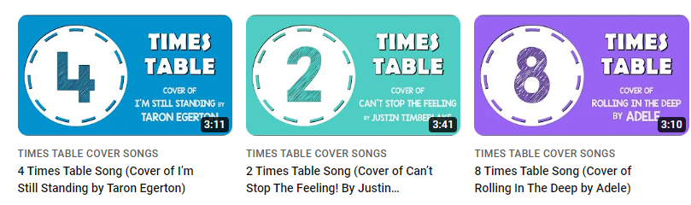
Times Tables
Children should practise their times tables every day, and there are many different ways they can do this.
-Songs
-Chanting
-Quick fire questions
-Games (e.g. Hit the button)

Slide 10
1. Timestables.co.uk – MTC Simulator
A free, accurate imitation of the real 25‑question check with 6‑second timers.
🔗 https://www.timestables.co.uk/multiplication-tables-check
2. Times Table Kids – Free MTC Practice Tool
Child‑friendly, motivational, timed questions mirroring the official format, with certificates and instant feedback.
🔗 https://timestablekids.com/multiplication-table-check
3. Hit the Button
Hit the Button is great because it builds rapid recall of number facts through fast‑paced, engaging practice that motivates children to improve their accuracy and speed.
🔗 https://www.topmarks.co.uk/maths-games/hit-the-button

Slide 11
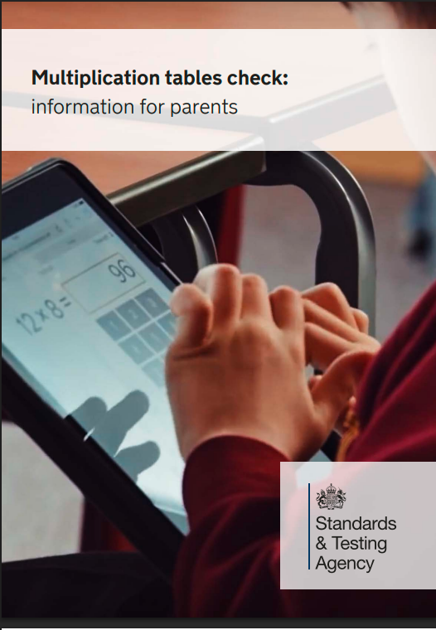
This document will be sent out to all parents in Year 4 to give you some information on the MTC.
https://www.gov.uk/government/publications/multiplication-tables-check-information-for-parents/multiplication-tables-check-information-for-parents-text-version--2

Slide 12


