Slide 1
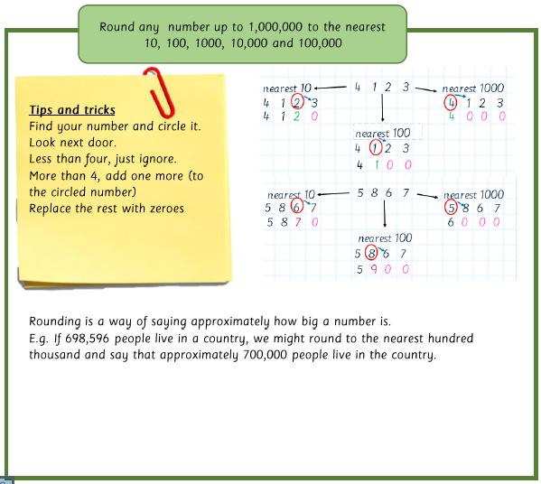
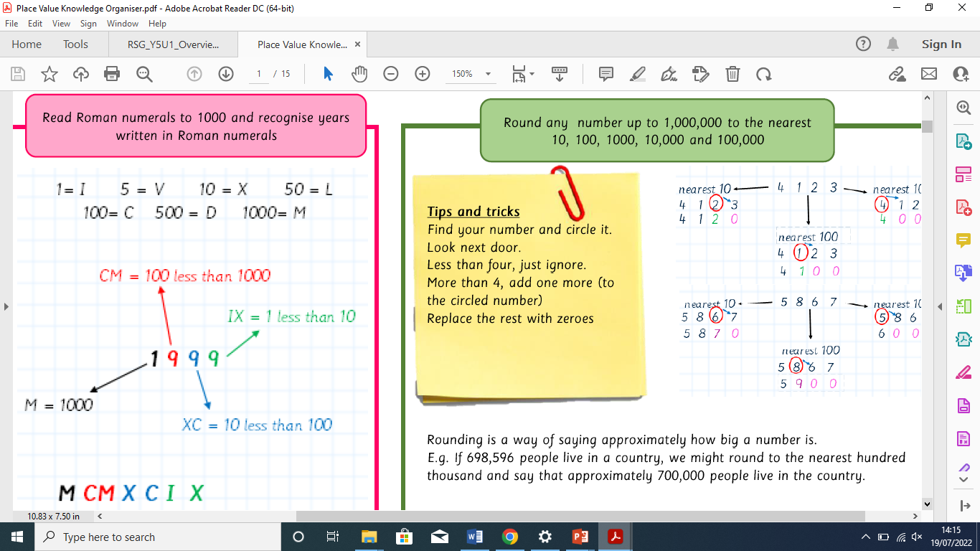
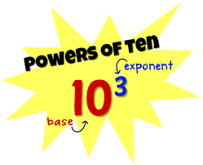
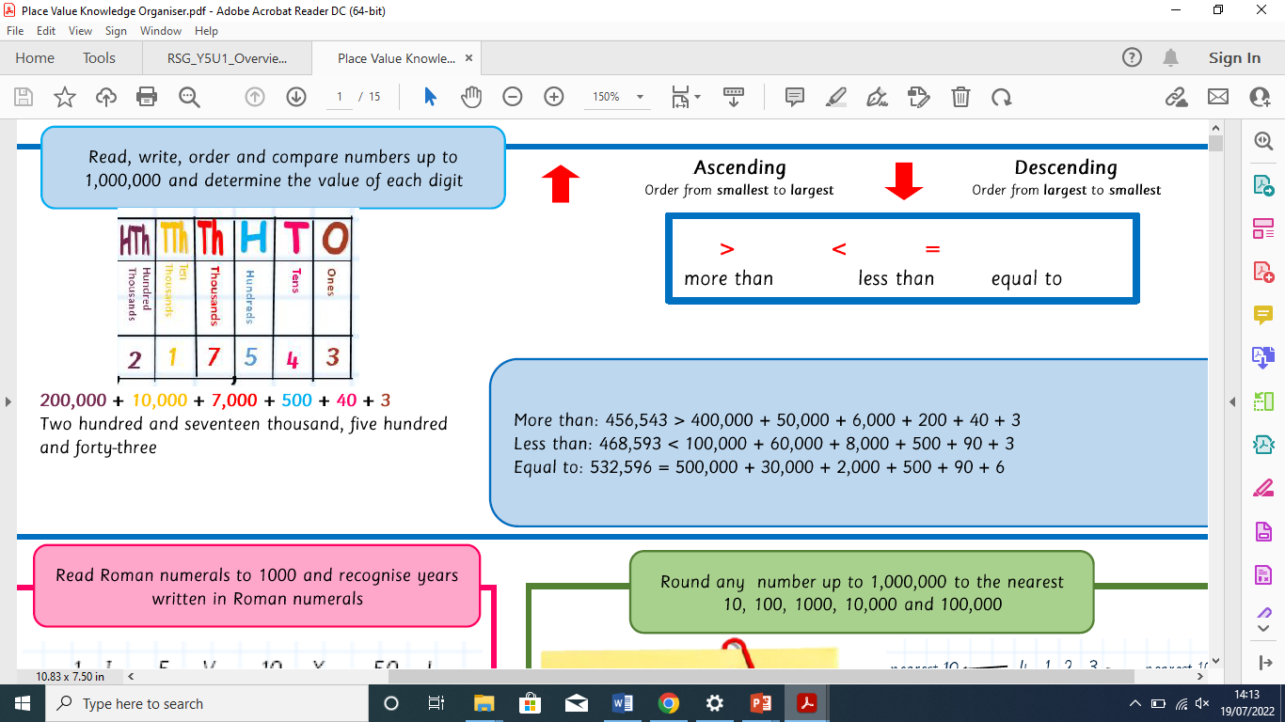
YEAR 5 - Place Value
Key Vocabulary
Value | Tens
Hundreds | Thousands
Ascending | Descending
Digit | Order
Numeral | Equal
Rounding | Compare

