Slide 1


Welcome to Lower Key Stage 2
St. Joseph’s School
Love, Learn, Grow

Slide 2

Our School Prayer
St. Joseph’s is our school.
Teach us Lord, to Love, Learn and Grow together.
Just as you guided your beloved son, Jesus.
Open our hearts to your plans for us and
Show us your path to follow.
Each day, help us to feel your presence among us,
Protecting us on our journey.
Holy Spirit be with us.
St. Joseph pray for us.
Amen

Slide 3
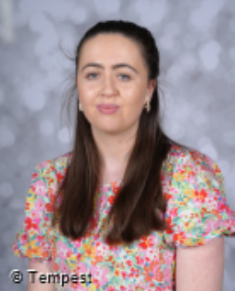
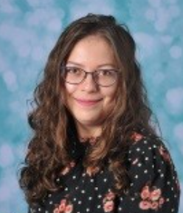
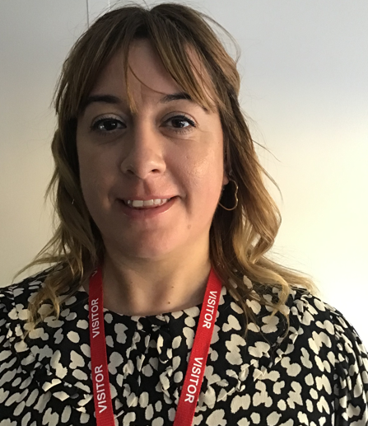
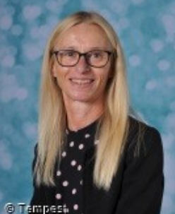
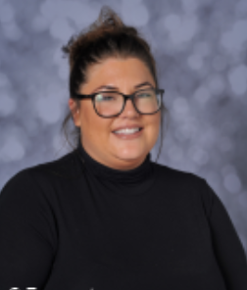
Year 3 Teachers
Miss Boyce
Mrs Szczupak
Teaching Assistants
Miss Mulqueen
Mrs Ledgar
Ms Williams

Slide 4
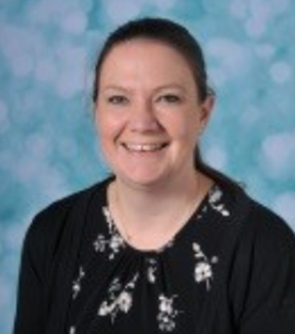
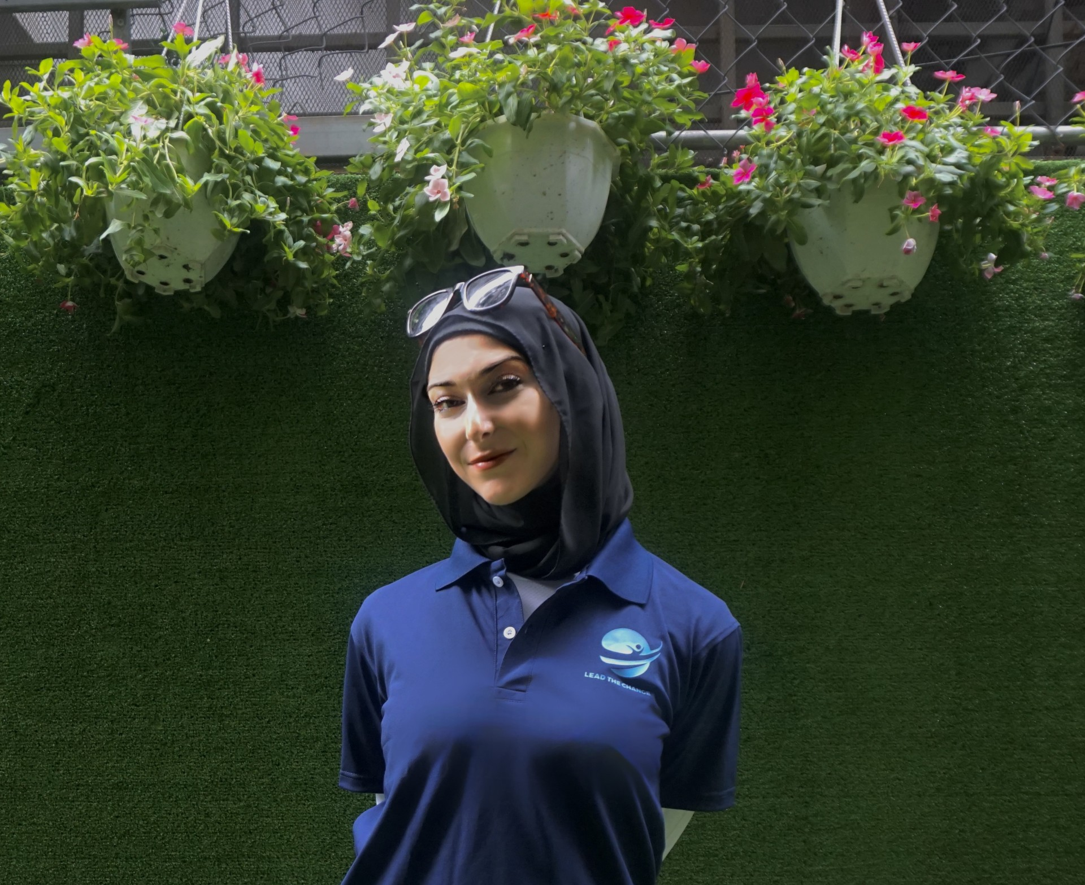
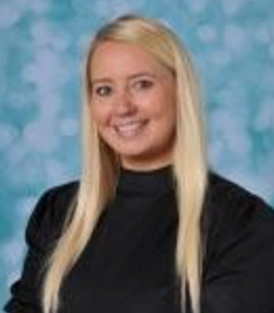
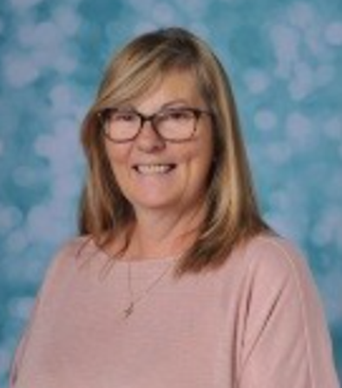
Year 4 Teachers
Mrs Fallon
Miss Kennedy (Student teacher)
Mrs
Sheppard
Mrs Ford

Slide 5
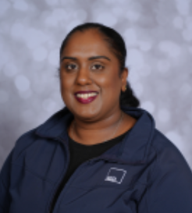
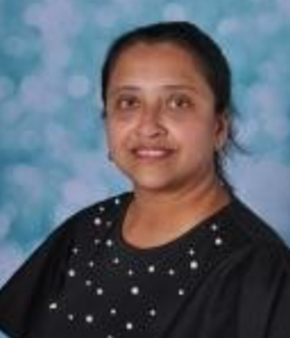
Year 4 Teaching Assistants
Mrs O’Farrell
Mrs Gupta

Slide 6
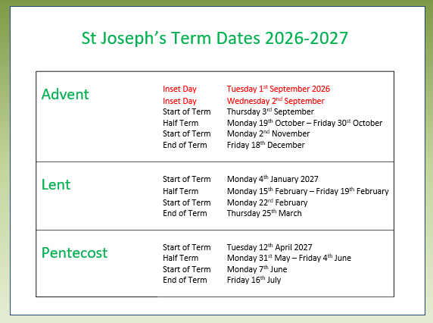

Slide 7

See website for full curriculum overviews

Slide 8

Our Learning Characteristics

Slide 9
Key Dates
Year 3 Dates | Events
3S Class Assembly Chiltern Open Air Museum 3B Class Assembly Year 3 Assembly National Portrait Gallery | 14.10.26 15.10.26 03.03.27 18.05.27 TBC
Year 4 Dates | Events
4F Class Assembly 4FS Class Assembly Woodrow Egyptian Day Carol Concert Passion Play Year 4 Assembly | 06.10.26 02.02.27 24.03.27-25.03.27 TBC 15.12.26 (TBC) 17.03.27 (TBC) 27.04.27

Slide 10
Forest School Dates
3S | 3B | 4F | 4SF
11.09.26 18.09.26 25.09.26 08.01.27 15.01.27 22.01.27 14.05.27 21.05.27 28.05.27 |  | 27.11.26 04.12.26 11.12.26 16.04.27 23.04.27 30.04.27 07.05.27 18.06.27 25.06.27 02.07.27
Key information about Forest School:
Waterproofs Wellies Warm clothes (hats, gloves, scarf) Spare named bag (for muddy clothes)

Slide 11
Sports Afternoons
Year 3
02.10.26 29.01.27 30.04.27
Year 4
06.11.26 12.02.27 14.05.27

Slide 12
Parent Drop In Evening Advent Term 1
Monday 28th September 3.30- 4.30pm Year 4 Tuesday 29th September 3.30- 4.30pm Year 3
You do not need to book Come in off the playground Chance to catch up with the teacher Look at books Keep teacher informed about things Raise a concern
Parents’ Evening Advent Term 1
Tuesday 13th October 3.45 - 6.45pm Wednesday 14th October 4.15 - 7.15pm

Slide 13


Curriculum Year 3
See website for full curriculum overviews

Slide 14

Curriculum Year 4
See website for full curriculum overviews

Slide 15

A typical week…
Writing and Maths daily
Reading lessons
SPAG (spelling / grammar)
Humanities (History/Geography)
RE x 2 per week
Assemblies -whole school Monday, Celebration on Friday and Phase Assembly or Open the Book on Thursday
Music, computing, Spanish, PE x 1 per week (additional Sports afternoons)
PSHE Day each half term
Art/D&T week each half term

Slide 16

Expectations
For a safe and happy school, we are expected to: Arrive at school on time. Take pride in our school building. Wear our school uniform with pride. Look after our belongings. Be truthful, well-mannered and kind. Act responsibly and set a good example for others. Take responsibility for our actions in school, on trips and online. Keep our school litter free. Exercise self-control.

Slide 17


Tough Ten
Given out on a Wednesday and due back the following Wednesday. To be marked by parents/carers each week.

Slide 18

KIRFs

Slide 19
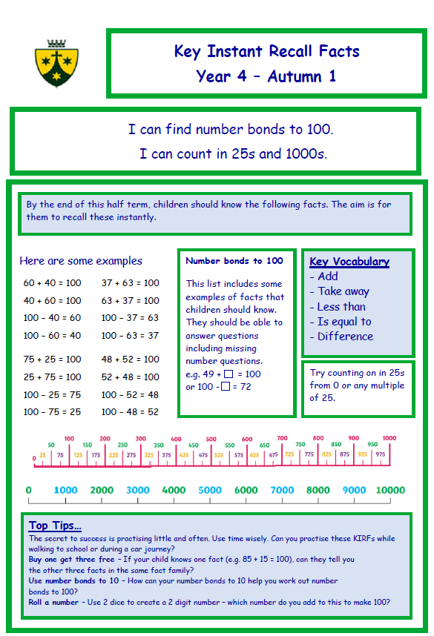

Slide 20
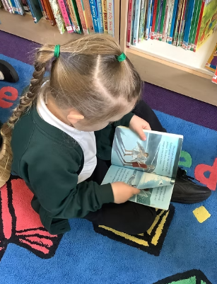
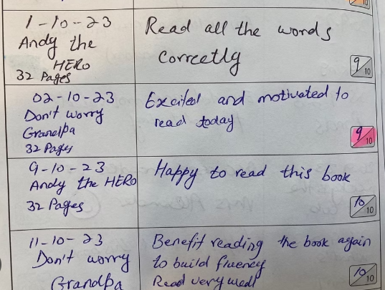
Daily Reading at home – completing the Reading Record
All pupils must read every evening –This must be recorded in the Reading Record daily.
Children will be tested in school every half term on Accelerated Reader.
They are also expected to complete an Accelerated Reader Test every time they finish a book (at least once a month).

Slide 21

Stationery
2 pencils
Pencil sharpener
30cm ruler
Blue handwriting pen (not biro)
Purple pen
Whiteboard pen
Pritt Stick
Eraser
Pack of coloured pencils
Small scissors
All items to be clearly labelled
Pencil cases should be small enough to fit inside their tray
(no Smiggle pencil cases please).

Slide 22


Stationery Shop is open every morning
Key Stage 1 Hall Door

Slide 23
End of day procedures
Passwords - to be confirmed with new class teacher – important for other people collecting your child. Assumed that other adults having this information is permission to release children.
Contact details updated via the school office if there are any changes.
Children will only be released to those over the age of 16 (Years EYFS – Year 4).

Slide 24
Key Information
Label school uniform and PE kits (including bags).
Appropriate clothing for the season (coat, sunhat etc.)
Children in KS2 can bring fruit/veg for a break time snack. This should be in their school bag not in their lunchbox.
Water bottle (reusable / no juice).
Reading books in school every day

Slide 25
Working Together
Uniform
Reading daily- encourage accelerated reader quizzes
Providing PE kit (Y3 – Tuesday and Wednesday/Y4 Swimming kit Wednesday)
Homework support
Independence

Slide 26
 | Uniform Key Stage 2 (Year 3 – Year 6) Item | Available from
Winter | Half Term Advent (Oct) – start of Pentecost Term (after Easter)
 | Dark green V-necked jumper with school crest | Earth Website
 | Dark green tie with thin gold double stripe | Earth Website
 | White cotton shirt | Any stockist
 | Dark grey full-length school trousers (formal straight trousers / not jersey) / Dark grey pleated, full or A-line knee-length skirt or pinafore | Any stockist
 | Dark grey or white knee/ankle socks or tights (no branded logos) | Any stockist
Summer | Black shoes (no branded logos) Start of Pentecost Term (after Easter) - Half Term Advent (Oct) | Any stockist
 | Dark grey knee length school shorts (formal straight / not jersey) / Dark grey full-length school trousers (formal straight trousers / not jersey) / Dark grey pleated, full or A-line knee-length skirt or pinafore White cotton shirt (worn with school tie) School tie (if wearing a cotton shirt) White polo shirt with or without school crest (worn without school tie) Dark green and white full gingham dress Dark grey or white knee / ankle socks or tights (no branded logos) Dark Green Baseball cap / Kepi cap with or without school crest Black shoes (no branded logos) No all in ones or playsuits are permitted | Any stockist Any stockist Earth Website Earth Website / Any stockist Any stockist Any stockist Earth Website / Any stockist Any stockist
Outdoor Wear
 | Black / navy coat (plain – no branded logos) | Any stockist
 | Dark green shower-proof jacket or fleece with school crest | Earth Website
PE and Games
 | Dark green gym bag with school crest | Earth Website
 | Black (plain – no branded logos) loose fitting shorts | Any stockist
 | Green T-shirt with gold school crest | Earth Website
 | Black (plain – no branded logos) tracksuit bottoms Black (plain – no branded logos) sweatshirt | Any stockist Any stockist
 | Trainers (suitable for sporting activity) | Any stockist
School bag
 | Dark green book bag with school crest (Infants) | Earth Website
 | Dark green rucksack (large) with school crest | Earth Website

Slide 27
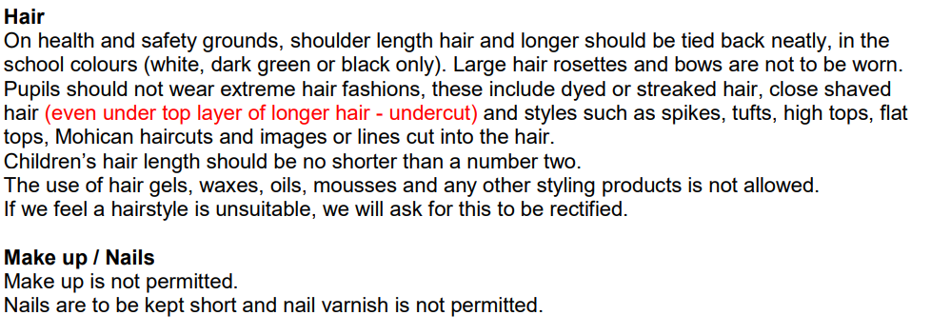
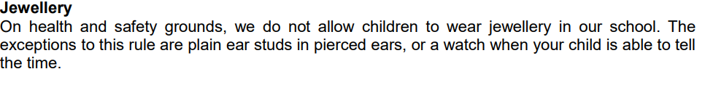
Uniform

Slide 28
Communication with school
Class teacher
EYFS Leader
Mrs Pugsley
Phonics Leader
Mrs O’Kane
Years 1-2 Leader
Mrs Davies
Year 3-4
Leaders
Mrs Fallon
Mrs Sheppard
Years 5-6
Leaders
Miss Minoli
Mrs Gilmour
Assistant Headteacher
Mrs Ford (SENCo/Inclusion/ Safeguarding)
Deputy Headteachers
Mrs O’Kane and Mrs Thomson (Curriculum and Assessment / Behaviour)
Mrs Lovegrove
Headteacher

Slide 29
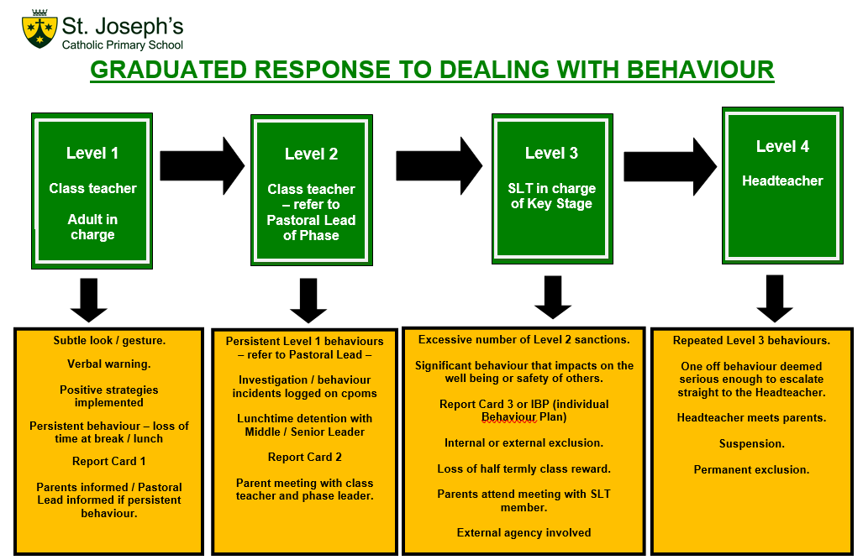
Please see our full Positive Behaviour Policy – on the school website
Notes:
SLT

Slide 30

Raise Your Child’s Attendance,
- Raise their Chances!
High attendance encourages the widest possible opportunities for YOUR child.
Notes:
KS

Slide 31
The Impact of Non-Attendance
95% - 9 days, 50 lessons lost
90% - 19 days, 100 lessons lost
85% - 29 days, 150 lessons lost
80% - 38 days, 200 lessons lost
All children should be in school at ALL times
We do understand that 100% is not always possible due to a child being unwell
Nevertheless, FULL ATTENDANCE should always be the AIM

Slide 32
School Hours
8:30am –
School gates open, all pupils welcomed.
Pupils that arrive at this time have the opportunity to settle in the classroom.
8:45am –
The school gates are closed. The school day has officially started.
8:55am -
Registers are officially closed and sent to Attendance Officer. Any pupils arriving after this time are recorded as late on the register. Pupils with 10 late codes will be invited to a meeting to discuss poor punctuality.
9.00am -
Pupils arriving after 9am will be coded as U, this will be recorded as absent and will affect attendance figure.
3.30pm -
School day finishes and all pupils are expected to be collected on time or prior arrangements made by parents to use the wrap around provisions provided by Busy Living.

Slide 33

Appointments during school time
Taking your child out of school for medical/dental appointments disrupts their learning, along with the learning of rest of the class
Appointments must be booked outside of the school day or during the holiday period
Documentation must be produced, in advance, for any appointments that you wish your child to attend during the school day

Slide 34

Holidays and exceptional circumstance leave
No holidays during term time are allowed, any term time holidays will be recorded as unauthorised and escalated to Buckinghamshire County Council attendance team, where parents will enter an attendance contract and penalty fines will be given, direct from the council
(contracts and fines are not limited to term time holidays, also to persistent absence and persistent lateness).
All holidays need to be taken during the school holidays.
If any leave is required during term time,
due to special circumstance, speak with
the Attendance Officer and we can
discuss further, supporting documents
will be required

Slide 35


Rewards
Weekly Draw
We reward those pupils who do achieve 100% attendance on a weekly basis, with the winner of the draw receiving a goodie bag each Friday.
Grand Prize
Our grand prize draw raffle of a £50 Amazon voucher will also reward those pupils who have full attendance each week during the term.
Both these draws are celebrated during assemblies, with the whole school present.

Slide 36
Information
Attendance Policy is available to view on our website, along with an attendance chart, which outlines the procedures, so that everyone is clear of the process with regards to attendance
01753 887743 / absence@stjosephschalfont.school
Contact before 8:30am if your child cannot attend school, giving the reason. You must contact the school each day your child is absent.
All attendance related queries can be directed straight to the Attendance Officer, preferably after 10am, Monday-Friday.

Slide 37
Dietary & Medical Needs
Inform us immediately of any changes to dietary or medical needs
If we are required to keep medication onsite permanently you will need to complete:
  Healthcare plan and an agreement for administering medication
If we are required to keep medication onsite, short term, for example antibiotics, you will need to complete:
  Agreement for administering medication
All medication must be brought to the school office by an adult, are not permitted to carry any type of medication in their bag.
All medication must be prescribed, in the original packaging and age related.

Slide 38

Takes precedence over everything else in school.
Mrs Ford (Assistant Headteacher) Safeguarding Lead for the school.
Mrs O’Kane and Mrs Thomson (Deputy Headteachers) Deputy Safeguarding Lead for the school.
Mrs Lovegrove (Headteacher) has overall responsibility for Safeguarding.
If you have any safeguarding concerns, please bring them to the attention of one of the members of staff listed above.
Notes:
SLT

Slide 39
Check your emails / texts regularly – this is the main means of communication from school.
Check weekly school newsletter– emailed every Friday.
Check school website https://www.stjosephschalfont.school
Instagram: stjosephscsp
Whatsapp groups are not the schools means of communicating information – often parents putting information on these groups causes confusion and complicates things.
Please use the official means of communication as outlined above.
Drop In Session this half term
Monday 28th September 3.30-4.30pm Year 4
Tuesday 29th September 3.30-4.30pm Year 3
Parents’ Evenings
Tuesday 13th October 3.45-6.45pm / Wednesday 14th October 4.15-7.15pm
Please make every effort to attend coffee mornings / assemblies and key parent workshops on curriculum areas to remain informed and support us and your child.
Parking around School
Please be considerate to the local Residents. Please use the Church carpark and walk up Priory Road.

Slide 40
Supporting Your Child
Read to your child as well as them reading to you
Use knowledge organisers for regular quizzing
Quizzing on Accelerated Reader
The school website has links to additional educational sites and materials that you may wish to access
Teach them to be independent!

Slide 41

St Joseph’s is a school that goes above and beyond for its pupils.
The school ensures that pupils feel valued and that their individual talents are harnessed.
Early reading is expertly taught. Children get off to a flying start with reading as soon as they join the school.
Pupils are happy, and they keenly attend school.
They welcome people from different backgrounds with open arms and treat each other with respect.
The school provides extensive opportunities for pupils. Consequently, they make great strides in their personal development.
They learn to respect everyone regardless of background or beliefs.
Pupils lead the way.
Pupils trust the dedicated and caring staff to look after them.
The school has gone from strength to strength in recent years. Every member of the school community makes sure that pupils receive the highest quality of education.
Pupils become articulate, respectful, well-rounded young people.
The school has high expectations for what pupils can achieve. Pupils work hard to meet these expectations.
They behave exceptionally well and demonstrate highly positive attitudes to learning.
The school embraces equality and diversity. Well-trained, skilled staff waste no time quickly identifying pupils who have special educational needs and/or disabilities.
The school’s curriculum is ambitious, exciting and engaging. It is meticulously designed and delivered.
Pupils have a thirst for learning, immersing themselves in tasks and discussions. They produce high-quality work.
Leaders have a highly accurate picture of the school’s strengths and priorities for further development.
The arrangements for safeguarding are effective.
May 2025

Slide 42

Thank you for coming and for your continuing support.
QUESTIONS

