Slide 1
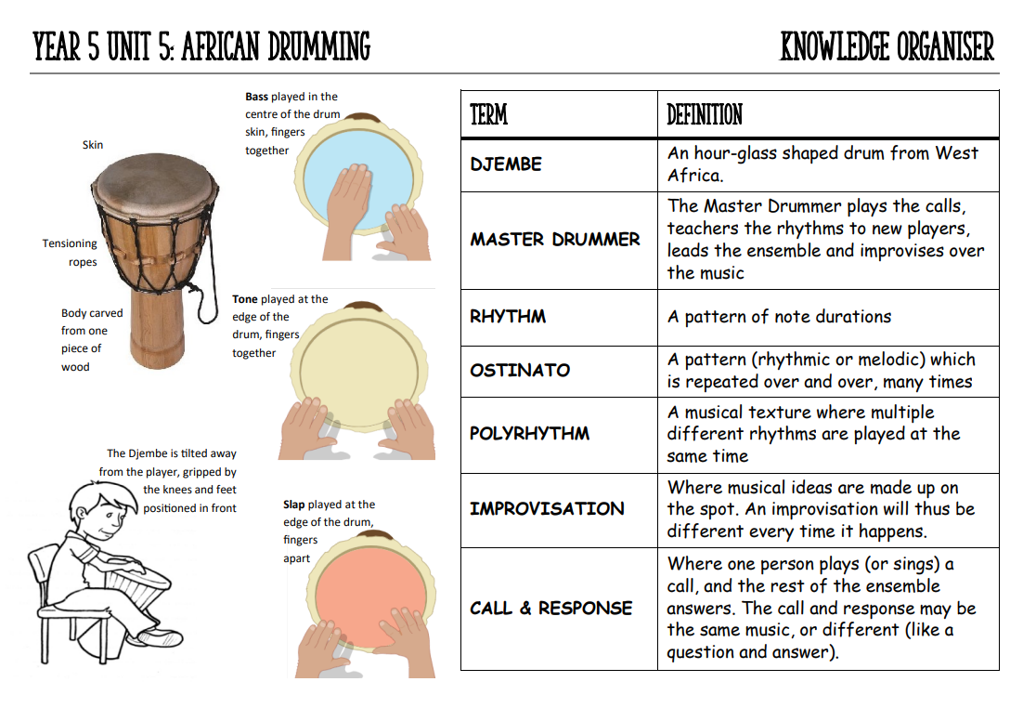
Year 6 – Music Knowledge Organiser – African Drumming

Slide 2
