Slide 1
Welcome!
Love, Learn, Grow
Notes:
CL

Slide 2
Our School Prayer
St. Joseph’s is our school.
Teach us Lord, to Love, Learn and Grow together.
Just as you guided your beloved son, Jesus.
Open our hearts to your plans for us and
Show us your path to follow.
Each day, help us to feel your presence among us,
Protecting us on our journey.
Holy Spirit be with us.
St. Joseph pray for us. Amen
Notes:
CL

Slide 3
Mrs Lovegrove Headteacher
Notes:
CL

Slide 4
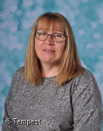
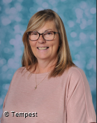
Senior Leadership Team
Mrs O’Kane
Deputy Headteacher
Mrs Ford
Assistant Headteacher / SENDCo
Notes:
CL

Slide 5
Notes:
CL

Slide 6
“The future of the planet lies in the palm of the hands of those adults who have dedicated their lives to young people
– the magic weavers.”
(Sir John Jones)
Notes:
CL

Slide 7
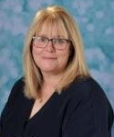
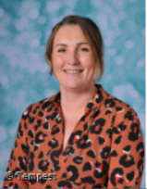
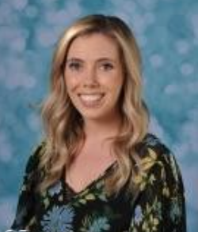
EYFS Team
Mrs Pugsley Mrs McGinty Miss Minoli
Early years Lead St Martin Class St Josephine Bakhita Class
EYFS SENDCo
Notes:
Sarah P

Slide 8
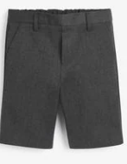
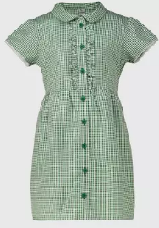
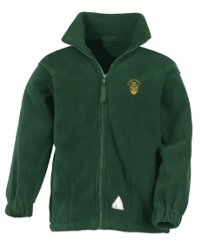
Uniform
All children wear school uniform
https://www.earthuniform.com/
Uniform Shop – Opens every Wednesday and Thursday at 3:30pm
Details on school website
Notes:
Sarah P

Slide 9
What will I need?
Water bottle
Weather appropriate clothing- sun hat, coat.
Change of clothes and underwear.
Reading record/ books- Reception
PE kits- Reception
All items labelled carefully.
Always check your child’s bag at the end of each day.
Notes:
Sarah P

Slide 10
Lunches and information
Children in Reception and Key Stage 1 are entitled to a free hot school meal.
They will be encouraged to select their own meal with the support of an adult.
There is also a salad bar.
We encourage the children to select their own cutlery and carry their own trays.
Children can sit with their friends.
There is a 30min time slot for lunch followed by a 30 mins playtime.
Lunch menus can be found on our school website.
Notes:
Sarah P

Slide 11
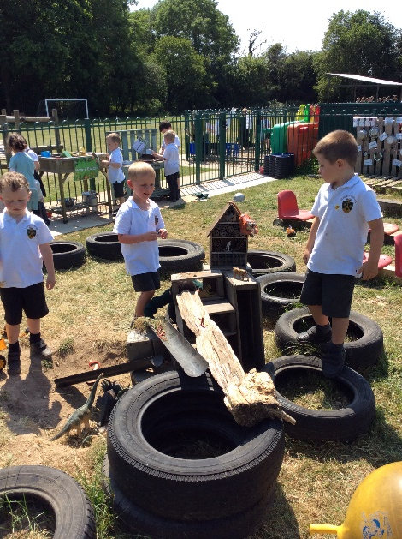
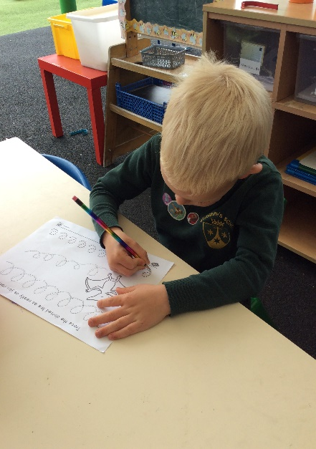
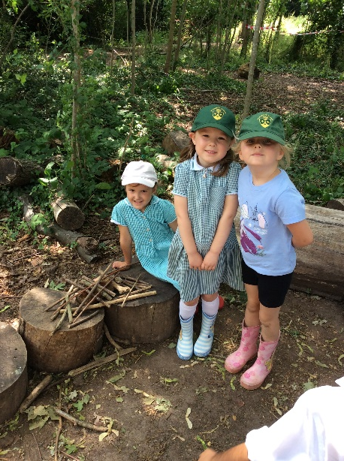
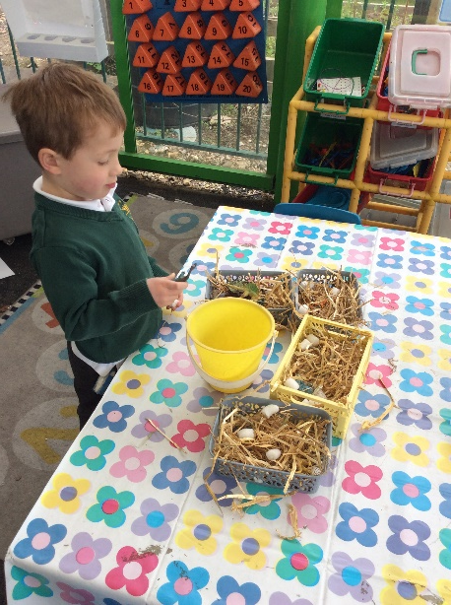
Typical Preschool day
Morning:
8.30- 8.50 am – Children arrive and self registrate
8.50 - 9 am – Morning welcome
9 – 9.30 am - Continuous provision and focus groups
9.30 – 9.45 am – Literacy and Snack time
9.45 – 10.45 am – Continuous provision and focus groups
10.45 – 11.00 am – Maths
11.00 – 11.30 am – Continuous provision and focus groups
11.30 – Tidy up and get ready for lunch/ home time
11.45 – Lunch and home time for morning children
Afternoon:
12.15-3.15 pm – Afternoon session will include maths and literacy recap for afternoon children.
Children attending all day will receive a topic related teaching input.
Big question story time.
Home time.
Notes:
Sarah P

Slide 12
Typical Reception school day
Morning:
8.30- 8.50 am – Children arrive and soft start activity
8.50 - 9 am – Register
9 – 9.30 am - Phonics
9.30 – 9.45 am – Literacy
9.45 – 10.45 am – Continuous provision and focus groups
10.45 – 11.00 am – Maths
11.00 – 11.30 am – Continuous provision and focus groups
11.30 – Tidy up and get ready for lunch
11.45 – Lunch
12.15 – 12.55 – Outside play
1pm – Register
Afternoon:
1pm-3.30pm – Afternoon subjects consist of RE, topic or PE. We have collective worship 2 times a week. We also have our third and fourth continuous provision sessions.
Big question story time.
Home time.
Notes:
Sarah P

Slide 13
Drop off and pick up arrangements
Morning drop off
Main gates open at 8.30am. Parents can walk across the Key Stage 1 playground, to the entrance of the Reception and preschool.
School adults will be around to direct/help parents.
Preschool parents are welcome to walk their child into the classroom and complete self registration.
Reception parents drop off at the classroom door, an adult will be ready to greet your child.
If you wish to bring your child into the classroom (for the first few weeks), you are welcome, but we encourage your child to be as independent as possible.
Pick up Preschool- 3:15pm
Pick up Reception- 3.30pm
Mrs McGinty’s class will be dismissed from their classroom door which is at the far end of the Key Stage 1 playground.
Miss Minoli’s class will be dismissed from the main Reception doors which lead onto the Key Stage 1 playground
Passwords to be confirmed with new class teacher – important for other people collecting your child.
Children will only be released to those over the age of 16 (Years Reception – Year 4).
Notes:
Sarah P

Slide 14
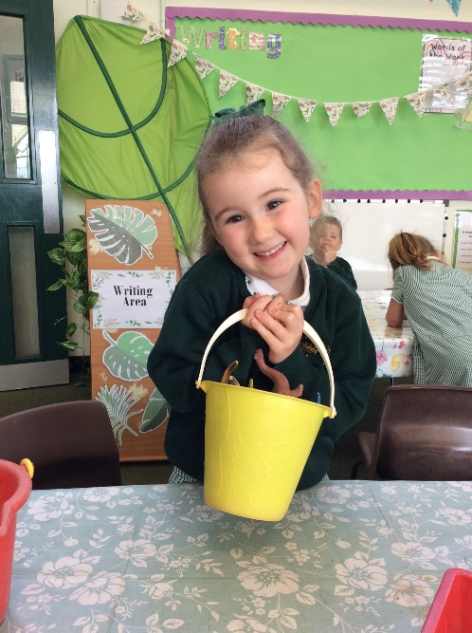
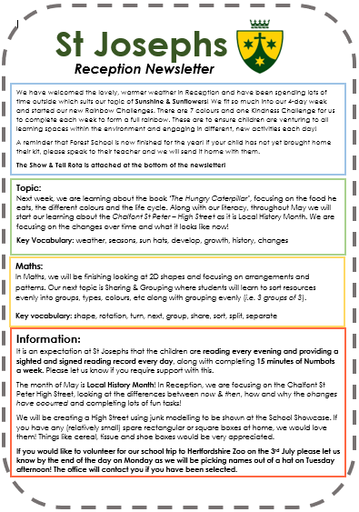
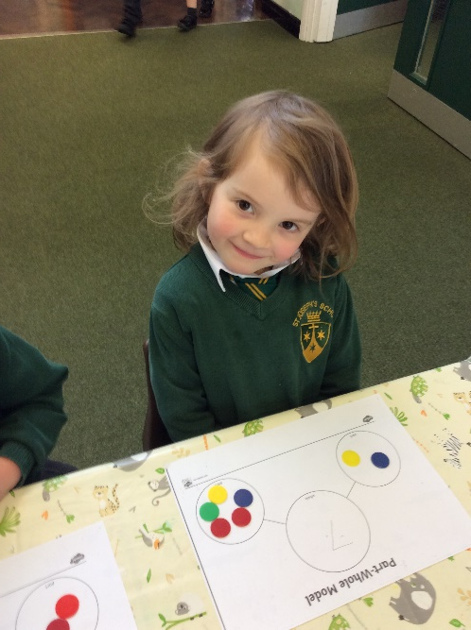
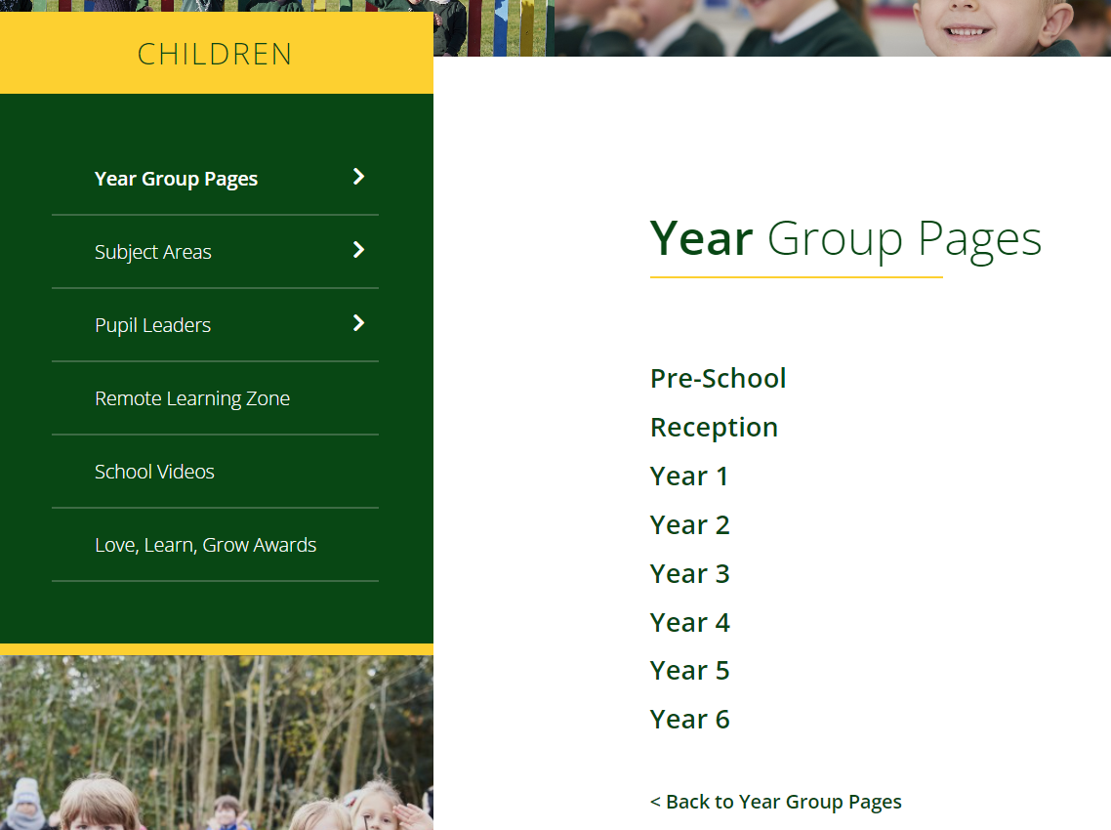
Information about learning
On the website, under the tab ‘children’ you will find the class page. Here you will find curriculum information.
You will receive a newsletter once a week via email. We will celebrate previous learning and will inform you of the focus for your child’s learning over the coming week.
Notes:
Sarah C

Slide 15
Communication with school
You can email or phone the office with any enquires or to arrange an appointment with a member of staff
Class teacher
EYFS Leader
Key Stage 1 lead
Lower Key stage 2 lead
Upper Key stage 2 lead
Deputy Headteacher
Mrs O’Kane (Curriculum and Assessment / Behaviour)
Assistant Headteacher
Mrs Ford (SENCo/Inclusion / Safeguarding)
Mrs Lovegrove
Headteacher
Notes:
Sarah P

Slide 16
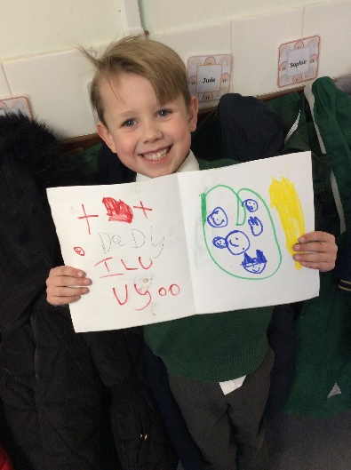
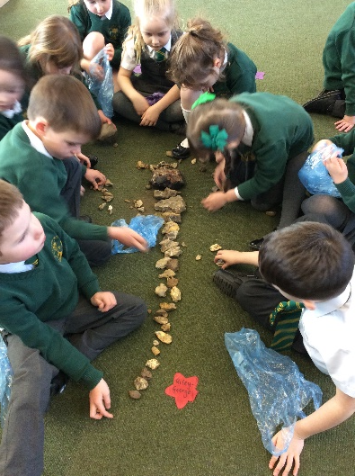
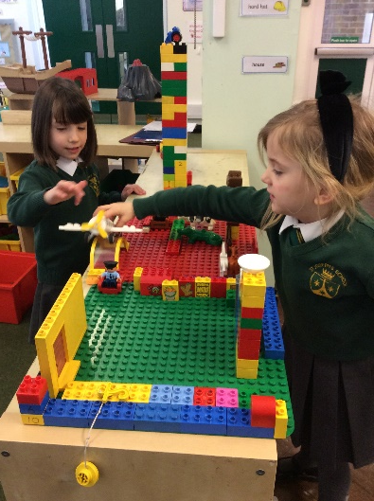
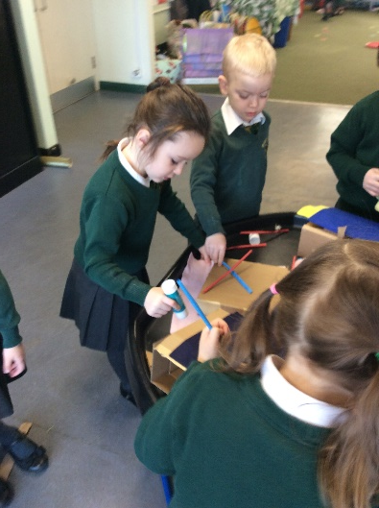
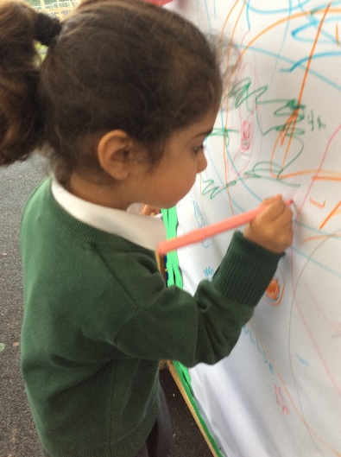
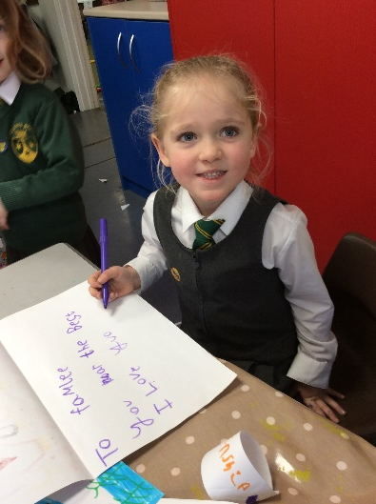
What next….?
Important forms to be completed online will be sent via email by the beginning of July. It will include an admission form which will need to be completed as soon as possible.
Meet the teacher meetings will take place next week.
Notes:
Dalia

Slide 17
What you can do to help your child over the summer?
Conversations
Practise writing their names.
Lots of counting – stairs, sausages, cars, anything!
Read lots of stories, ask them questions about what happened.
Recognise numbers – on doors, shop windows.
Dress themselves.
Be independent in their hygiene.
Practise carrying a plate to the sink, using knife and forks etc.
Notes:
Sarah C

Slide 18
Notes:
CL

Slide 19
We look forward to you joining our Early Years Team in September!
Notes:
CL

