Slide 1
Welcome to Early Years
St. Joseph’s School
Love, Learn, Grow

Slide 2
Our School Prayer
St. Joseph’s is our school.
Teach us Lord, to Love, Learn and Grow together.
Just as you guided your beloved son, Jesus.
Open our hearts to your plans for us and
Show us your path to follow.
Each day, help us to feel your presence among us,
Protecting us on our journey.
Holy Spirit be with us.
St. Joseph pray for us.
Amen

Slide 3
At ST JOSEPH’S WE LOVE, LEARN AND GROW TOGETHER!
LOVE | LEARN | GROW
Love of our faith | Learn about our faith and Jesus | Spiritually
Love of Learning | Achieve our potential | Academically
Love life/the world | Learn from our mistakes | Morally
Love ourselves | Learn who we are / who I am | Confidently
Love others | Learn from others | Socially

Slide 4
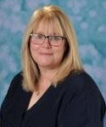
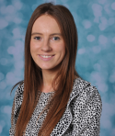
EYFS Team
Mrs Pugsley
Pre School Teacher
St Joseph’s
EYFS Lead
EYFS SENCo
Mrs Attia
Reception Teacher
St Martin
Mrs Barugh
Reception teacher
St Josephine

Slide 5
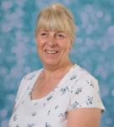
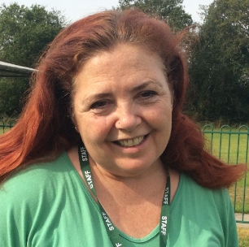
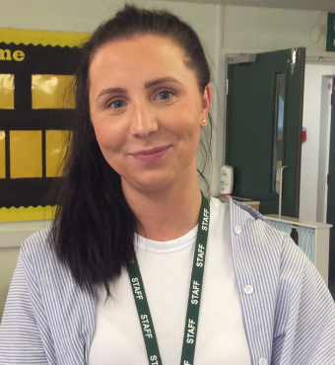
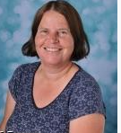
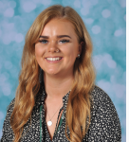
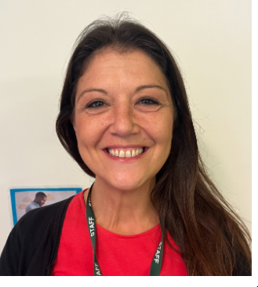
EYFS Team
Mrs Hart
Higher Level
Teaching Assistant
Mrs Sweeney
Teaching Assistant
Mrs Breen
Teaching Assistant
Mrs Woods
Teaching Assistant
Mrs Bentley
Higher Level Teaching Assistant
Miss Edwards
Teacher Assistant
Mrs Ruth
Teaching Assistant
Miss Morris
Teaching Assistant

Slide 6
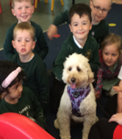
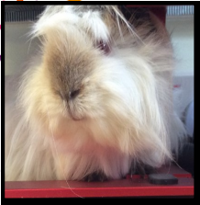
Most popular members of staff
Minnie
Joey
Cazza and Tish-tish

Slide 7
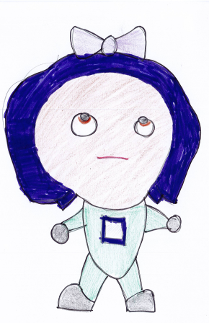
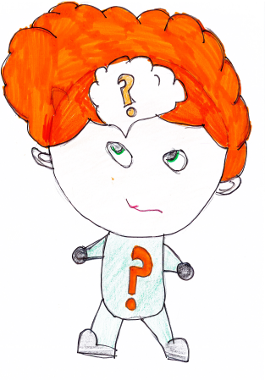
Our Learning Characteristics
Bounce-back Beth
Reflective Rose
Independent Ian
Teamwork Tim
Curious Chris
Motivated Millie

Slide 8
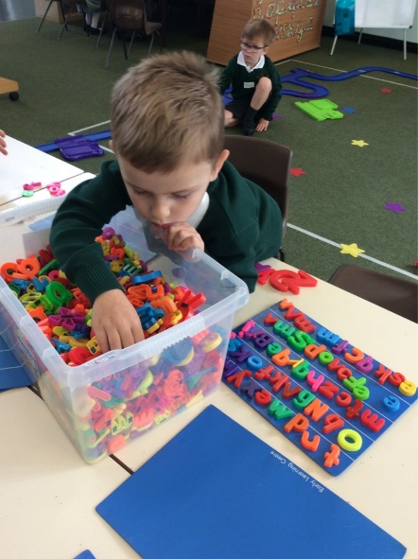
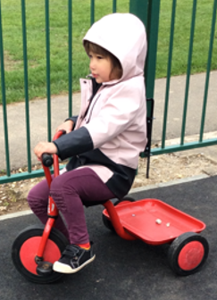
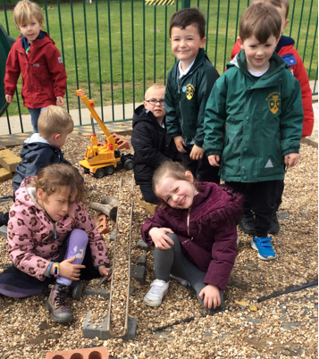
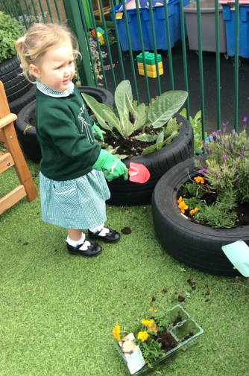
Curriculum
The outdoor learning environment is an essential extension of the indoor learning environment and is considered to be of equal importance.
There are 7 areas of learning. These are broken into-
Three prime areas:
Personal, social and emotional development
*Self regulation
*Managing self
*Building relationships
Communication and language
*Listening, attention and understanding
*Speaking
Physical development
*Fine motor skills
*Gross motor skills

Slide 9
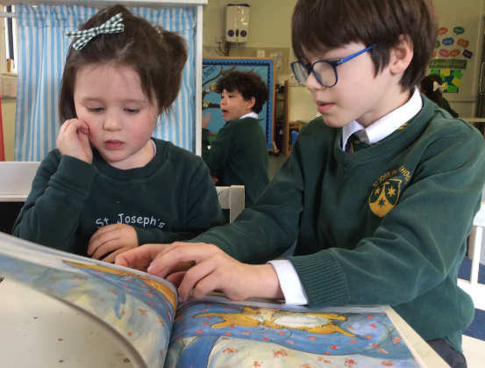
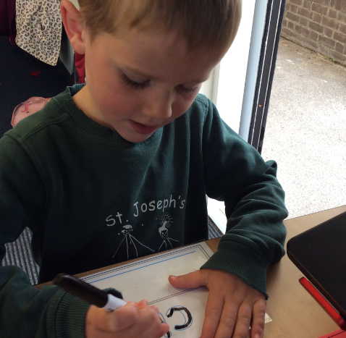
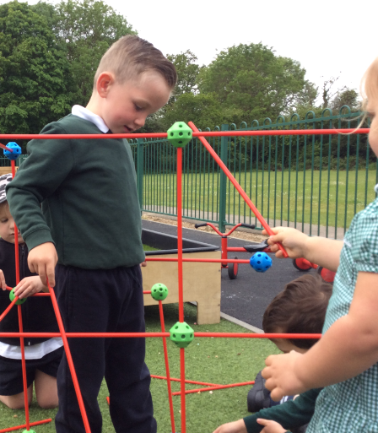
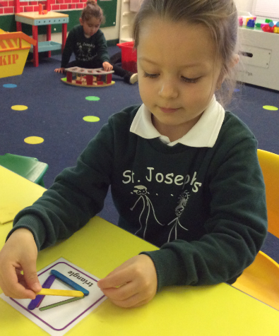
Four specific areas:
Literacy
*comprehension
*Word reading
*Writing
Mathematics
*Number
*Numerical patterns
Understanding the world
*Past and present
*People, cultures and communities
*The natural world
Expressive arts and design
*Exploring and using media and materials
*Being imaginative

Slide 10
Topics
Advent 1 – Me and my community Exploring Autumn
Advent 2 - Once upon a time Sparkle and Shine
Lent 1 – Starry night Winter Wonderland
Lent 2 – Dangerous Dinosaurs Puddles and Rainbows
Pentecost 1 – Sunshine and Flowers Shadows and Reflections
Pentecost 2 - Big Wide World Splash

Slide 11
A typical week in Preschool
Focus text
Star number
A fine and gross motor skill focus
An Art activity
A perfect Poem
Class reading – daily big question
Library visit
Physical activity focus
Child led play through continuous provision
.

Slide 12
A typical week in Reception
Phonics and Funky Fingers daily
English and Maths input and teacher led activity. Continuous provision set up for the week will reflect the learning from our lessons
Topic input and activity three times a week
RE twice a week
Assemblies and Hymn practice
PE once a week

Slide 13
Assessments – baseline currently underway
Targeted groups to develop knowledge of phonic sounds.
Speed recognition / decoding in words and encoding for spelling.
Daily sessions
Parents’ workshop– encourage you to make every effort to attend this session.
Thursday 28th September 6.00pm

Slide 14
Expectations
For a safe and happy school, we are expected to: Arrive at school on time. Take pride in our school building. Wear our school uniform with pride. Look after our belongings. Be truthful, well-mannered and kind. Act responsibly and set a good example for others. Take responsibility for our actions in school, on trips and online. Keep our school litter free. Exercise self-control.

Slide 15
End of day procedures
Passwords to be confirmed with new class teacher – important for other people collecting your child.
Contact details regularly updated via the school office.
Children will only be released to those over the age of 16 (Years EYFS – Year 4).

Slide 16
Key Information
Ensuring children are on time for school and at school every day- school is open from 8.30am (all absences must be reported to the school office via telephone or email by 9am)
Ruck sack containing reading folder every day. (Reception)
Labelled P.E. kit. and school uniform. (Reception)
Named water bottle.(EYFS)
Coat every day (uniform policy). (EYFS)
Wellies in a named bag. (EYFS)
Sun hat and sun cream applied at home in the summer. (EYFS)
No toys from home. (EYFS)

Slide 17
Term Dates 2023 / 2024
Advent Term | Tuesday 5th September – Wednesday 20th December Half Term Monday 23rd October – Friday 3rd November Welcome Liturgy – Monday 16th October 1:45pm Thursday 28th September 6.00pm – RWInc (Reception) Visits from Special people in our community - TBC
Lent Term | Wednesday 3rd January – Thursday 28th March Half Term Monday 12th February – Friday 16th February Living Eggs - TBC
Pentecost Term | Monday 15th April – Friday 19th July Half Term Monday 27th May -Friday 31st May Preschool - Forest School Reception - Willows Farm – TBC

Slide 18
Stronger together

Slide 19
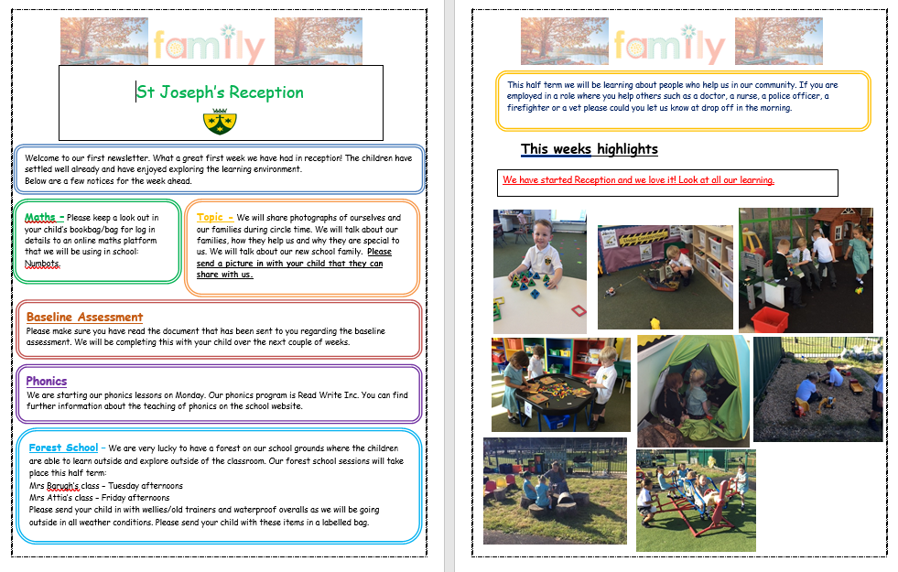
Newsletter

Slide 20
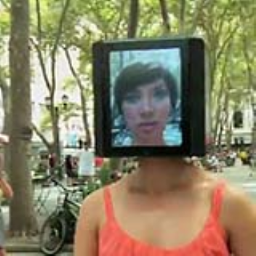
Tapestry
Tapestry- An online journal record children’s home learning and ‘WOW’moments at school.
Website: https://eylj.org/
Provide the school with an
email and we will do the rest!
You will be sent an activation
link.

Slide 21
Logging in to Tapestry
Once we have a valid email for you, you will be sent an activation link. This link will ask you to set up a password and direct you to Tapestry
When logging in you should see a page like this:

Slide 22
How to record learning

Slide 23
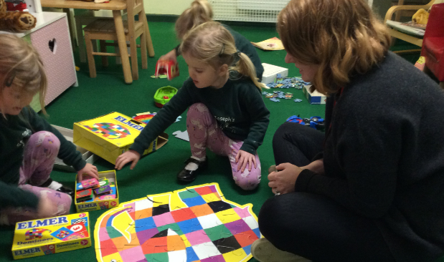
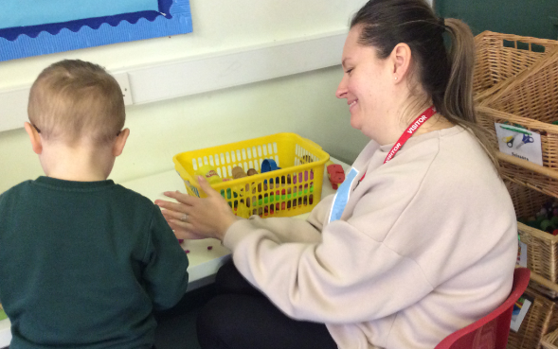
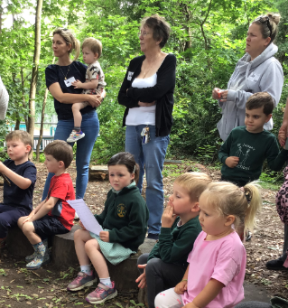
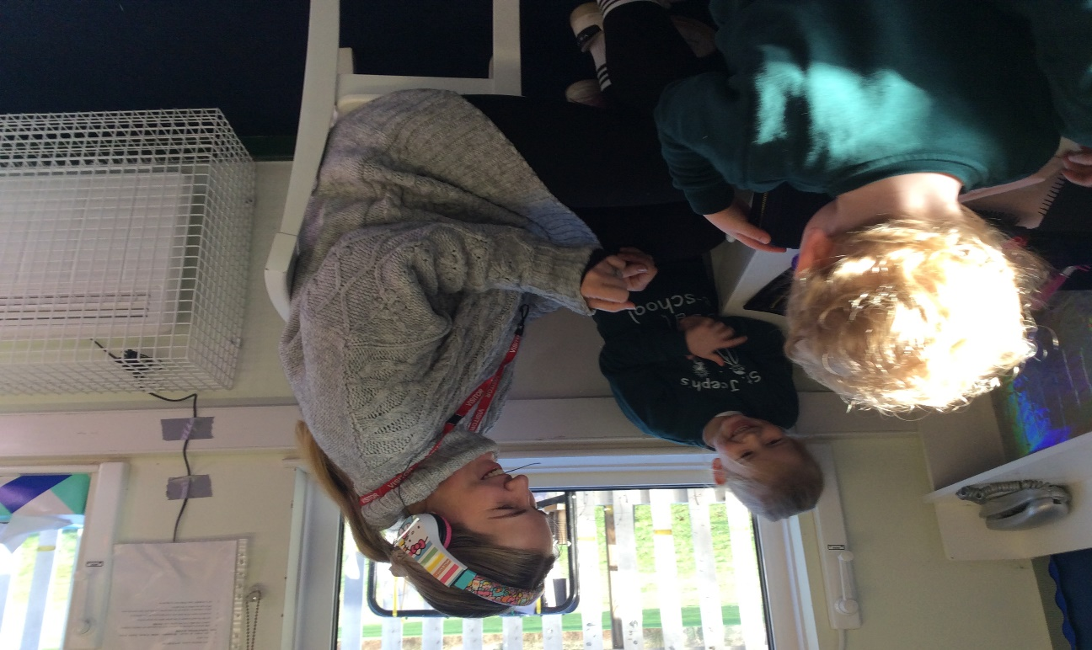
Join the fun!
Stay and play, Time to read, Forest school, trips.

Slide 24
Raise Your Child’s Attendance, -Raise their Chances! High attendance encourages the widest possible opportunities for YOUR child.
What does
“Good attendance”
mean?

Slide 25
Why do children need to come to school?
To receive the best education possible
To learn new and interesting things every day
To develop their social skills
To see their friends and encourage new friendships
To become successful in their future career
Its fun, every day is different!
It’s the law
High school attendance will lead to increased learning and greater achievements and opportunities in life

Slide 26
What is good attendance?
22-23 attendance figure for the school 92%, compared to 93.8% nationally
DFE acceptable level of attendance 96%-100%
Our target figure for 23-24 is 96% for all pupils
Is 90% attendance for the academic year good?

Slide 27
90% attendance is……..
90% attendance = ½ day missed every week!!
Would an employer find this acceptable?
1 school year at 90% attendance = 4 whole weeks of lessons missed

Slide 28
School Hours
8:30am - School gates open, all pupils welcomed.
Pupils that arrive at this time, have the opportunity to talk to their peers and teachers whilst they prepare in good time for their school day.
8:45am - Class register and lunch order is taken. The school day has officially started.
8:55am - Registers are officially closed and sent to Attendance Officer. Any pupils arriving after this time are recorded as late on the register. Pupils with 10 late codes will be invited to a meeting to discuss poor punctuality.
9am - pupils arriving after 9am will be coded as U, this will be recorded as absent and will affect attendance figure.
3pm - School day finishes and all pupils are expected to be collected on time or prior arrangements made by parents to use the wrap around provisions provided by Busy Living.

Slide 29
How does absence affect your child’s progress at school?
95% - 9 days, 50 lessons lost
90% - 19 days, 100 lessons lost
85% - 29 days, 150 lessons lost
80% - 38 days, 200 lessons lost
Before you decide to keep your child absent from school, you must consider;
2 weeks unauthorised, term time holiday, plus 4 days illness, plus 2 days dentist or medical appointments…… already over 100 educational lessons lost!

Slide 30
How can YOU support? Encouragement
Set a good bedtime routine
Be prepared the night before
Have a good morning routine
Be in school at least 5 minutes early, every day, to give your child the time to settle, feel prepared and confident, ready for their school day

Slide 31
Expectations
All children should be in school at ALL times
We do understand that 100% is not always possible due to a child being unwell
Nevertheless, FULL ATTENDANCE should always be the AIM

Slide 32
Appointments during school time
Taking your child out of school for medical/dental appointments disrupts their learning, along with the learning of rest of the class
Appointments must be booked outside of the school day or during the holiday period ( 11 + weeks)
Documentation must be produced, in advance, for any appointments that you wish your child to attend during the school day

Slide 33
Holidays and exceptional circumstance leave
No holidays during term time are allowed, any term time holidays will be recorded as unauthorised and escalated to Buckinghamshire County Council attendance team, where parents will enter an attendance contract and penalty fines will be given, direct from the council
(contracts and fines are not limited to term time holidays, also to persistent absence and persistent lateness).
All holidays need to be taken during the school holidays.
Children are very open, as they should be, and they do tell adults within the school if they have been absent due to a day out, family holiday. Discussions will taken place, to ensure we are coding all absences correctly on the register.
If any leave is required during term time, due to special circumstance, speak with the attendance officer and we can discuss further , supporting documents will be required

Slide 34
Rewards
Weekly Draw
We reward those pupils who do achieve 100% attendance on a weekly basis, with the winner of the draw receiving a goodie bag each Friday.
Grand Prize
Our grand prize draw raffle of a £50 Amazon voucher will also reward those pupils who have full attendance each week during the term.
Both these draws are celebrated during assemblies, with the whole school present.

Slide 35
High Attendance
We aim for at least 96% attendance for every pupil
171 pupils achieved over 96% attendance last year.
341 pupils achieved over 96% attendance last week!
Well done!
High attendance equals:
Widest possible learning opportunities, higher qualifications, more choices in the future
Primary education is the foundation for life long learning!

Slide 36
Information
Attendance Policy is available to view on our website, along with the new attendance chart, which outlines the procedures, so that everyone is clear of the process with regards to attendance
01753 887743 / absence@stjosephschalfont.school
Contact before 8:30am if your child cannot attend school, giving the reason. You must contact the school each day your child is absent.
All attendance related queries can be directed straight to the Attendance Officer, preferably after 10am, Monday-Friday.

Slide 37
Dietary & Medical Needs
Inform us immediately of any changes to dietary or medical needs
If we are required to keep medication onsite permanently you will need to complete:
Healthcare plan and an agreement for administering medication
If we are required to keep medication onsite, short term, for example antibiotics, you will need to complete:
Agreement for administering medication
All medication must be brought to the school office by an adult, no pupil is expected to carry any type of medication in their bag
All medication must be prescribed, in the original packaging and age related

Slide 38
Please see our full Positive Behaviour Policy – on the school website

Slide 39
Communication with school
Class teacher
EYFS Leader
EYFS SENCo
Mrs Pugsley
Years 1-2 Leader
Mrs Fallon
Year 3-4
Leader
Mrs Davies
Years 5-6
Leader
Miss Whelan
Assistant Headteacher
Mrs Ford (SENCo/Inclusion / Safeguarding)
Deputy Headteacher
Mrs O’Kane (Curriculum and Assessment / Behaviour)
Mrs Lovegrove
Headteacher

Slide 40
Takes precedence over everything else in school.
Mrs Ford (Assistant Headteacher) Safeguarding Lead for the school.
Mrs O’Kane (Deputy Headteacher) Deputy Safeguarding Lead for the school.
Mrs Lovegrove (Headteacher) has overall responsibility for Safeguarding.
If you have any safeguarding concerns please bring them to the attention of one of the members of staff listed above.

Slide 41
Check your emails / texts regularly – this is the main means of communication from school.
Check weekly school newsletter– emailed on Friday.
Check school website and twitter account.
https://www.stjosephschalfont.school
https://www.twitter.com/StJosephsCSP
Tuesday 3.00-3.30pm Parent Drop in session
Please make every effort to attend coffee mornings / assemblies and key parent workshops on curriculum areas to remain informed and support us and your child.
Parking around School
Please be aware that the local Residents’ Group
have established a communication channel with the
Chalfonts Neighbourhood Policing Team
reporting all incidents of inconsiderate parking.

Slide 42
Supporting at home
Encourage your child to get dressed independently.
Practise mark making at home if possible. Encourage the children to hold their pencil correctly.
Play games such as I spy to encourage children to start to think about the initial sounds in words.
Play games/ puzzles together to encourage problem solving skills and turn taking.
Sing nursery rhymes together to develop language.
Read a story every night before bed.
Start to sound out words (Fred Talk) such as ‘I can see a c-a-t cat’.
Spend 10mins a day have a 1:1 conversation with your child.
Practise counting e.g. walking up the stairs

Slide 43
Thank you for coming and for your continuing support.

