Slide 1
Welcome to Lower Key Stage 2
St. Joseph’s School
Love, Learn, Grow
Notes:
Karen

Slide 2
Our School Prayer
St. Joseph’s is our school.
Teach us Lord, to Love, Learn and Grow together.
Just as you guided your beloved son, Jesus.
Open our hearts to your plans for us and
Show us your path to follow.
Each day, help us to feel your presence among us,
Protecting us on our journey.
Holy Spirit be with us.
St. Joseph pray for us.
Amen

Slide 3
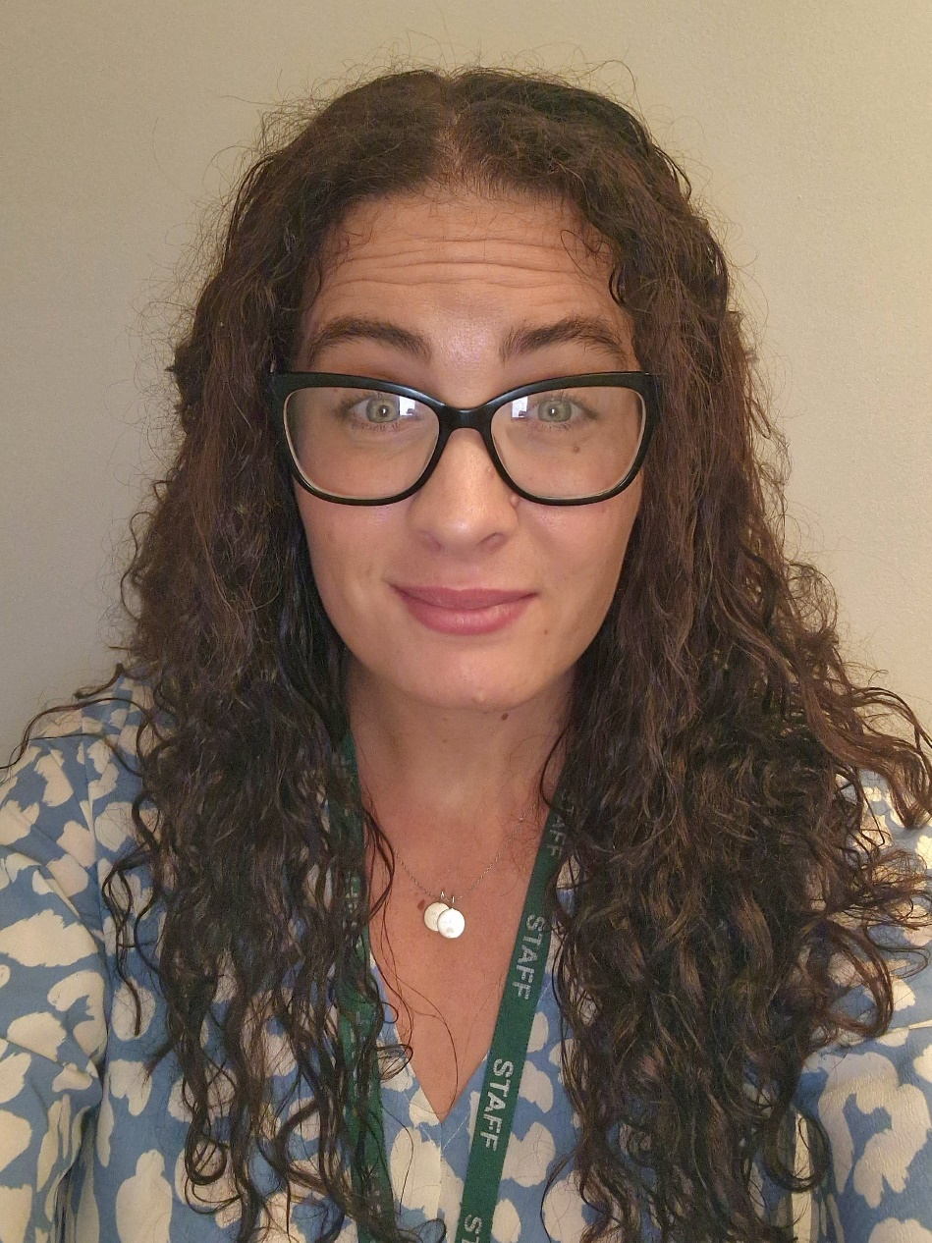
Lower Key Stage 2 Phase Leader Senior Teacher
(Leadership Team of School)
RE Co-ordinator

Slide 4
Term Dates 2023/2024
Advent Term | 5th September – 20th December Half Term Monday 23rd October – Friday 3rd November
Lent Term | 3rd January – 28th March Half Term Monday 12th February – Friday 16th February
Pentecost Term | 5th April – 19th July Half Term Monday 27th May -Friday 31st May
Notes:
Sonia

Slide 5
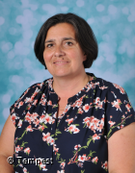
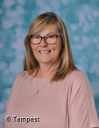
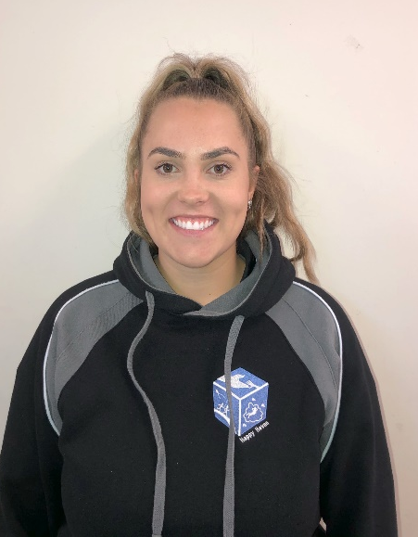
Year 3 Staff Team
Mrs Gilmour Mrs Ford Miss Burston
Supporting Staff
Mrs McGinty
Mrs Carmichael
Mrs Devine
Notes:
Alex

Slide 6
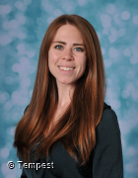
Year 4 Staff Team
Mrs Davies Mrs Hearnden
Supporting Staff
Mrs McGinty
Mrs Soper
Mrs Ledgar
Ms Jaura
Mrs Gupta
Notes:
Alex

Slide 7
See website for full curriculum overviews
Notes:
Donna

Slide 8
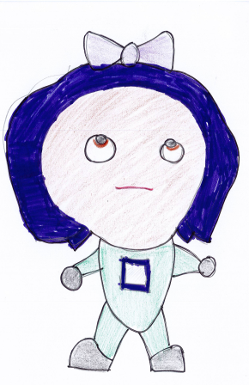
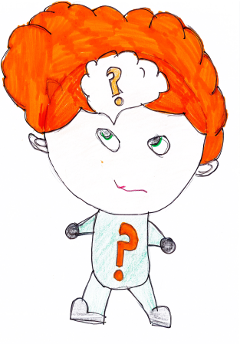
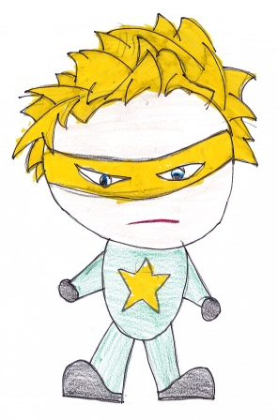
Our Learning Characteristics
Bounce-back Beth
Reflective Rose
Independent Ian
Teamwork Tim
Curious Chris
Motivated Millie
Notes:
Shona

Slide 9
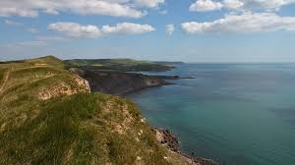
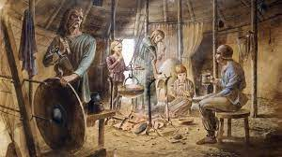
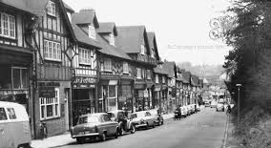
Curriculum - Year 3
See website for termly curriculum overviews
Advent
The Stone Age
Coasts
Lent
The Bronze Age and Iron Age
Climate and Weather
Pentecost
Our World
Local History
Notes:
Gabrielle

Slide 10
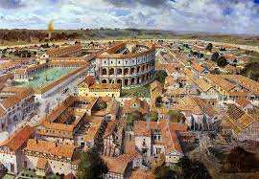
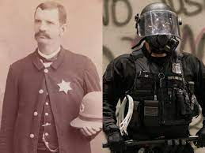
Curriculum - Year 4
See website for termly curriculum overviews
Advent
Rivers and the Water Cycle
Egyptians
Lent
Roman Britain
The Americas
Pentecost
Crime and Punishment
Earthquakes and Volcanoes
Notes:
Gabrielle

Slide 11
A typical week…
Writing (including SPAG) and maths daily
Reading lessons and class reading
Humanities (history/geography)
RE x 2 per week
Science x 2 per week
Assemblies
Music, computing, Spanish, PSHE, Art/D&T and a visit to the library
PE x 1 per week (Year 4 - swimming)
Notes:
Gabrielle

Slide 12
Expectations
For a safe and happy school, we are expected to: Arrive at school on time. Take pride in our school building. Wear our school uniform with pride. Look after our belongings. Be truthful, well-mannered and kind. Act responsibly and set a good example for others. Take responsibility for our actions in school, on trips and online. Keep our school litter free. Exercise self-control.
Notes:
Shona

Slide 13
Notes:
Alex

Slide 14
Key Dates
Year 3 Dates | Events
13.12.2023 18.01.2024 21.03.2024 20.03.2024 16.05.2024 | Carol Concert 7pm 3B Class Assembly Year 3 Assembly Passion Play 7pm 3GF Class Assembly
Year 4 Dates | Events
13.12.2023 25.01.2024 22.02.2024 20.03.2024 23.05.2024 20.06.2024 17th/18th April | Carol Concert 7pm 4H Class Assembly Year 4 Assembly Passion Play 7pm Gurdwara Visit 4D Class Assembly Woodrow High House – Residential Trip
Notes:
Donna

Slide 15
Sports Afternoons
Year 3
16th November 11th January 20th June
Year 4
23rd November 18th January 27th June
Notes:
Gabrielle

Slide 16
Forest School Dates
3GF 3B | 4D | 4H
February/March June/July | January/February June/July
Key information about Forest School:
Waterproofs Change of clothes Wellies Warm clothes (hats, gloves, scarf)
Notes:
Shona

Slide 17
Stationery
Handwriting pen
Pencils
Purple pen
Pencil sharpener
Whiteboard pen
Glue stick
Eraser
Coloured pencils
Solid 30 cm ruler
All items to be clearly labelled
Pencil cases should be small enough to fit inside their tray
(no Smiggle pencil cases please).
Notes:
Alex

Slide 18
WRITING PENCIL: 60p
HANDWRITING PEN: £1
30CM RULER: 50p
PURPLE PEN: 80p
ERASER: 30p
BASIC SHARPENER: 30p
SHARPENER WITH CONTAINER FOR SHARPENINGS: 70p
GLUE STICK (Pritt): £1.50
DRY WIPE MARKER: 70p
Stationery Shop is open every morning at
Key Stage 1 Hall Door
Notes:
Alex

Slide 19
End of day procedures
Passwords to be confirmed with new class teacher – important for other people collecting your child.
Contact details regularly updated via the school office.
Children will only be released to those over the age of 16 (Years Reception – Year 4).
Notes:
Donna

Slide 20
Key Information
Label school uniform and PE kits (including bags).
Appropriate clothing for the season (coat, sunhat etc.)
Children in KS2 can bring fruit/veg for a break time snack.
Water bottle (reusable/no juice).
Year 4 – swimming. This will take place on a Wednesday afternoon during the Advent and Lent Terms.
Notes:
Sonia

Slide 21
Working Together
Uniform/labelled
Reading daily
Providing PE kit (Year 3 on Tuesday/Year 4 Swimming on Wednesday)
Homework support
Support in school – volunteers
Notes:
Alex

Slide 22
Communication with school
Class teacher
EYFS Leader
Mrs Pugsley
Years 1-2 Leader
Mrs Fallon
Year 3-4
Leader
Mrs Davies
Years 5-6
Leader
Miss Whelan
RWInc
Coordinator
Mrs Barugh
Assistant Headteacher
Mrs Ford (SENCo/Inclusion / Safeguarding)
Deputy Headteacher
Mrs O’Kane (Curriculum and Assessment / Behaviour)
Mrs Lovegrove
Headteacher
Notes:
KF

Slide 23
Please see our full Positive Behaviour Policy – on the school website
Notes:
CL

Slide 24
Raise Your Child’s Attendance, -Raise their Chances! High attendance encourages the widest possible opportunities for YOUR child.
What does
“Good attendance”
mean?

Slide 25
Why do children need to come to school?
To receive the best education possible
To learn new and interesting things every day
To develop their social skills
To see their friends and encourage new friendships
To become successful in their future career
Its fun, every day is different!
It’s the law
High school attendance will lead to increased learning and greater achievements and opportunities in life

Slide 26
What is good attendance?
22-23 attendance figure for the school 92%, compared to 93.8% nationally
DFE acceptable level of attendance 96%-100%
Our target figure for 23-24 is 96% for all pupils
Is 90% attendance for the academic year good?

Slide 27
90% attendance is……..
90% attendance = ½ day missed every week!!
Would an employer find this acceptable?
1 school year at 90% attendance = 4 whole weeks of lessons missed

Slide 28
School Hours
8:30am - School gates open, all pupils welcomed.
Pupils that arrive at this time, have the opportunity to talk to their peers and teachers whilst they prepare in good time for their school day.
8:45am - Class register and lunch order is taken. The school day has officially started.
8:55am - Registers are officially closed and sent to Attendance Officer. Any pupils arriving after this time are recorded as late on the register. Pupils with 10 late codes will be invited to a meeting to discuss poor punctuality.
9am - pupils arriving after 9am will be coded as U, this will be recorded as absent and will affect attendance figure.
3pm - School day finishes and all pupils are expected to be collected on time or prior arrangements made by parents to use the wrap around provisions provided by Busy Living.

Slide 29
How does absence affect your child’s progress at school?
95% - 9 days, 50 lessons lost
90% - 19 days, 100 lessons lost
85% - 29 days, 150 lessons lost
80% - 38 days, 200 lessons lost
Before you decide to keep your child absent from school, you must consider;
2 weeks unauthorised, term time holiday, plus 4 days illness, plus 2 days dentist or medical appointments…… already over 100 educational lessons lost!

Slide 30
How can YOU support? Encouragement
Set a good bedtime routine
Be prepared the night before
Have a good morning routine
Be in school at least 5 minutes early, every day, to give your child the time to settle, feel prepared and confident, ready for their school day

Slide 31
Expectations
All children should be in school at ALL times
We do understand that 100% is not always possible due to a child being unwell
Nevertheless, FULL ATTENDANCE should always be the AIM

Slide 32
Appointments during school time
Taking your child out of school for medical/dental appointments disrupts their learning, along with the learning of rest of the class
Appointments must be booked outside of the school day or during the holiday period ( 11 + weeks)
Documentation must be produced, in advance, for any appointments that you wish your child to attend during the school day

Slide 33
Holidays and exceptional circumstance leave
No holidays during term time are allowed, any term time holidays will be recorded as unauthorised and escalated to Buckinghamshire County Council attendance team, where parents will enter an attendance contract and penalty fines will be given, direct from the council
(contracts and fines are not limited to term time holidays, also to persistent absence and persistent lateness).
All holidays need to be taken during the school holidays.
Children are very open, as they should be, and they do tell adults within the school if they have been absent due to a day out, family holiday. Discussions will taken place, to ensure we are coding all absences correctly on the register.
If any leave is required during term time, due to special circumstance, speak with the attendance officer and we can discuss further , supporting documents will be required

Slide 34
Rewards
Weekly Draw
We reward those pupils who do achieve 100% attendance on a weekly basis, with the winner of the draw receiving a goodie bag each Friday.
Grand Prize
Our grand prize draw raffle of a £50 Amazon voucher will also reward those pupils who have full attendance each week during the term.
Both these draws are celebrated during assemblies, with the whole school present.

Slide 35
High Attendance
We aim for at least 96% attendance for every pupil
171 pupils achieved over 96% attendance last year.
341 pupils achieved over 96% attendance last week!
Well done!
High attendance equals:
Widest possible learning opportunities, higher qualifications, more choices in the future
Primary education is the foundation for life long learning!

Slide 36
Information
Attendance Policy is available to view on our website, along with the new attendance chart, which outlines the procedures, so that everyone is clear of the process with regards to attendance
01753 887743 / absence@stjosephschalfont.school
Contact before 8:30am if your child cannot attend school, giving the reason. You must contact the school each day your child is absent.
All attendance related queries can be directed straight to the Attendance Officer, preferably after 10am, Monday-Friday.

Slide 37
Dietary & Medical Needs
Inform us immediately of any changes to dietary or medical needs
If we are required to keep medication onsite permanently you will need to complete:
Healthcare plan and an agreement for administering medication
If we are required to keep medication onsite, short term, for example antibiotics, you will need to complete:
Agreement for administering medication
All medication must be brought to the school office by an adult, no pupil is expected to carry any type of medication in their bag
All medication must be prescribed, in the original packaging and age related

Slide 38
Takes precedence over everything else in school.
Mrs Ford (Assistant Headteacher) Safeguarding Lead for the school.
Mrs O’Kane (Deputy Headteacher) Deputy Safeguarding Lead for the school.
Mrs Lovegrove (Headteacher) has overall responsibility for Safeguarding.
If you have any safeguarding concerns please bring them to the attention of one of the members of staff listed above.
Notes:
Karen

Slide 39
Check your emails / texts regularly – this is the main means of communication from school.
Check weekly school newsletter– emailed on Friday.
Check school website, Twitter account and Facebook page.
Website: www.stjosephschalfont.school
Twitter: @StJosephsCSP
Facebook: St Joseph’s Chalfont St Peter
Tuesday 3.00-3.30pm Parent Drop in session
Please make every effort to attend coffee mornings / assemblies and key parent workshops on curriculum areas to remain informed and support us and your child.
Parking around School
Please be aware that the local Residents’ Group have established a communication channel with the Chalfont’s Neighbourhood Policing Team reporting all incidents of inconsiderate parking.
Notes:
Karen

Slide 40
Supporting Your Child
Read to your child as well as them reading to you
Times tables and number facts
Use knowledge organisers for regular quizzing
Quizzing on Accelerated Reader
The school website has links to additional educational sites and materials that you may wish to access
Encourage independence
Notes:
Alex

Slide 41
Thank you for coming and for your continuing support.

