Slide 1
Welcome to Key Stage 1
St. Joseph’s School
Love, Learn, Grow
Notes:
CL

Slide 2
Our School Prayer
St. Joseph’s is our school.
Teach us Lord, to Love, Learn and Grow together.
Just as you guided your beloved son, Jesus.
Open our hearts to your plans for us and
Show us your path to follow.
Each day, help us to feel your presence among us,
Protecting us on our journey.
Holy Spirit be with us.
St. Joseph pray for us.
Amen
Notes:
CL

Slide 3
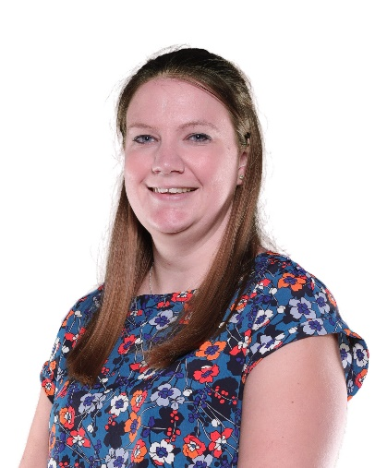
Key Stage 1 Phase Leader Senior Teacher
(Leadership Team of School)

Slide 4
Term Dates 2023 / 2024
Advent Term | Tuesday 5th September – Wednesday 20th December Half Term Monday 23rd – Friday 3rd November
Lent Term | Wednesday 3rd January – Thursday 28th March Half Term Monday 12th February – Friday 16th February
Pentecost Term | Monday 15th April – Friday 19th July Half Term Monday 27th -Friday 31st May

Slide 5
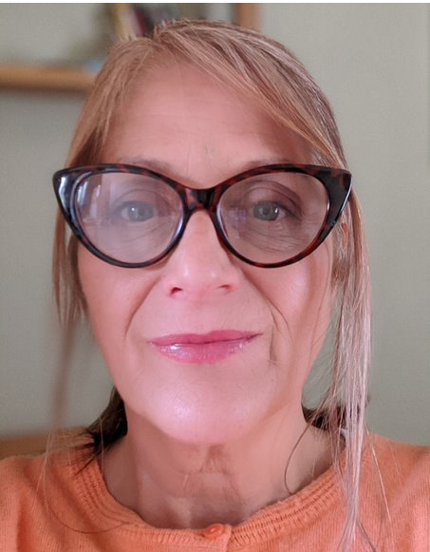
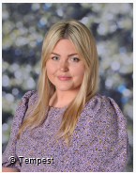
Year 1 Staff Team
Teaching Assistants
Miss Manners
Mrs Morgan
Miss Bailey
Miss Bryan
Notes:
JB

Slide 6
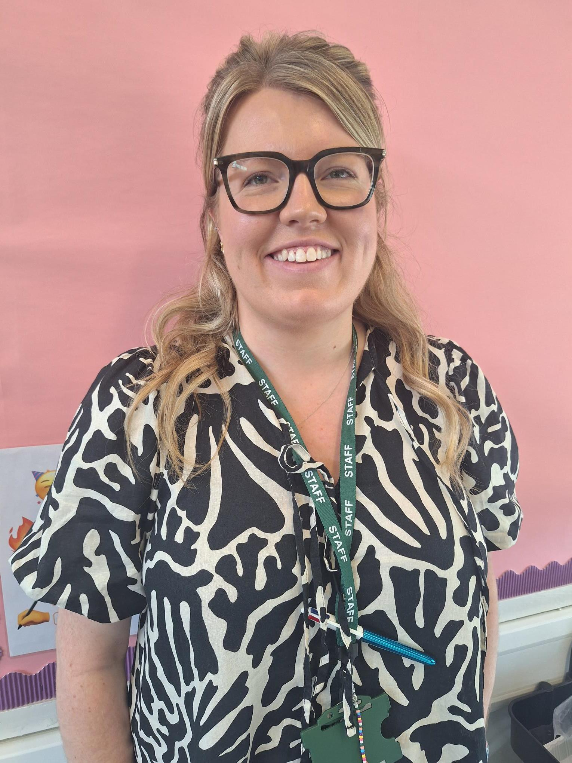
Year 2 Staff Team
Teaching Assistants
Miss Morris
Miss Russell
Mrs Fallon
Miss Eaton

Slide 7
See website for full curriculum overviews
Notes:
KF

Slide 8
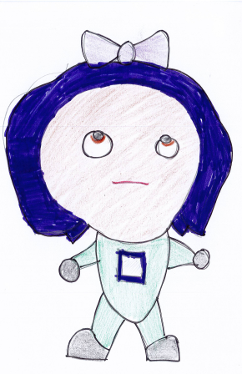
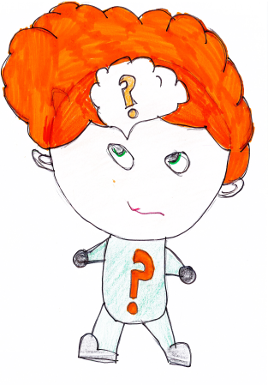
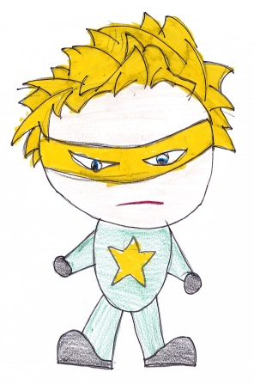
Our Learning Characteristics
Bounce-back Beth
Reflective Rose
Independent Ian
Teamwork Tim
Curious Chris
Motivated Millie

Slide 9
Curriculum Year 1
See website for full curriculum overviews
Advent
World Journeys
Observe changes across the four seasons and describe weather associated with them and how day length varies. Seaside collage, Seaside themed day.
The Greatest Explorers (with a focus on transport)
First aeroplane flight, Rainhill Trials of Stephenson’s Rocket, Isaac Newton*, make an image with a moving part.
Lent
My Family
Explore similarities and differences between their own lives and their grandparents lives’, distinguish between an object and the material from which it is made and identify and name a variety of everyday materials, make a sandwich.
Our Local Area
Develop local knowledge based on the view from the school, Identify and name a variety of common wild and garden plants, including deciduous and evergreen trees, drawing & digital media creating a sunflower picture based on the artist: Van Gough.
Pentecost
The Greatest Explorers
Investigate the lives and journeys of five explorers from various eras, compare and describe differences in their own features (eye, hair, skin colour, etc.) and recognise that humans have many similarities.
design and build a bee house.
Animals and their Habitats
Look at animals who live in 5 of our continents looking at the landscapes and the animals homes, identify and name a variety of common animals including fish, amphibians, reptiles, birds and mammals.

Slide 10
Curriculum Year 2
See website for full curriculum overviews
Advent
Journey of Food The children will look at the journey of food. They will study what countries food comes from around the world.
Fire! Fire!
The children will be learning about Great Fire of London in History, and write our own newspaper reports.
Lent
Habitats The children learn about habitats and write a letter to London zoo.
Holidays
We will look at what holidays were like in 1950/60. Particularly seaside holidays. We will even be sending our own postcards as if we were there!
Pentecost
Heroes
We learn about historical figures such as Florence Nightingale, and even exploring the work of famous scientists such as Alexander Fleming. Wonders of the world
We learn all about the seven wonders of the world and talk about the countries they are in. The children learn to research and present their information. In science we explore animal adaptation.
Notes:
AF- We are learning about English through RWI

Slide 11
A typical week…
English (include phonics/ SPAG) and Maths daily
Maths fluency sessions
Reading lessons
Topic work
RE x 2 per week
Assemblies and Hymn practice
Music, ICT, PSHE and a visit to the Library
PE x 1 per week (3 dedicated afternoons)

Slide 12
Last July – assessments
Just before Advent Half Term - children re-assessed and re-grouped.
Aim is to move Year 2 –from phonics to reading lessons as quickly as possible.
Reception and Year 1 will be mixed as stage not age groups. Though some children may join the reading group in Year 2.
Daily sessions of 40 mins – all children in RWInc or Reading lesson group.
RWinc books will follow a 3 day cycle - issued on Monday and Wednesday.
Wednesday books should stay in the bag WTF – we will remove Monday
Monday books stay in the bag MT – we will remove on Wednesday
RWInc books should be re-read as often as possible – aim is to develop fluency.
2 x library books each week – reading for pleasure.
Additional loosely linked books for children to access.
Reading must be daily – must be recorded in the Reading Record.
Notes:
(we are initially working from these assessments for the

Slide 13
RWInc Workshop
Thursday 28th September 6.00-7.00pm
Year 2 Reading Workshop
Thursday 28th September 7.00-8.00pm
Parents only

Slide 14
Expectations
For a safe and happy school, we are expected to: Arrive at school on time. Take pride in our school building. Wear our school uniform with pride. Look after our belongings. Be truthful, well-mannered and kind. Act responsibly and set a good example for others. Take responsibility for our actions in school, on trips and online. Keep our school litter free. Exercise self-control.
Notes:
MH

Slide 15
SET: MONDAY
DUE: WEDNESDAY
Year 2
Year 2
Notes:
AF - Year 2 – Wider C – RE, Science, Humanities, We will focus on AR and TT Rockstars after Christmas.

Slide 16
Key Dates
Year 1 Dates | Events
7th November 7th March 11th March 25th April 23rd May 4th July (TBC) | Science Museum 1JB Class Assembly Local walk 1EB Class Assembly Year 1 Assembly Woburn Safari Park
Year 2 Dates | Events
6th November 6th and 7th December December (TBC) January (TBC) 6th June 28th March 4th July | Great Fire of London Day KS1 Nativity Pantomime (tbc) Sea life Centre, London 2E Class Assembly 2F Class Assembly Year 2 Liturgy
Notes:
JB

Slide 17
Sports Afternoons
Year 1
19th October 8th February 6th June
Year 2
9th November 22nd February 13th June
Notes:
JB

Slide 18
Forest School Dates
1EB | 1JB | 2F | 2E
November/ December May | November/ December May | January/ February June / July | January/ February June / July
Key information about Forest School:
Forest School is a child-centred inspirational learning process, that offers opportunities for holistic growth through weekly sessions. It supports play, exploration and risk taking. Taking part in forest school allows your child to develop confidence and self-esteem through learner inspired, hands-on experiences in a natural setting.

Slide 19
Stationery
2 Pencils
Pencil sharpener
Whiteboard pen
Pritt Stick
Eraser
Pack of coloured pencils
Purple pencil for editing
Ruler
All items to be clearly labelled
Pencil cases should be small enough to fit inside their tray
(no Smiggle / oversized or fancy pencil cases please).
Notes:
SC

Slide 20
WRITING PENCIL: 60p
HANDWRITING PEN: £1
30CM RULER: 50p
PURPLE PEN: 80p
ERASER: 30p
BASIC SHARPENER: 30p
SHARPENER WITH CONTAINER FOR SHARPENINGS: 70p
GLUE STICK (Pritt): £1.50
DRY WIPE MARKER: 70p
Highlighter pens £1
Stationery Shop is open every morning
Key Stage 1 Hall Door
Notes:
SC

Slide 21
End of day procedures
Passwords to be confirmed with new class teacher – important for other people collecting your child.
Contact details regularly updated via the school office
Children will only be released to those over the age of 16 (Years Reception – Year 4).
Notes:
KF

Slide 22
Key Information / reminders
Label school uniform and PE kits.
Appropriate clothing for the season (coat, sunhat etc.)
Fruit is provided at break times for KS1 Children.
Water bottle (reusable container / no juice).
Notes:
AF – jumpers and PE kits NEED to be labelled

Slide 23
Working Together
Ensuring children are on time for school and at school every day- school is open from 8.30am (all absences must be reported to the school office via telephone or email by 9am
Uniform
Reading daily
Providing PE kit (Year 1 Tuesday / Year 2 Wednesday)
Homework support – not over supporting
Support in school – volunteers
Notes:
MH

Slide 24
Communication with school
Class teacher
EYFS Leader
Mrs Pugsley
Years 1-2 Leader
Mrs Fallon
Year 3-4
Leader
Mrs Davies
Years 5-6
Leader
Miss Whelan
RWInc
Coordinator
Mrs Barugh
Assistant Headteacher
Mrs Ford (SENCo/Inclusion / Safeguarding)
Deputy Headteacher
Mrs O’Kane (Curriculum and Assessment / Behaviour)
Mrs Lovegrove
Headteacher
Notes:
KF

Slide 25
Please see our full Positive Behaviour Policy – on the school website
Notes:
CL

Slide 26
Raise Your Child’s Attendance, -Raise their Chances! High attendance encourages the widest possible opportunities for YOUR child.
What does
“Good attendance”
mean?

Slide 27
Why do children need to come to school?
To receive the best education possible
To learn new and interesting things every day
To develop their social skills
To see their friends and encourage new friendships
To become successful in their future career
Its fun, every day is different!
It’s the law
High school attendance will lead to increased learning and greater achievements and opportunities in life

Slide 28
What is good attendance?
22-23 attendance figure for the school 92%, compared to 93.8% nationally
DFE acceptable level of attendance 96%-100%
Our target figure for 23-24 is 96% for all pupils
Is 90% attendance for the academic year good?

Slide 29
90% attendance is……..
90% attendance = ½ day missed every week!!
Would an employer find this acceptable?
1 school year at 90% attendance = 4 whole weeks of lessons missed

Slide 30
School Hours
8:30am - School gates open, all pupils welcomed.
Pupils that arrive at this time, have the opportunity to talk to their peers and teachers whilst they prepare in good time for their school day.
8:45am - Class register and lunch order is taken. The school day has officially started.
8:55am - Registers are officially closed and sent to Attendance Officer. Any pupils arriving after this time are recorded as late on the register. Pupils with 10 late codes will be invited to a meeting to discuss poor punctuality.
9am - pupils arriving after 9am will be coded as U, this will be recorded as absent and will affect attendance figure.
3pm - School day finishes and all pupils are expected to be collected on time or prior arrangements made by parents to use the wrap around provisions provided by Busy Living.

Slide 31
How does absence affect your child’s progress at school?
95% - 9 days, 50 lessons lost
90% - 19 days, 100 lessons lost
85% - 29 days, 150 lessons lost
80% - 38 days, 200 lessons lost
Before you decide to keep your child absent from school, you must consider;
2 weeks unauthorised, term time holiday, plus 4 days illness, plus 2 days dentist or medical appointments…… already over 100 educational lessons lost!

Slide 32
How can YOU support? Encouragement
Set a good bedtime routine
Be prepared the night before
Have a good morning routine
Be in school at least 5 minutes early, every day, to give your child the time to settle, feel prepared and confident, ready for their school day

Slide 33
Expectations
All children should be in school at ALL times
We do understand that 100% is not always possible due to a child being unwell
Nevertheless, FULL ATTENDANCE should always be the AIM

Slide 34
Appointments during school time
Taking your child out of school for medical/dental appointments disrupts their learning, along with the learning of rest of the class
Appointments must be booked outside of the school day or during the holiday period ( 11 + weeks)
Documentation must be produced, in advance, for any appointments that you wish your child to attend during the school day

Slide 35
Holidays and exceptional circumstance leave
No holidays during term time are allowed, any term time holidays will be recorded as unauthorised and escalated to Buckinghamshire County Council attendance team, where parents will enter an attendance contract and penalty fines will be given, direct from the council
(contracts and fines are not limited to term time holidays, also to persistent absence and persistent lateness).
All holidays need to be taken during the school holidays.
Children are very open, as they should be, and they do tell adults within the school if they have been absent due to a day out, family holiday. Discussions will taken place, to ensure we are coding all absences correctly on the register.
If any leave is required during term time, due to special circumstance, speak with the attendance officer and we can discuss further , supporting documents will be required

Slide 36
Rewards
Weekly Draw
We reward those pupils who do achieve 100% attendance on a weekly basis, with the winner of the draw receiving a goodie bag each Friday.
Grand Prize
Our grand prize draw raffle of a £50 Amazon voucher will also reward those pupils who have full attendance each week during the term.
Both these draws are celebrated during assemblies, with the whole school present.

Slide 37
High Attendance
We aim for at least 96% attendance for every pupil
171 pupils achieved over 96% attendance last year.
341 pupils achieved over 96% attendance last week!
Well done!
High attendance equals:
Widest possible learning opportunities, higher qualifications, more choices in the future
Primary education is the foundation for life long learning!

Slide 38
Information
Attendance Policy is available to view on our website, along with the new attendance chart, which outlines the procedures, so that everyone is clear of the process with regards to attendance
01753 887743 / absence@stjosephschalfont.school
Contact before 8:30am if your child cannot attend school, giving the reason. You must contact the school each day your child is absent.
All attendance related queries can be directed straight to the Attendance Officer, preferably after 10am, Monday-Friday.

Slide 39
Dietary & Medical Needs
Inform us immediately of any changes to dietary or medical needs
If we are required to keep medication onsite permanently you will need to complete:
Healthcare plan and an agreement for administering medication
If we are required to keep medication onsite, short term, for example antibiotics, you will need to complete:
Agreement for administering medication
All medication must be brought to the school office by an adult, no pupil is expected to carry any type of medication in their bag
All medication must be prescribed, in the original packaging and age related

Slide 40
Takes precedence over everything else in school.
Mrs Ford (Assistant Headteacher) Safeguarding Lead for the school.
Mrs O’Kane (Deputy Headteacher) Deputy Safeguarding Lead for the school.
Mrs Lovegrove (Headteacher) has overall responsibility for Safeguarding.
If you have any safeguarding concerns please bring them to the attention of one of the members of staff listed above.
Notes:
KF

Slide 41
Check your emails / texts regularly – this is the main means of communication from school.
Check weekly school newsletter– emailed on Friday.
Check school website and twitter (X) account.
https://www.stjosephschalfont.school/
Tuesday 3.00-3.30pm Parent Drop in session
Please make every effort to attend coffee mornings / assemblies and key parent workshops on curriculum areas to remain informed and support us and your child.
Parking around School
Please be aware that the local Residents’ Group
have established a communication channel with the
Chalfonts Neighbourhood Policing Team
reporting all incidents of inconsiderate parking.
Notes:
CL

Slide 42
Supporting Your Child
Read to your child as well as them reading to you.
Counting in 2’s, 5’s and 10’s, number bonds to 10/20, recognise numbers up to 50.
Number Bond and Times Tables.
Fine motor skills- e.g. lego, knex, cutting and making things, dot to dot.
Recap phonics sounds with your children- phonics information will be added to the school website.
The website has links to additional educational sites and materials that you may wish to access.
Notes:
JB

Slide 43
Thank you for coming and for your continuing support.
Notes:
CL

